Slide 1
High Performance Air Systems
Variable Air Volume Diffusers

Slide 2
Acutherm Capabilities
High Performance Air Systems
High performance air systems demand modern design approaches with leading-edge products and technology in order to optimize comfort and reduce energy consumption. A comfortable environment is achieved by providing the smallest possible zones of temperature control, allowing for individual temperature distribution and better air movement. Reduction in energy is realized by designing a low-pressure HVAC system that allows for maximum turn-down while maintaining temperatures.
Comfort
With each VAV diffuser acting as an individual zone of control, every area of a building can have separate, optimized temperature settings. The individual occupant selects a personal comfort setting, and average temperature is maintained within 1.5°F/0.9°C. Acutherm by Price VAV diffusers provide a constant discharge velocity with improved comfort as a result of higher throw, no dumping, improved room air movement and uniform temperature distribution.
Energy Savings
Acutherm by Price VAV diffusers allow for low-pressure, low-energy consumption systems. Our energy-efficient VAV diffuser systems prevent overcooling and overheating – resulting in 10%–47% energy savings when compared to other HVAC systems. Energy savings is produced from three sources: small zones, low turndown and pressure drop and low system pressure.
Sustainability
Sustainable buildings are designed to be environmentally responsible and resource efficient throughout their life cycle. For sustaining long-term usefulness, Acutherm by Price’s VAV diffuser systems are exceptionally adaptable to office changes. No diffuser zone is split when office walls are put up or moved. The modular concept and flexibility provided by a VAV diffuser system guarantees that any changes in the floor plan need not trigger expensive and disruptive changes to the HVAC system.

Slide 3
Acutherm Capabilities
Levels of Control
A comfortable environment can be provided with many different strategies. The zones shown are generalized examples of typical configurations you will find in many of today’s built environments.

Slide 4
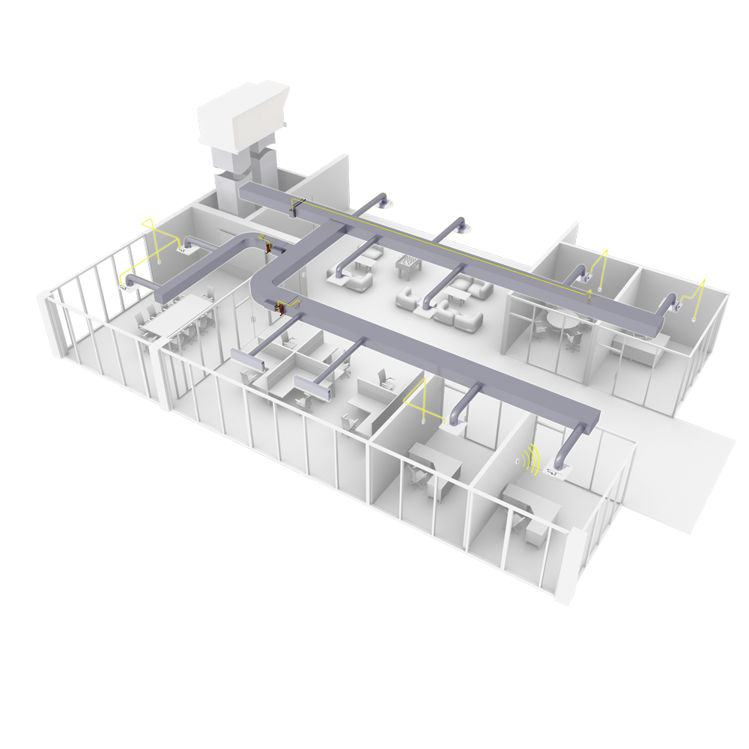
Acutherm Capabilities
Typical Zones
These examples demonstrate some
of the many products and options
available, and how Acutherm can
fit into each particular zone.
Large Meeting Room
Open Office with Perimeter
Small Office
Open Office
Small Meeting Room
4
1
5
2
3

Slide 5
Acutherm Capabilities
Comfort
Personal thermal comfort stems from appropriately sized zones of control. Creating many small zones provides exceptional levels of control, leading to outstanding occupant comfort.
Individual Thermostat Control
VAV diffusers are a cost-effective and practical way to provide this level of personalized control. Each VAV diffuser has an individual thermostat and built-in damper, allowing it to act as an individual VAV zone of control. The damper is continuously adjusted to vary the volume of airflow (warm or cold) into the room in response to room temperature and set point.

Slide 6
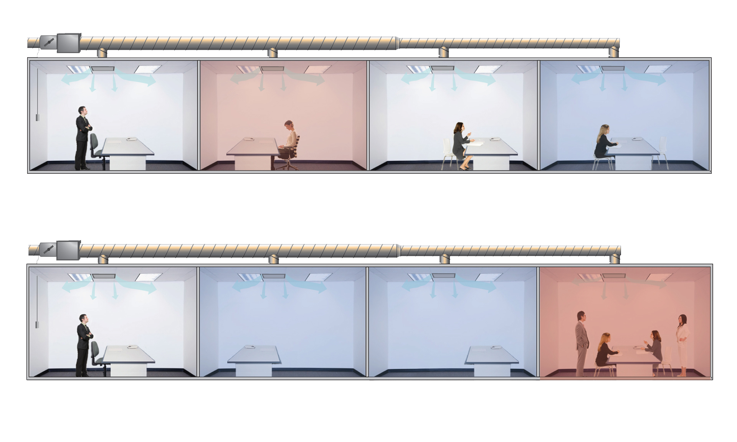
Acutherm Capabilities
Comfort
Traditional Box
Only those lucky enough to be next to a thermostat are happy
Energy is wasted and costs increase as unoccupied spaces are overcooled
The distant thermostat will not detect the increased load in this office, leaving occupants uncomfortable

Slide 7
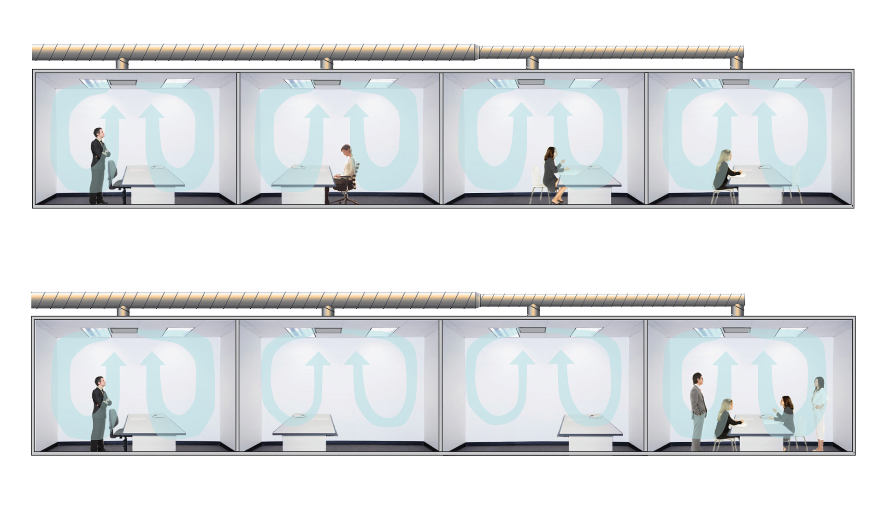
Acutherm Capabilities
Comfort
Acutherm by Price
Individual preferences are met, resulting in comfort for all occupants
As loads shift, the units automatically modulate the damper to properly supply each space
and ensure energy efficiency

Slide 8
Acutherm Capabilities
Comfort
Better Room Air Mixing
With an adjustable damper built right in, VAV diffusers are able to enhance occupant comfort by varying the discharge opening as they vary air volume. The result is an almost-constant discharge velocity, with the benefits of a better throw, no dumping, a higher level of room air movement and a uniform temperature distribution, even at low supply air volumes.
Room Mixing Comparison
On the following slides, computational fluid dynamics (CFD) analysis shows effective room air mixing with the VAV diffuser both at 100% open and at 25% open.

Slide 9
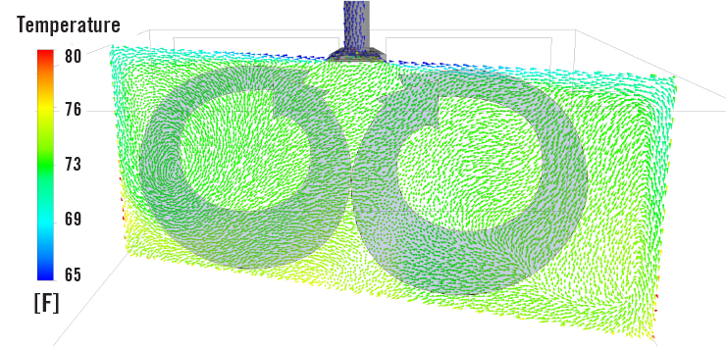
Acutherm Capabilities
Comfort
CFD analysis at 100% airflow
Comfort is maintained over full VAV range of operation from full flow through low flow turndown.

Slide 10
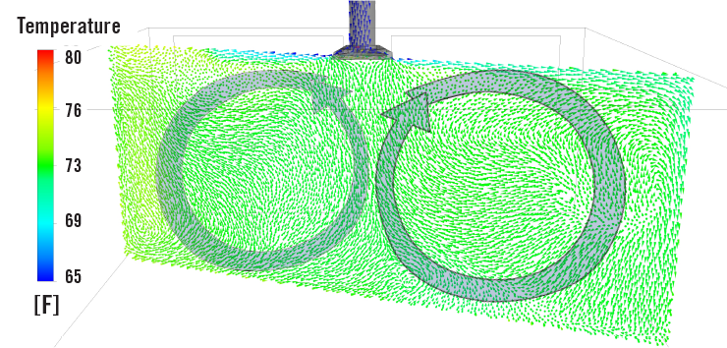
Acutherm Capabilities
Comfort
CFD analysis at 25% airflow
Comfort is maintained over full VAV range of operation from full flow through low flow turndown.

Slide 11
Acutherm Capabilities
Energy Savings
Savings from Three Sources
VAV diffusers allow for low-pressure, low-energy consumption systems. The energy savings of systems designed using VAV diffusers can be broken down into three main sources.
Small zones
Many small zones provide individual temperature control to prevent overcooling or overheating when spaces are unoccupied.
Low turndown and pressure drop
VAV diffuser systems do not have a velocity limitation because pressure independence is achieved by measuring only static pressure. The static pressure damper in a VAV diffuser system may be oversized to minimize pressure drop without the penalty of increasing minimum flow.
Low system pressure
VAV diffuser systems require low duct pressure, which reduces the required fan horsepower and, in turn, the energy required to operate the system.

Slide 12
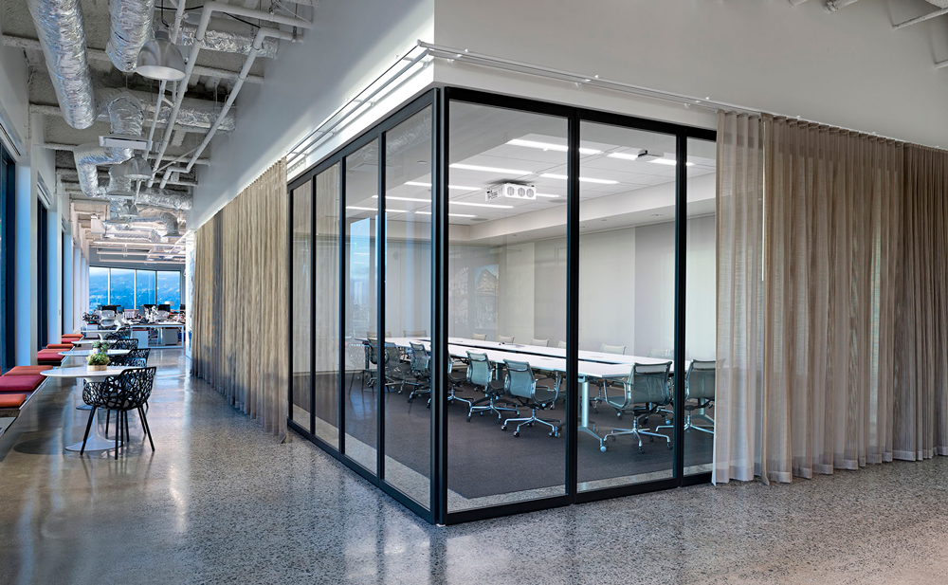
Acutherm Capabilities

Slide 13
Acutherm Capabilities
Sustainability
Enduring Ease-of-Use
Acutherm by Price VAV diffusers have a long life span and offer simple maintenance. Thermally powered units do not require any wiring and, aside from set point adjustment, are virtually maintenance free with 45+ years of proven operation. Motorized diffusers make use of long-life brushless motors to reduce maintenance requirements and provide near-silent operation.
Future-Proof Flexibility
VAV diffuser systems are exceptionally adaptable to office changes. The modular concept and flexibility provided by a VAV diffuser system means that any changes to the floor plan need not trigger expensive and disruptive changes to the HVAC system.

Slide 14
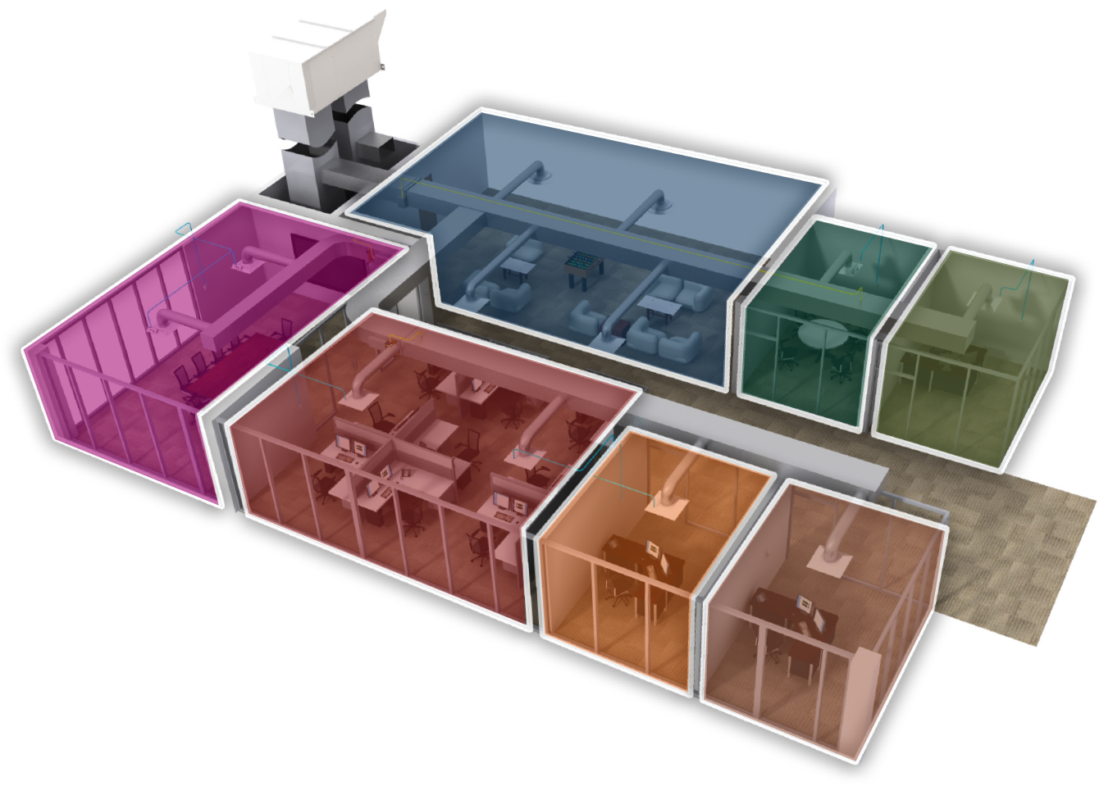
Acutherm Capabilities
Sustainability
Reconfiguration can occur without changes to the HVAC system
Original floorplan
with seven zones
of control

Slide 15
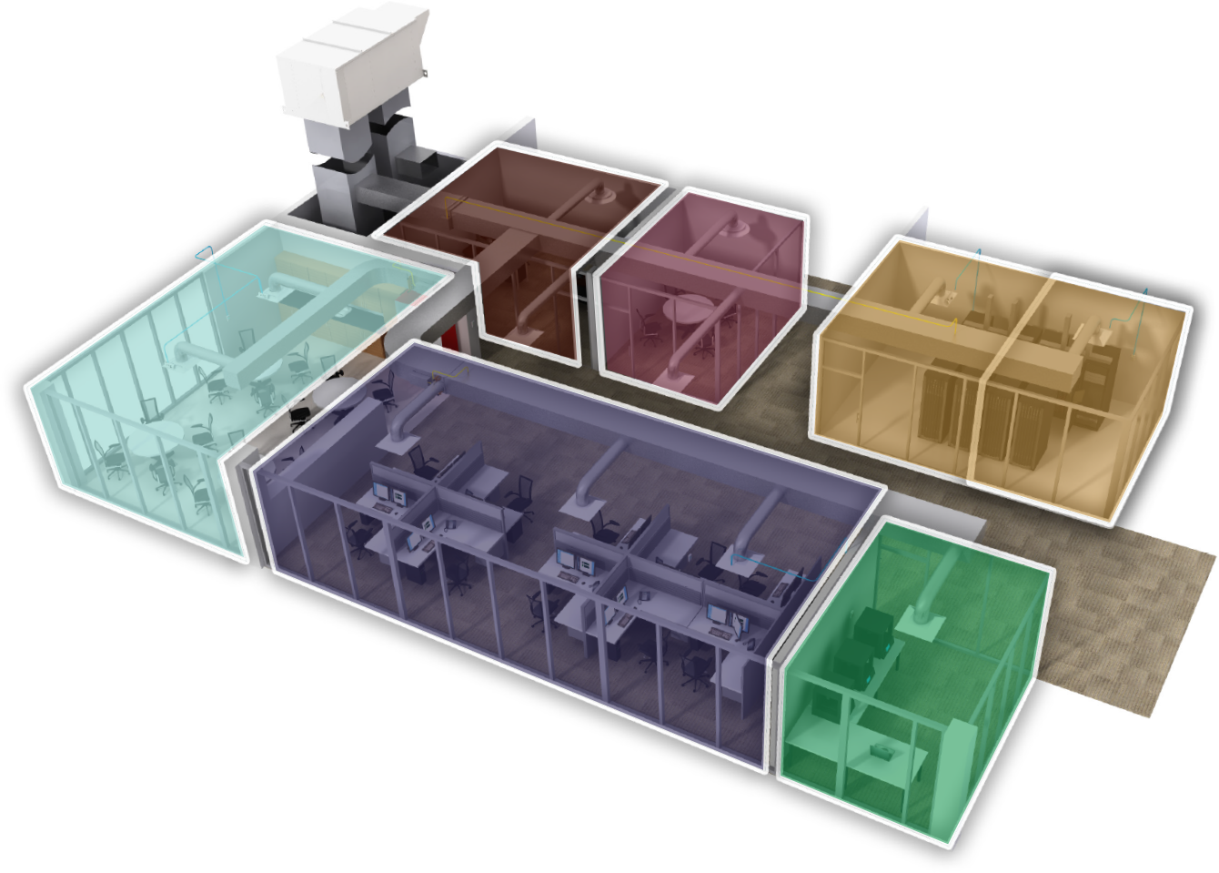
Acutherm Capabilities
Sustainability
Reconfiguration can occur without changes to the HVAC system
Modified floorplan
with seven zones
of control

Slide 16
High Performance Engineering

Slide 17
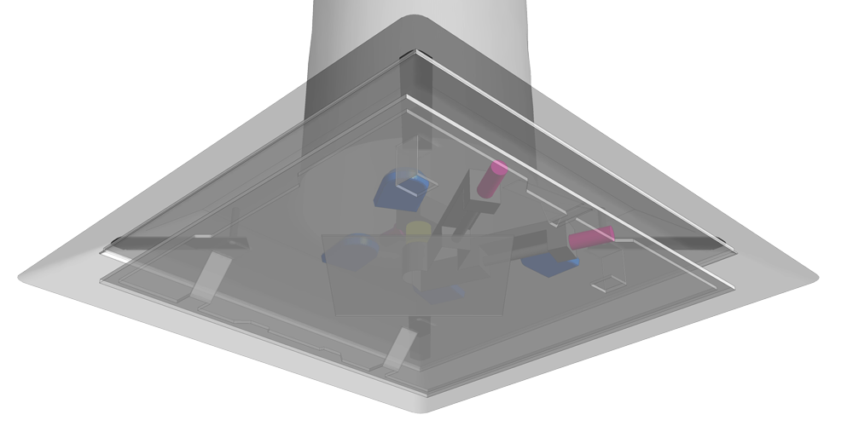
Acutherm Capabilities
High Performance Engineering
Each VAV diffuser is a ceiling diffuser with an integrated thermostat and damper, allowing it to act as an individual VAV zone of control. The damper is continuously adjusted to vary the volume of airflow (warm or cold) into the room in response to room temperature and setpoint. When supply air is warm, the VAV diffuser operates in heating mode and the damper opens in response to a drop in room temperature. When the supply air is cold, the VAV diffuser operates in cooling mode and the damper opens in response to a rise in room temperature.

Slide 18
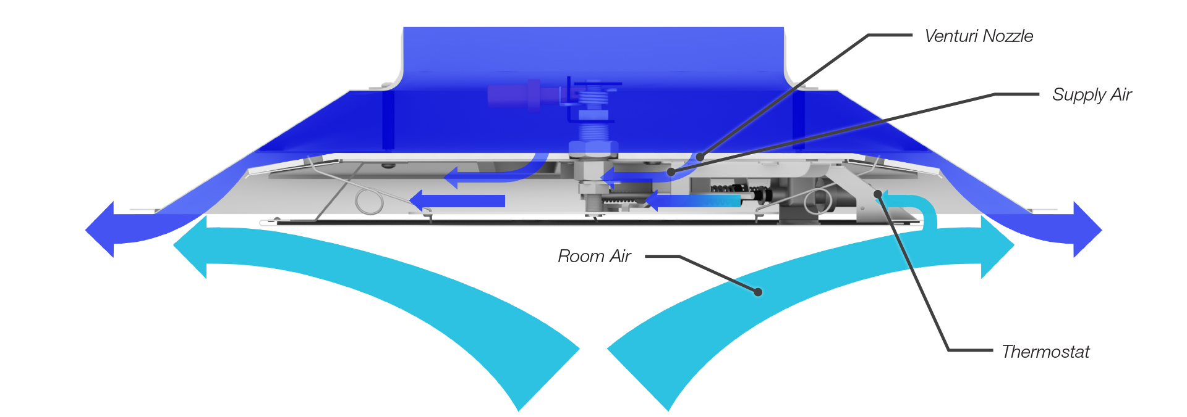
Acutherm Capabilities
High Performance Engineering
The high velocity discharge from the diffuser entrains room air into the supply air resulting in a rising column of room air under the diffuser. A small amount of supply air passed through a venturi nozzle creates an area of low pressure in the diffuser that induces a sample of room air over the thermostat. Room air is positively induced over the thermostat independent of diffuser damper position.

Slide 19
Acutherm Capabilities
High Performance Engineering
As with all diffusers, air circulates around the room in a circular motion. Secondary air rises under the diffuser, passes beneath the diffuser plaque and entrains with the primary air at the outside edge of the diffuser. This secondary air best represents average room temperature.
To monitor average room temperature, a continuous sample of secondary air is drawn around the plaque past the room thermostat(s). This is accomplished by feeding primary air through venturi nozzle(s). Primary air blowing through the nozzle(s) creates just enough vacuum to draw some secondary air around the plaque, over the thermostat(s) and out the other side.

Slide 20
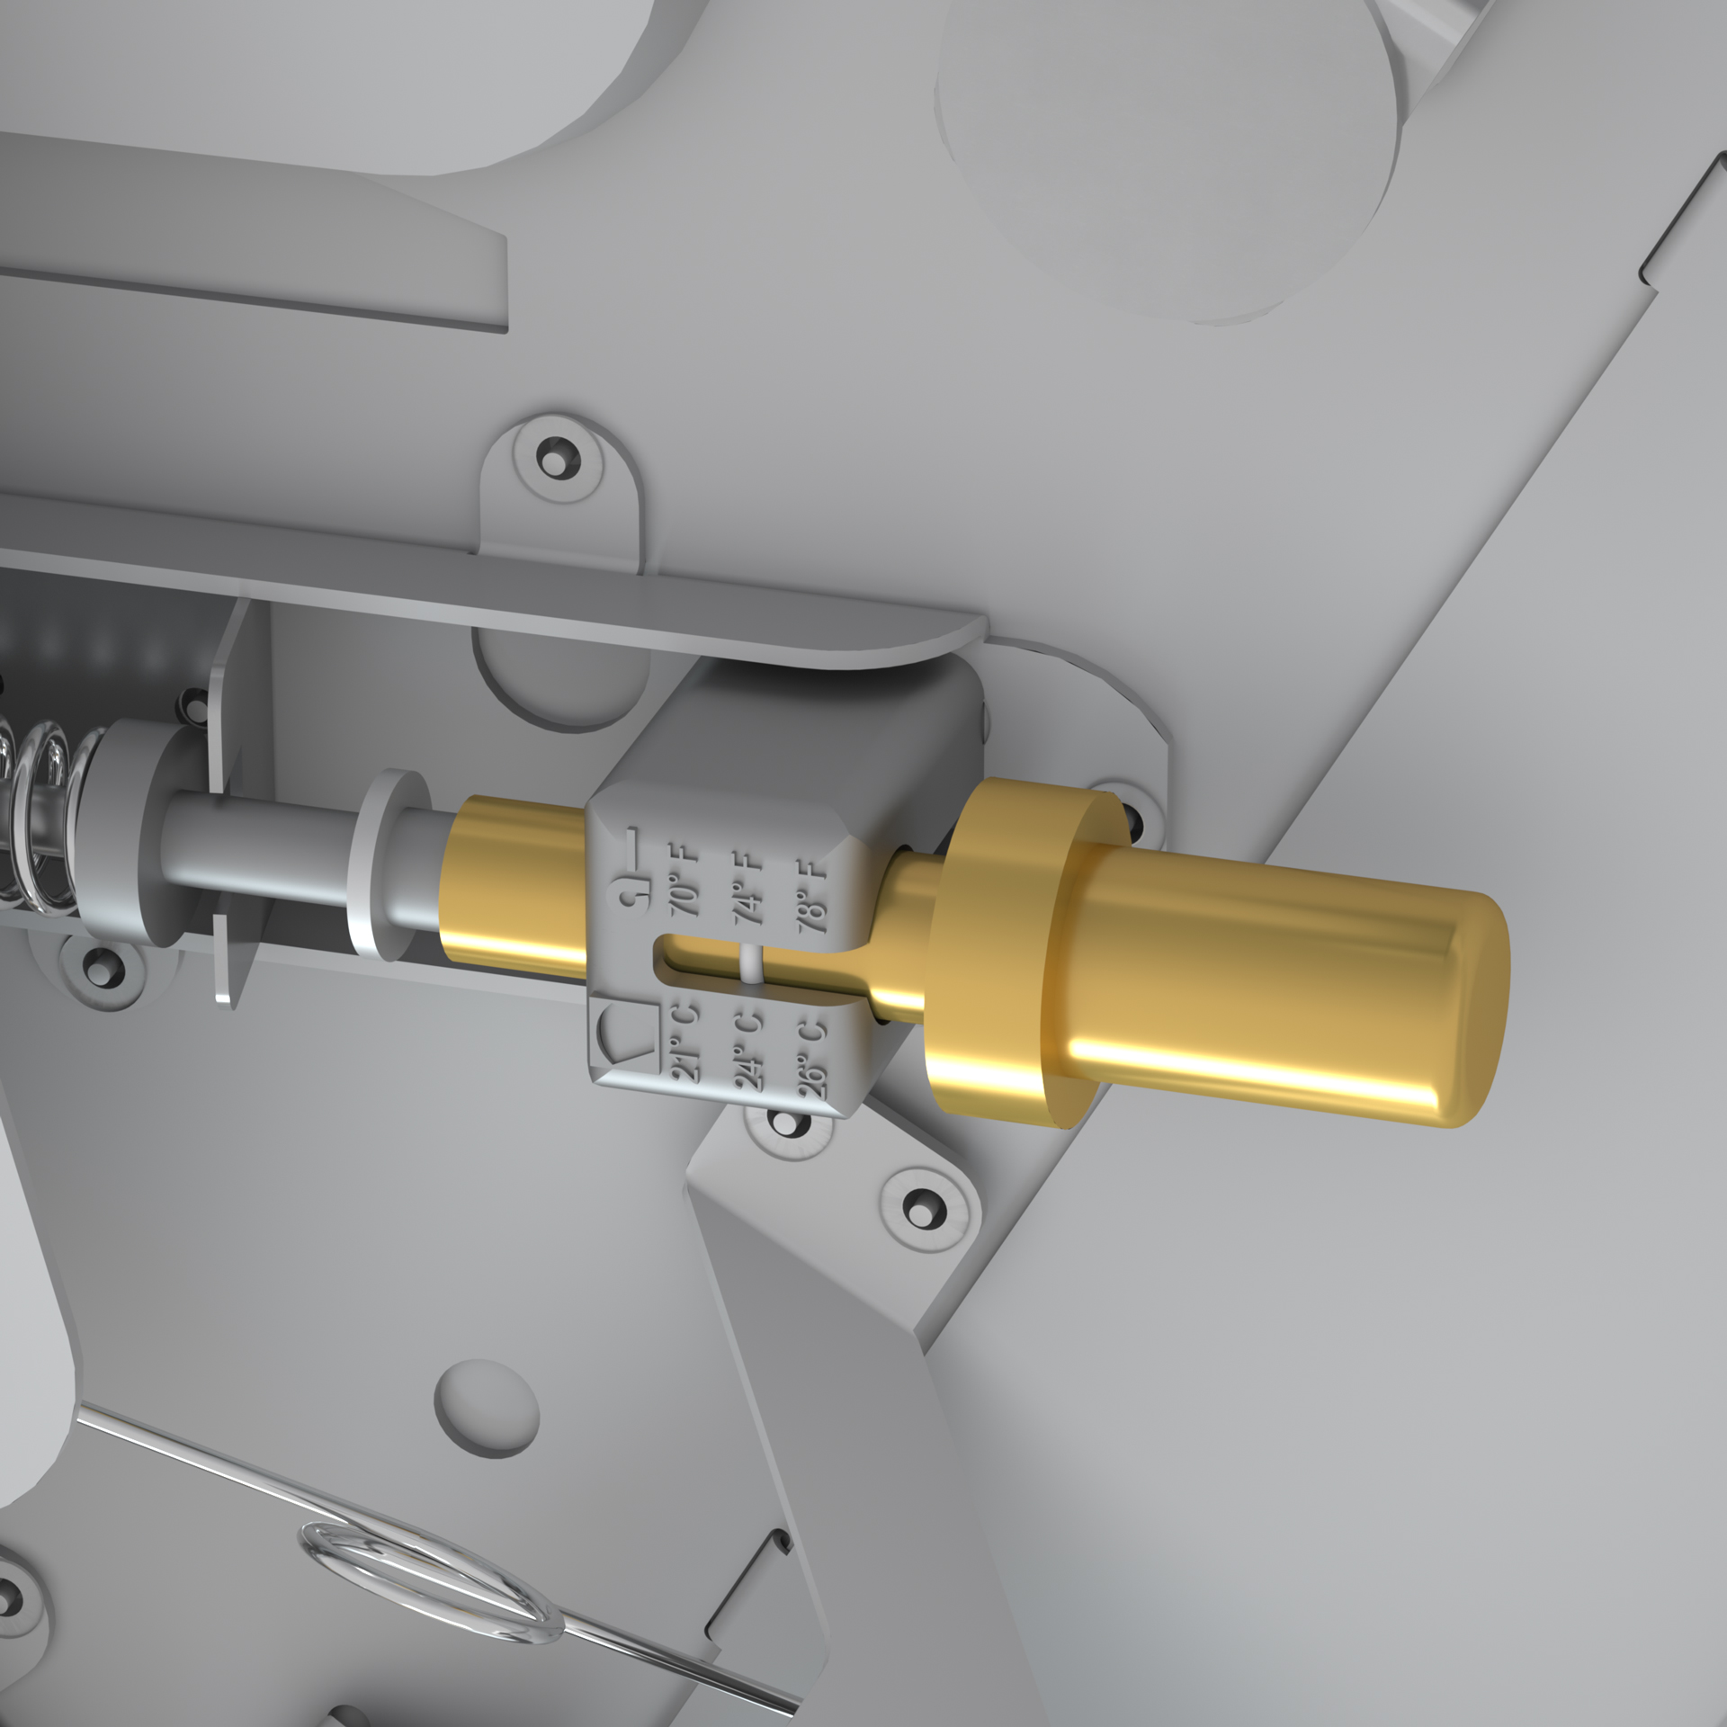
Acutherm Capabilities
High Performance Engineering
Thermostat and actuator - contains a blend of petroleum distillate waxes; the waxes melt and expand, driving a piston with a precise movement per degree temperature change.

Slide 21
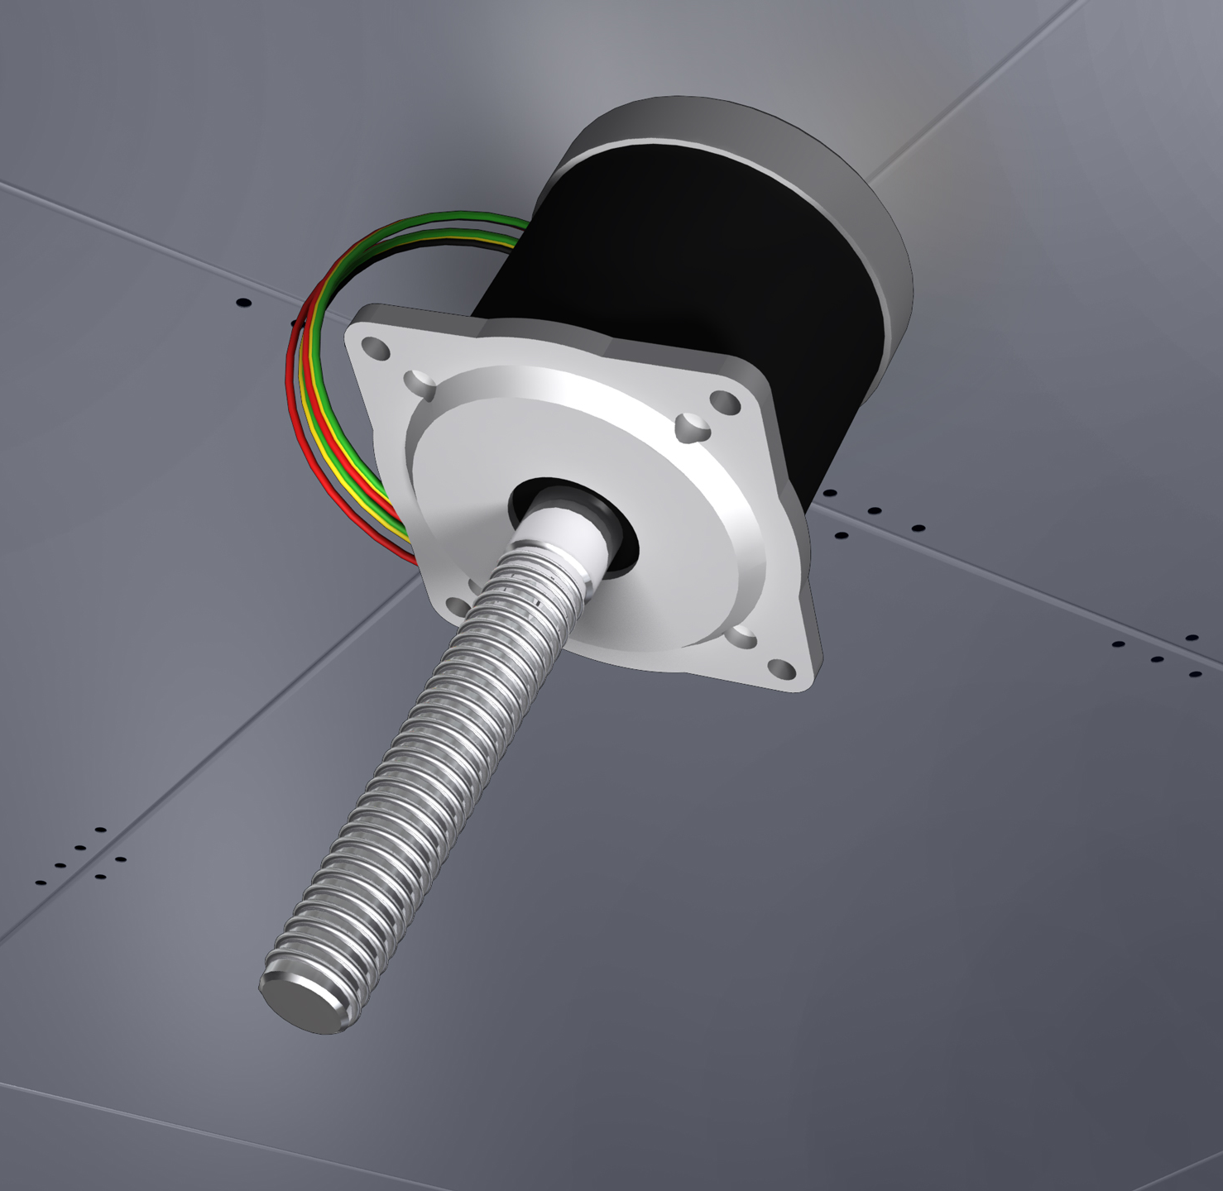
Acutherm Capabilities
High Performance Engineering
For electric diffusers, quiet, long-life, brushless motors provide repeatable and reliable control.

Slide 22
VAV Diffuser System Options

Slide 23
Acutherm Capabilities
VAV Diffuser System Options
As energy costs continue to rise, managing energy while balancing tenant comfort and operational costs is a significant challenge for commercial building owners and managers. A building automation system (BAS) is an option that provides monitoring of entire building systems with single-source control and troubleshooting.
Acutherm by Price’s VAV diffuser system is designed to work cooperatively with a wide range of BAS options. Whether you're looking for simple individual temperature control with no energy required for operation or full-scale networking for system scheduling, monitoring, reporting, troubleshooting and more, this guide will help you determine what is best for your building needs and budget.

Slide 24
Acutherm Capabilities
VAV Diffuser System Options
Mechanical Thermal VAV Diffusers
Therma-Fuser
Series
Our thermally actuated VAV diffusers are simple to install, require no maintenance, come with a 10-year warranty and offer the lowest cost per zone of control.
Digital Electric VAV Diffusers
Interoperable
Series
Advantage
Series
Our digital electric VAV diffusers use a controller and electric motor, allowing for an increased range of set points, and are available for both stand-alone and BACnet networking applications.

Slide 25
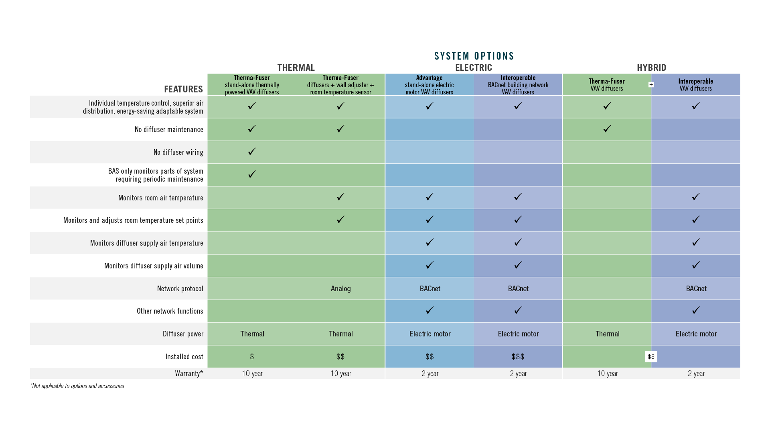
Acutherm Capabilities
VAV Diffuser System Options

Slide 26
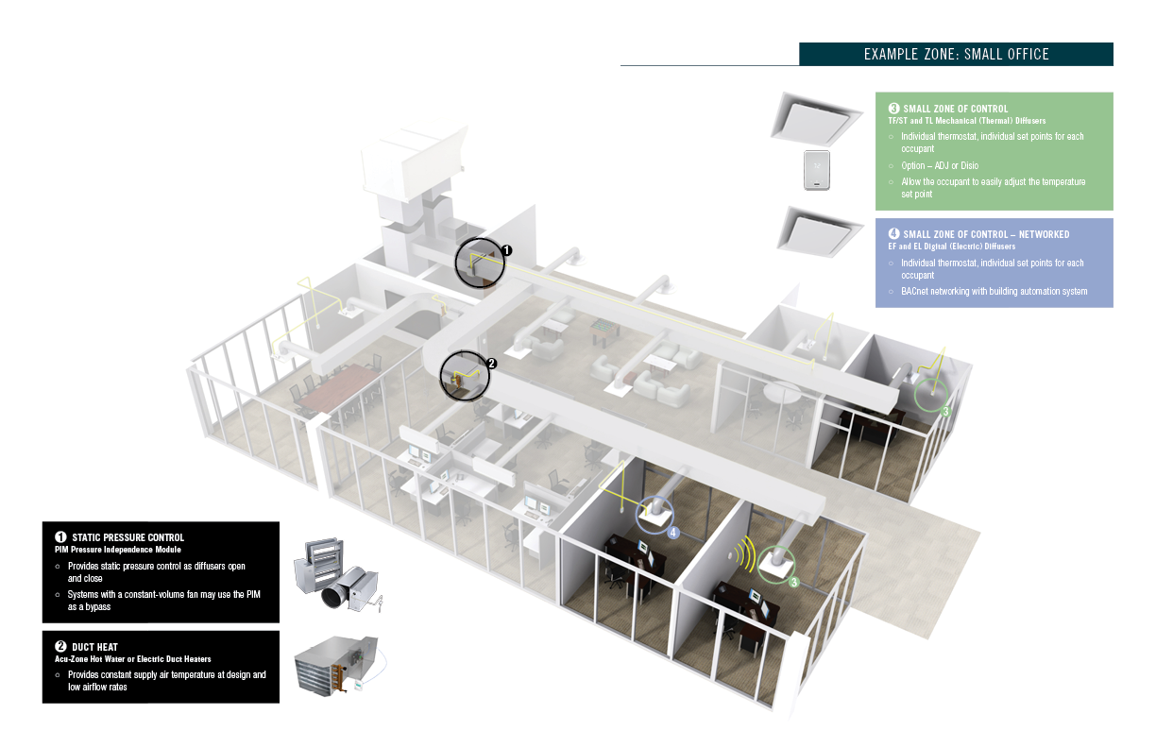
Acutherm Capabilities
Typical Zones & VAV Diffuser System Options

Slide 27
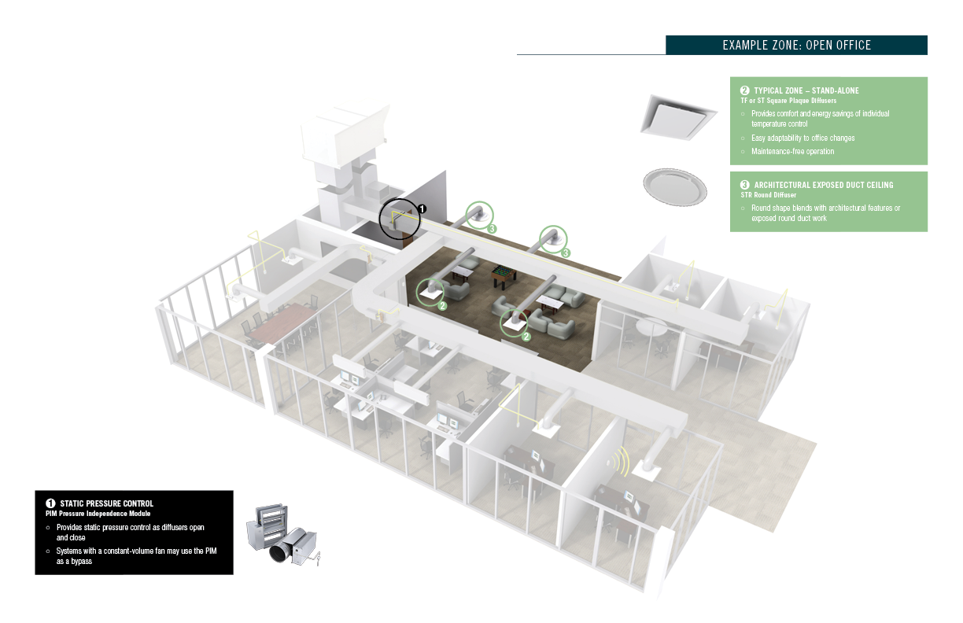
Acutherm Capabilities
Typical Zones & VAV Diffuser System Options

Slide 28
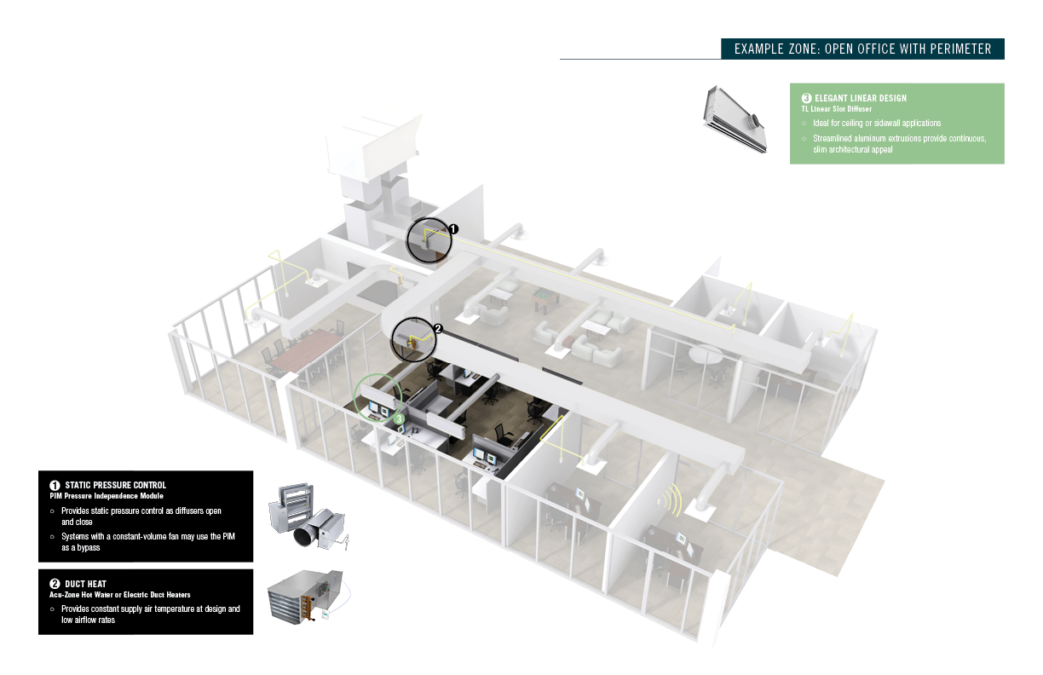
Acutherm Capabilities
Typical Zones & VAV Diffuser System Options

Slide 29
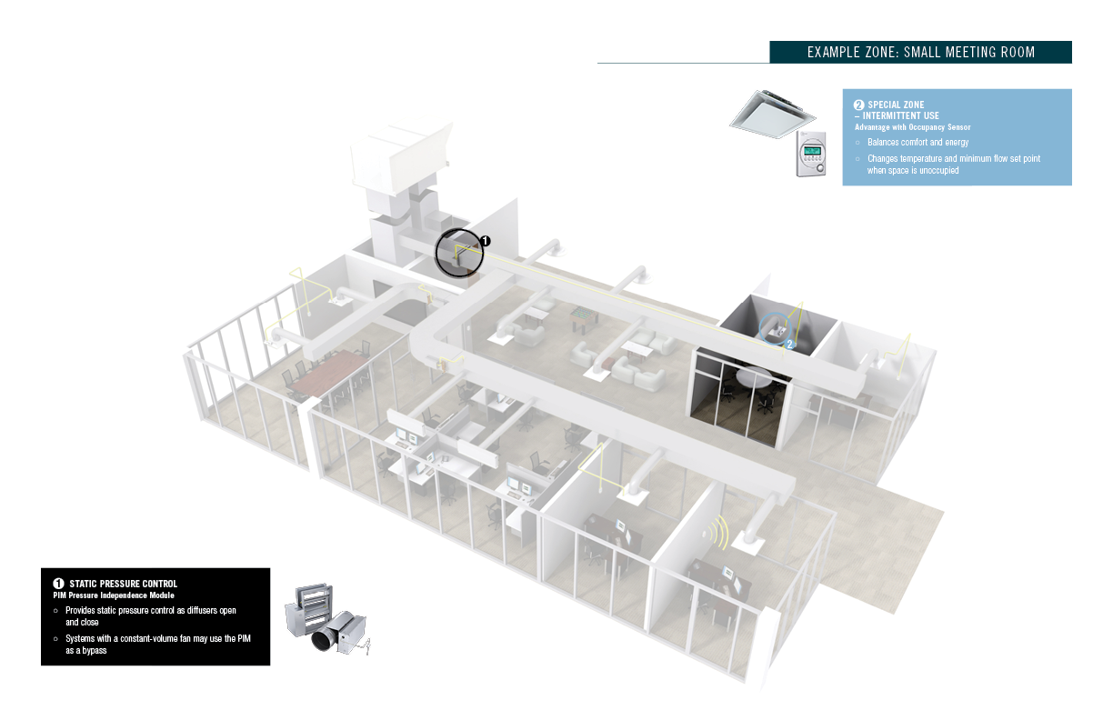
Acutherm Capabilities
Typical Zones & VAV Diffuser System Options

Slide 30
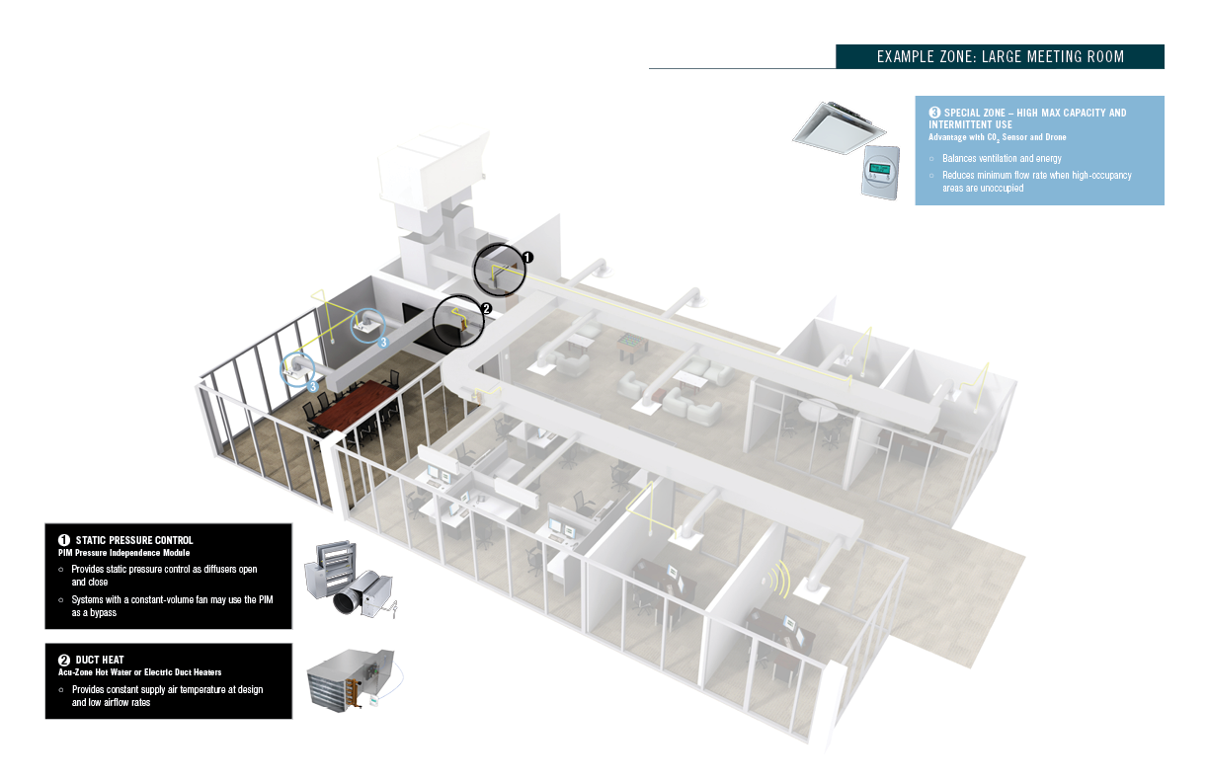
Acutherm Capabilities
Typical Zones & VAV Diffuser System Options

Slide 31
VAV Diffuser Products

Slide 32
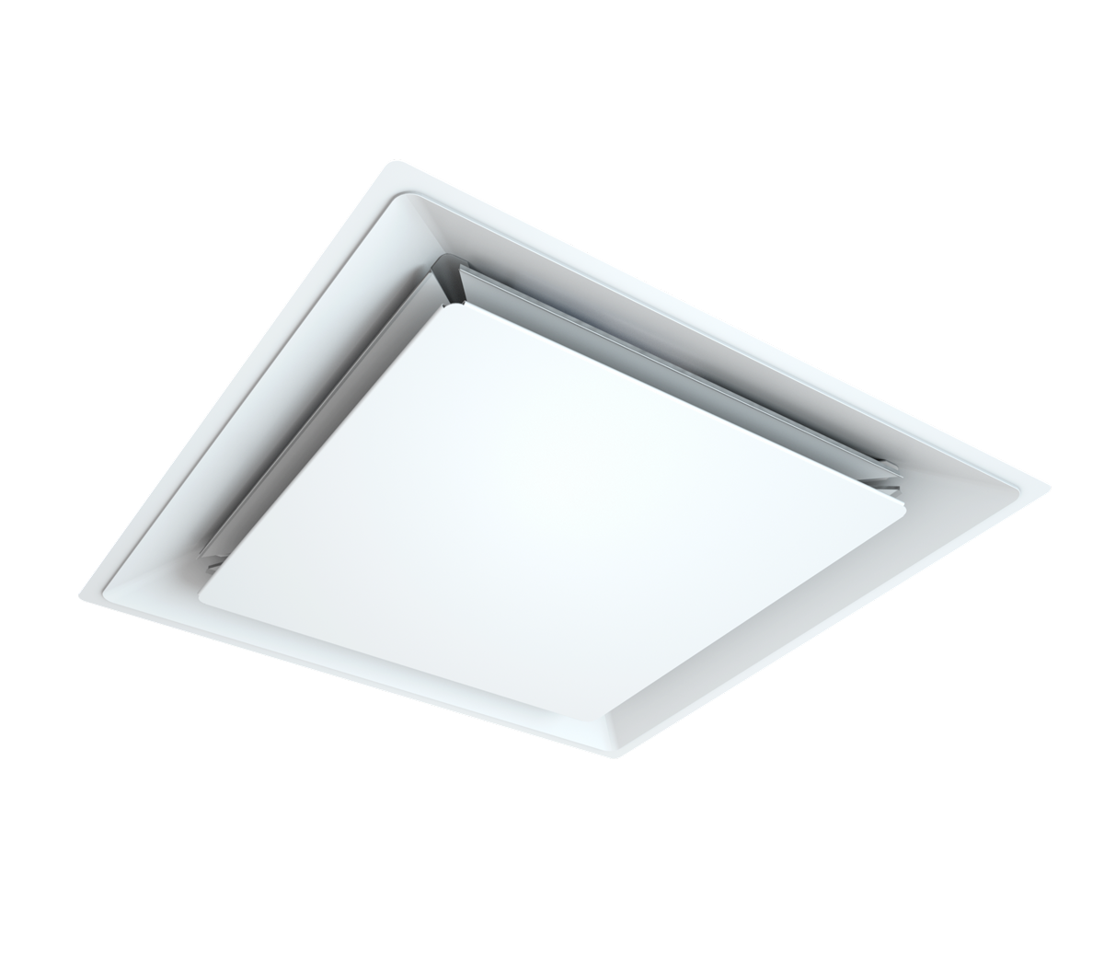
Acutherm Capabilities
VAV Diffuser Products
2 x 2 ft. Square Diffuser with Blade Damper
(24 in. / 600 mm square)
  Therma-Fuser™ Series – TF
  Interoperable Series - EF
    Four blade dampers provide superior throw with 66 linear inches of variable discharge area.
¹Throw for ∆ 20ºF / 11ºC at vt= 50 / 100 / 150 FPM / 0.25 / 0.50 / 0.75 m/s
²Noise based on Lw(10⁻¹² watts reference)-10db
Inlet diameter | 6 / 8 / 10 / 12 in. | 150 / 200 / 250 / 300 mm
Pressure ranges | 0.05 to 0.25 in. wg | 12 to 62 Pa
Air volumes | 100 to 720 CFM | 45 to 340 l/s
Throw¹ | 6 / 4 / 3 to 17 / 14 / 12 ft. | 0.6 / 0.3 / < 0.3 to 3.6 / 2.1 / 1.8 m
Noise² | < 15 to 34 NC | <15 to 34 NC

Slide 33
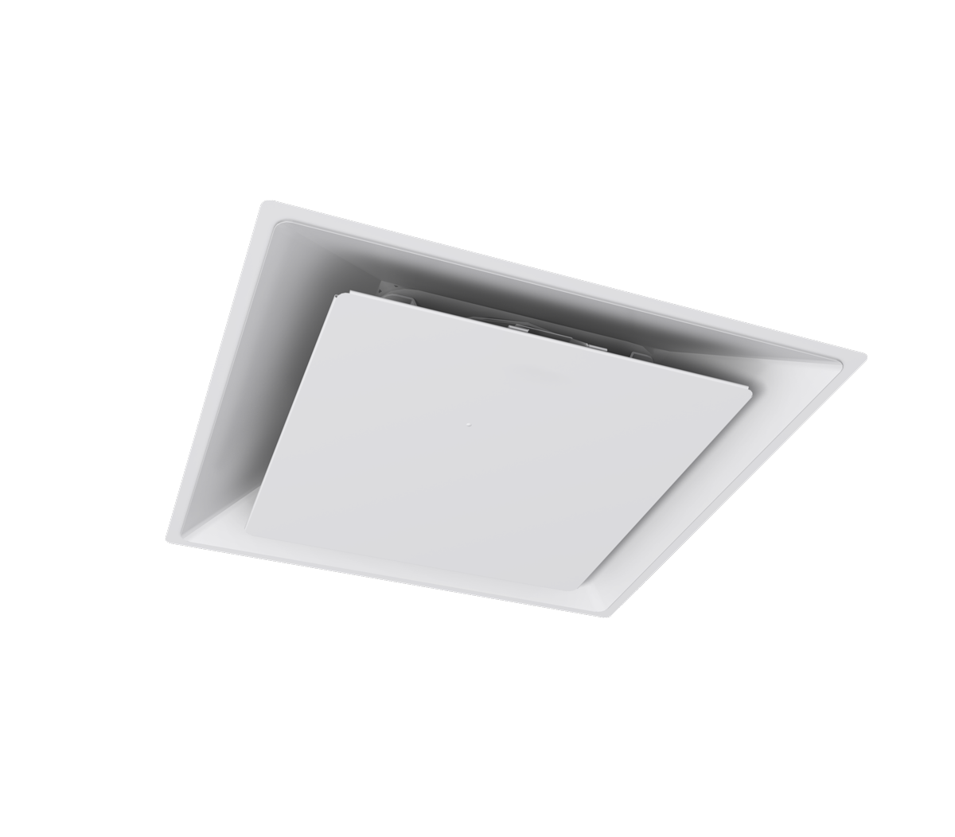
Acutherm Capabilities
VAV Diffuser Products
2 x 2 ft. Square Diffuser with Disc Damper
(24 in. / 600 mm square)
  Therma-Fuser™ Series - ST
    Easy adjustment minimum flow dial. One stop lever for balancing.
¹Throw for ∆ 20ºF / 11ºC at vt= 50 / 100 / 150 FPM / 0.25 / 0.50 / 0.75 m/s
²Noise based on Lw(10⁻¹² watts reference)-10db
Inlet diameter | 6 / 8 / 10 / 12 in. | 150 / 200 / 250 / 300 mm
Pressure ranges | 0.05 to 0.25 in. wg | 12 to 62 Pa
Air volumes | 100 to 720 CFM | 45 to 340 l/s
Throw¹ | 6 / 4 / 3 to 17 / 14 / 12 ft. | 0.6 / 0.3 / < 0.3 to 3.6 / 2.1 / 1.8 m
Noise² | < 15 to 34 NC | <15 to 34 NC

Slide 34
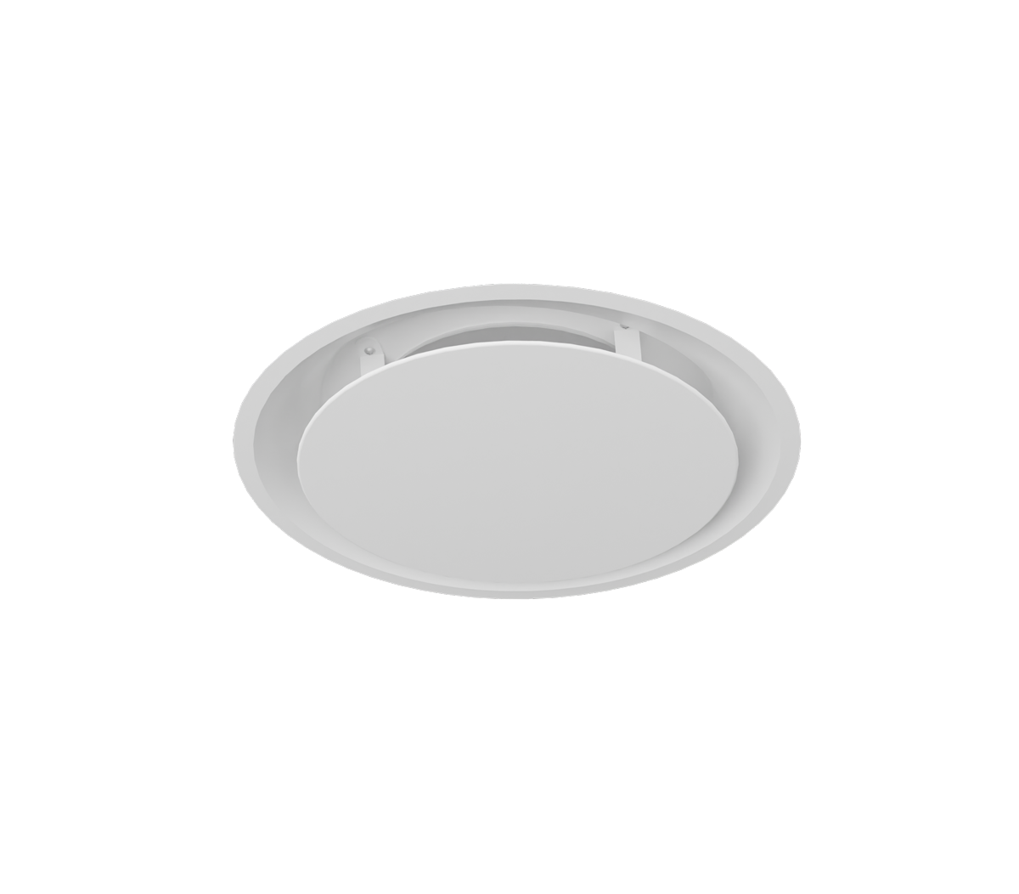
Acutherm Capabilities
VAV Diffuser Products
2 ft. Round Diffuser with Disc Damper (24 in. / 600 mm square)
  Therma-Fuser™ Series - STR
    With all the performance and air distribution of the ST, the round model has been developed for aesthetic consideration.
¹Throw for ∆ 20ºF / 11ºC at vt= 50 / 100 / 150 FPM / 0.25 / 0.50 / 0.75 m/s
²Noise based on Lw(10⁻¹² watts reference)-10db
Inlet diameter | 6 / 8 / 10 / 12 in. | 150 / 200 / 250 / 300 mm
Pressure ranges | 0.05 to 0.25 in. wg | 12 to 62 Pa
Air volumes | 105 to 740 CFM | 50 to 350 l/s
Throw¹ | 3 / 1 / < 1 to 13 / 11 / 9 ft. | 0.9 / 0.3 < 0.3 to 4.0 / 3.4 / 2.7 m
Noise² | < 15 to 38 NC | <15 to 38 NC

Slide 35
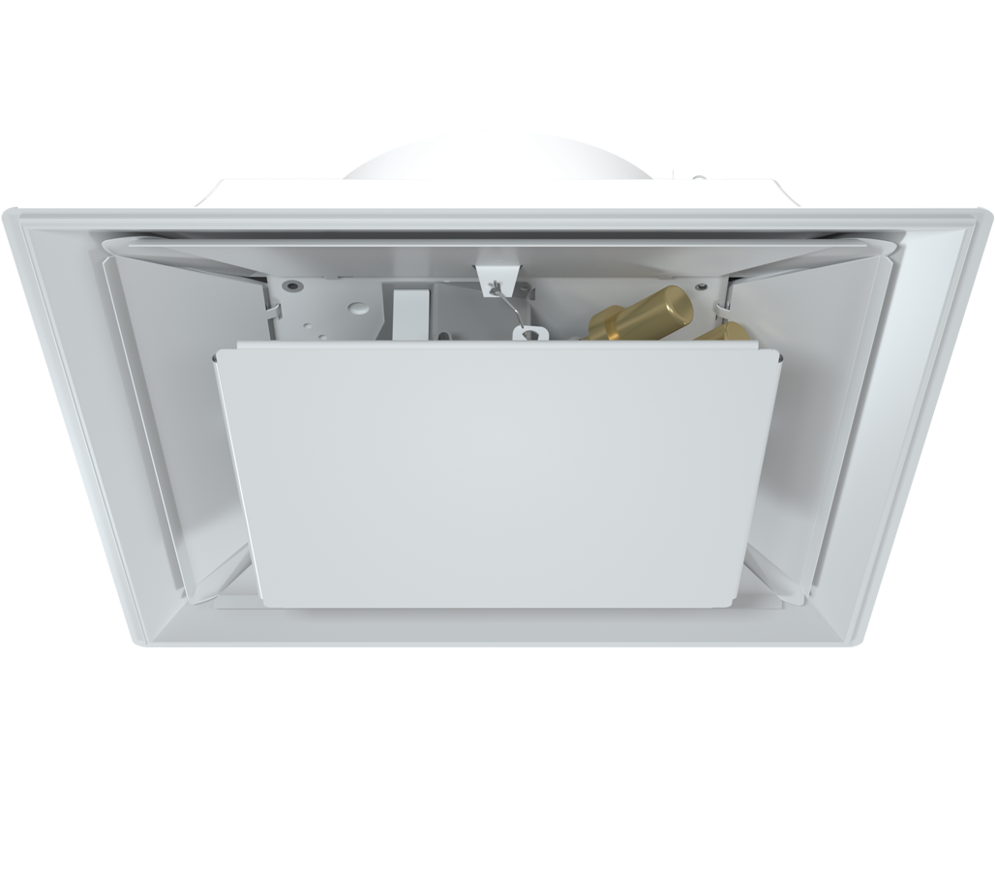
Acutherm Capabilities
VAV Diffuser Products
1 x 1 ft. Square Diffuser with Blade Damper
  Therma-Fuser™ Series – TK
    Specially designed for small task conditioning. Four-blade damper provides superior throw.
¹Throw for ∆ 20ºF / 11ºC at vt= 50 / 100 / 150 FPM / 0.25 / 0.50 / 0.75 m/s
²Noise based on Lw(10⁻¹² watts reference)-10db
Inlet diameter | 6 in. | 150 mm
Pressure ranges | 0.05 to 0.25 in. wg | 12 to 62 Pa
Air volumes | 115 to 265 CFM | 55 to 125 l/s
Throw¹ | 8 / 6 / 4 to 13 / 10 / 8 ft. | 2.5 / 1.7 / 1.2 to 4.0 / 3.0 / 2.5 m
Noise² | < 15 to 37 NC | <15 to 37 NC

Slide 36
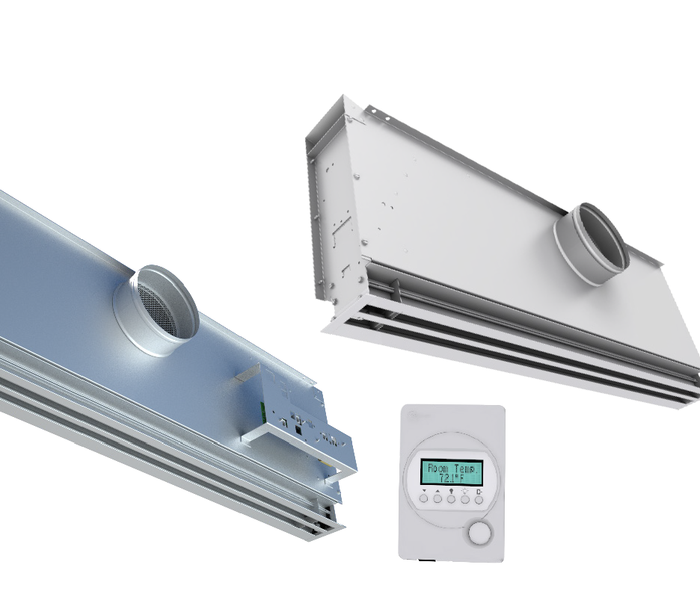
Acutherm Capabilities
VAV Diffuser Products
Linear Sidewall Diffuser and Continuous Linear Sidewall Diffuser
  Therma-Fuser™ Series – TLW & TLWC
  Interoperable Series – ELW & ELWC
    Designed for installation just below the ceiling in a narrow soffit which is an excellent solution when there is little or no space above the ceiling. Elegant sidewall linear design for individual units or continuous linear slots.
¹Throw for ∆ 20ºF / 11ºC at vt= 50 / 100 / 150 FPM / 0.25 / 0.50 / 0.75 m/s
²Noise based on Lw(10⁻¹² watts reference)-10db
Length | 24 / 36 / 48 / 60 in. | 600 / 900 / 1200 / 1500 mm
Slots | Multiple slots and blow patterns available
Pressure ranges | 0.05 to 0.25 in. wg | 12 to 62 Pa
Air volumes | 45 to 960 CFM | 20 to 455 l/s
Throw¹ | 4 / 3 / 2 to 40 / 33 / 25 ft. | 1.2 / 0.9 / 0.6 to 12.2 / 10.0 / 7.6 m
Noise² | < 15 to 42 NC | <15 to 42 NC

Slide 37
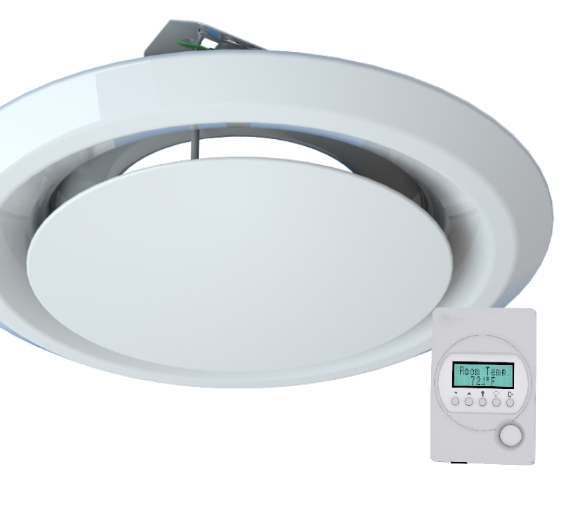
Acutherm Capabilities
VAV Diffuser Products
2 ft. Round Diffuser with Disc Damper
(24 in. / 600 mm round)
  Advantage Series – ADVR
    The pleasing round shape blends in with round architectural features or exposed round duct work.
¹Throw for ∆ 20ºF / 11ºC at vt= 50 / 100 / 150 FPM / 0.25 / 0.50 / 0.75 m/s
²Noise based on Lw(10⁻¹² watts reference)-10db
Inlet diameter | 6 / 8 / 10 / 12 in. | 150 / 200 / 250 / 300 mm
Pressure ranges | 0.05 to 0.25 in. wg | 12 to 62 Pa
Air volumes | 120 to 720 CFM | 59 to 340 l/s
Throw¹ | 3 / 4 / 7 to 10 / 12 / 17 ft. | 0.9 / 1 / 1.2 / 2 to 3.0 / 3.7 / 5.2 m
Noise² | < 15 to 42 NC | <15 to 42 NC

Slide 38
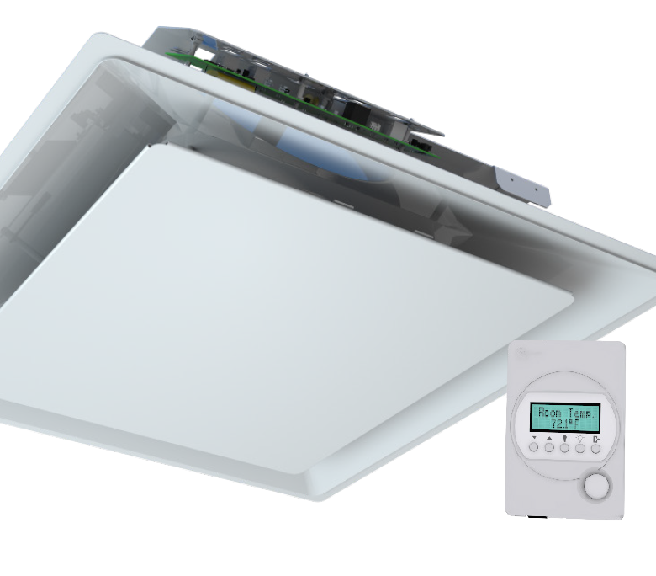
Acutherm Capabilities
VAV Diffuser Products
2 x 2 ft. Square Diffuser with Cone Damper (24 in. / 600 mm square)
  Advantage Series - ADV
    Designed to provide a greater range of operation and increased speed of response required by some projects.
¹Throw for ∆ 20ºF / 11ºC at vt= 50 / 100 / 150 FPM / 0.25 / 0.50 / 0.75 m/s
²Noise based on Lw(10⁻¹² watts reference)-10db
Inlet diameter | 6 / 8 / 10 / 12 / 14 in. | 150 / 200 / 250 / 300 / 350 mm
Pressure ranges | 0.05 to 0.25 in. wg | 12 to 62 Pa
Air volumes | 80 to 734 CFM | 37 to 346 l/s
Throw¹ | 2 / 1 / < 1 to 10 / 7 / 6 ft. | 0.6 / 0.3 < 0.3 to 3.6 / 2.1 / 1.8 m
Noise² | < 15 to 43 NC | <15 to 43 NC

Slide 39
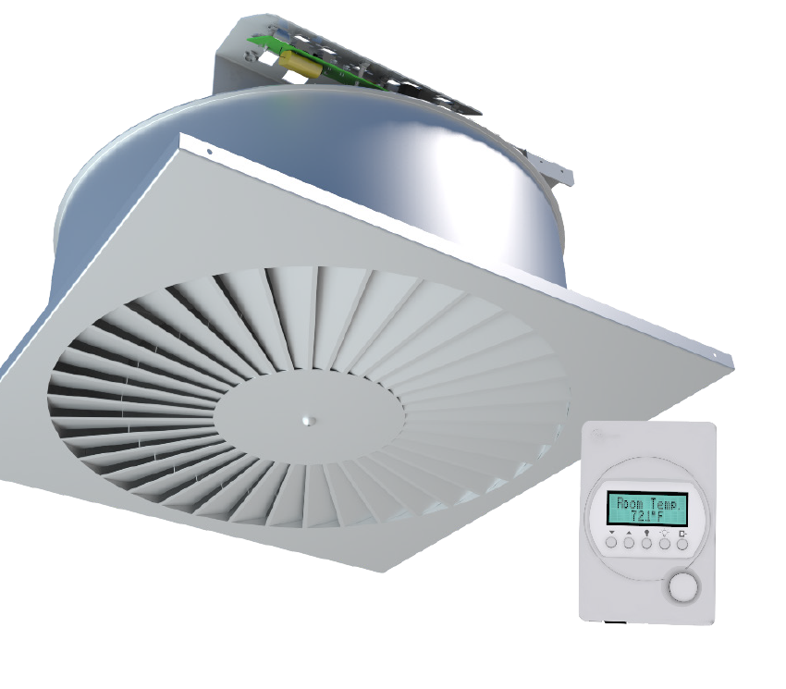
Acutherm Capabilities
VAV Diffuser Products
2 x 2 ft. Swirl Face Diffuser with Disc Damper
(24 in. / 600 mm square)
  Advantage Series – ADVS
    The swirl face provides a modern, aesthetically pleasing appearance combining a high-induction geometry with a VAV damper.
  ¹Throw for ∆ 20ºF / 11ºC at vt= 50 / 100 / 150 FPM / 0.25 / 0.50 / 0.75 m/s
  ²Noise based on Lw(10⁻¹² watts reference)-10db
Inlet diameter | 6 / 8 / 10 / 12 in. | 150 / 200 / 250 / 300 mm
Pressure ranges | 0.05 to 0.25 in. wg | 12 to 62 Pa
Air volumes | 130 to 525 CFM | 61 to 248 l/s
Throw¹ | 1 / 2 / 4 to 5 / 8 / 12 ft. | 0.3 / 0.6 / 1.2 to 1.5 / 2.4 / 3.7 m
Noise² | < 15 to 41 NC | <15 to 41 NC

Slide 40
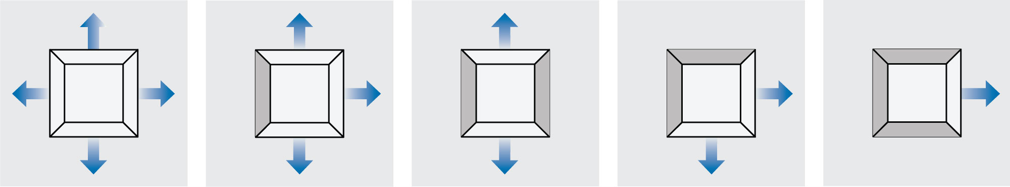
Acutherm Capabilities
VAV Diffuser Blow Patterns
Custom air blow patterns are available for most models.
Square Therma-Fuser Diffuser
4-Way Blow
3W 3-Way Blow
2W 2-Way Blow Opposite
2C 2-Way Blow Corner
1W 1-Way Blow

Slide 41
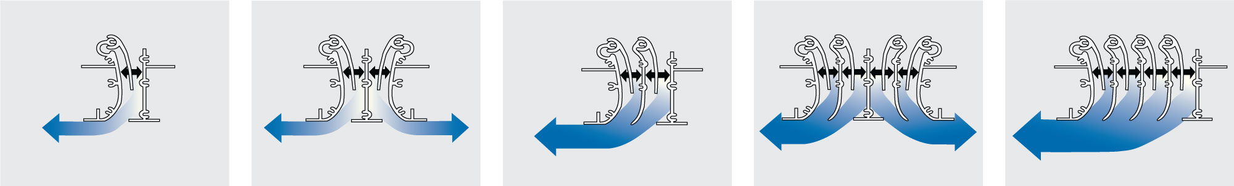
Acutherm Capabilities
VAV Diffuser Blow Patterns
Custom air blow patterns are available for most models.
Linear Therma-Fuser Diffuser
1-Slot 1-Way
2-Slot 2-Way
2-Slot 1-Way
4-Slot 2-Way
4-Slot 1-Way

Slide 42
Options & Accessories

Slide 43
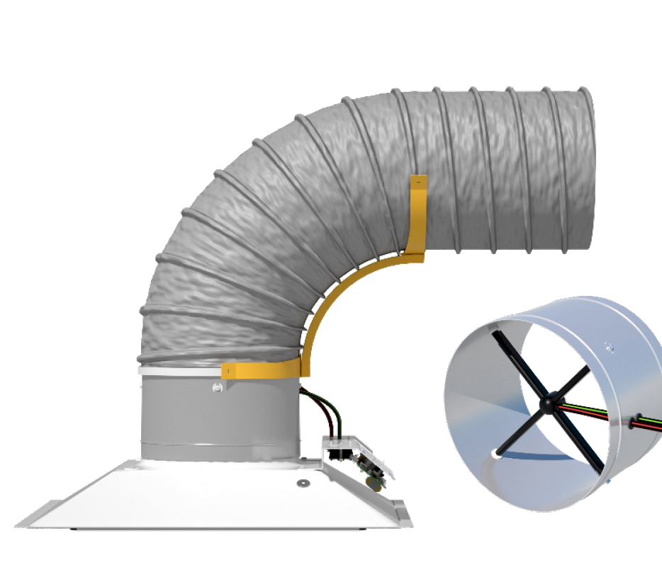
Acutherm Capabilities
Options & Accessories
DMSA Airflow Measurement for
Advantage Series Diffusers
    The Diffuser Measuring Station (DMSA) is an optional addition to the Advantage VAV diffuser providing airflow measurement at each Advantage master diffuser.

Slide 44
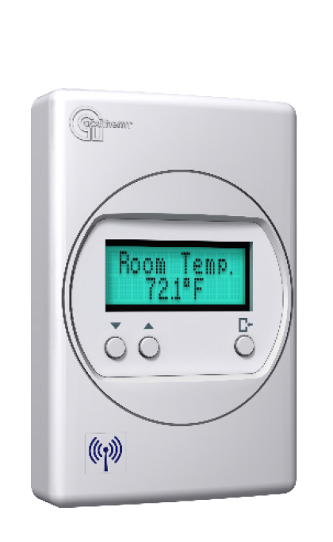
Acutherm Capabilities
Options & Accessories
Wall Adjusters and Thermostats
  Therma-Fuser™ Series – ADJ-D & ADJ-W
  Advantage Series - TSTAT*
  Interoperable Series – ADJ-B
    Acutherm’s wall adjusters for Therma-Fuser Series diffusers allow the occupant to easily adjust the temperature setpoint. The Wall Adjuster is available in a wired or wireless model. Wall Adjusters are easily integrated to BAS with a protocol independent interface.
    Acutherm’s thermostats for Advantage and Interoperable Series diffusers provide both room temperature and occupant adjustable room temperature setpoint.
*There are several options for the Advantage including LCD display, occupancy and CO₂ sensors.

Slide 45
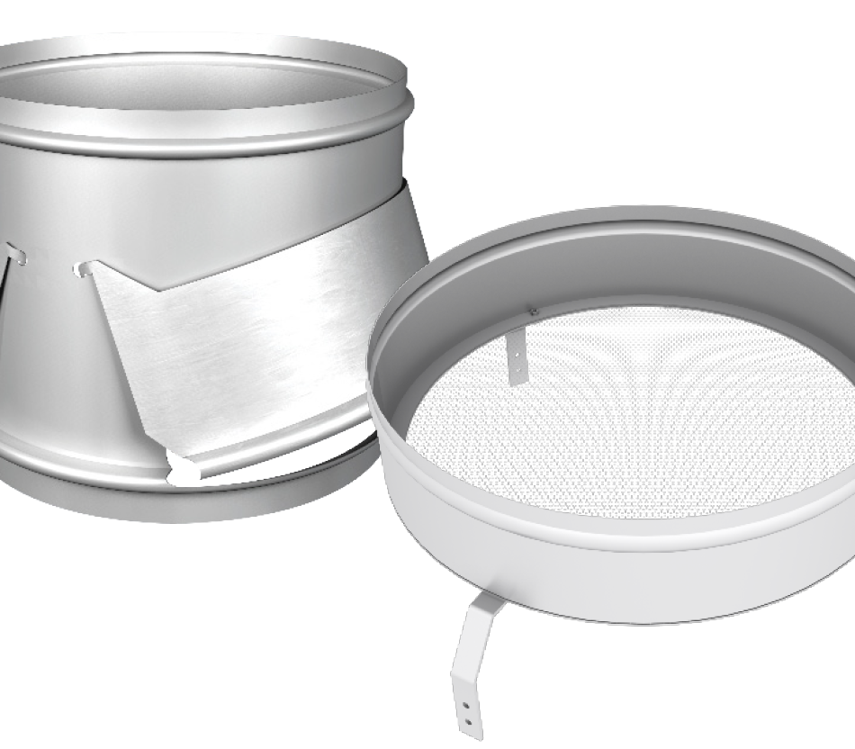
Acutherm Capabilities
Options & Accessories
Acutherm Pressure Relief Collar
and Relief Ring
  Therma-Fuser™ Series
  Advantage Series
  Interoperable Series
    The Acutherm Pressure Relief Collar and Relief Ring are both inexpensive solutions when duct pressures are higher than desired. When the diffuser reduces the air flow into the room these devices bypass the excess air into the plenum return system. Relief Rings are smaller but limited to 6, 8 and 10 in. inlets. Pressure Relief Collars are available up to 14 in. inlets.
 | Inlet sizes | Height
Relief ring | 6 / 8 / 10 in. 150 / 200 / 250 mm | 3 ¼ in. 121 mm
Pressure relief collar | 6 / 8 / 10 / 12 / 14 in. 150 / 200 / 250 / 300 / 350 mm | 8 in. 203 mm

Slide 46
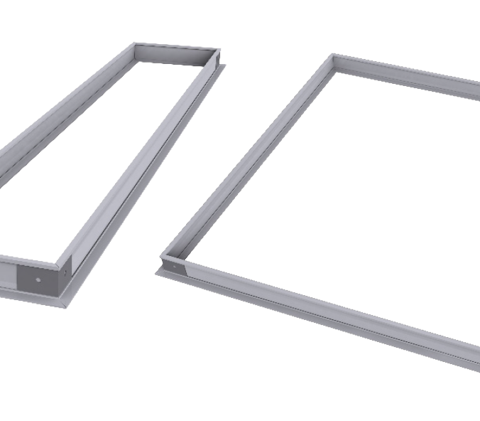
Acutherm Capabilities
Options & Accessories
Ceiling Approaches
  Therma-Fuser™ Series
  Advantage Series
  Interoperable Series
    Acutherm offers a variety of ceiling frames to suit most ceiling types. Diffusers installed in special ceilings should be done such that obstacles are not below the plane of the diffuser casing extended. Breaking this plane risks breaking Coanda and could allow primary air to drop.

Slide 47
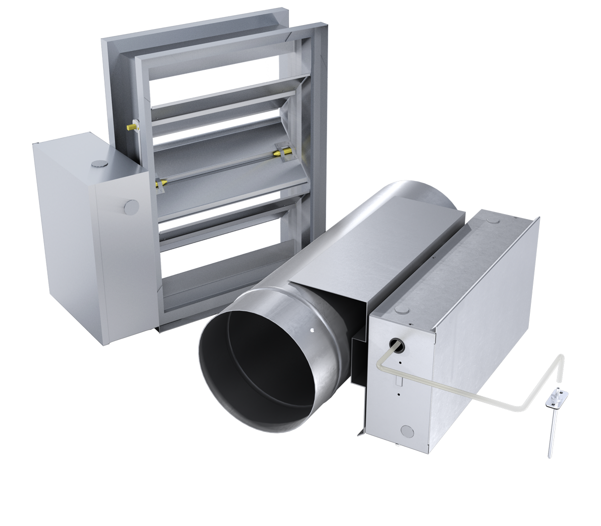
Acutherm Capabilities
Options & Accessories
Static Pressure Control
  Therma-Fuser™ Series – PIM
  Advantage Series – PIM
  Interoperable Series – PIM
    The Acutherm Pressure Independence Module (PIM) helps VAV diffuser to operate quietly at both full flow and turn down conditions by providing pressure independence as either a modulating bypass or zone damper. It can be supplied with or without a damper; square/rectangular opposed blade, or round damper with peripheral gasket, tested to ASHRAE 130 and AHRI 880.

Slide 48
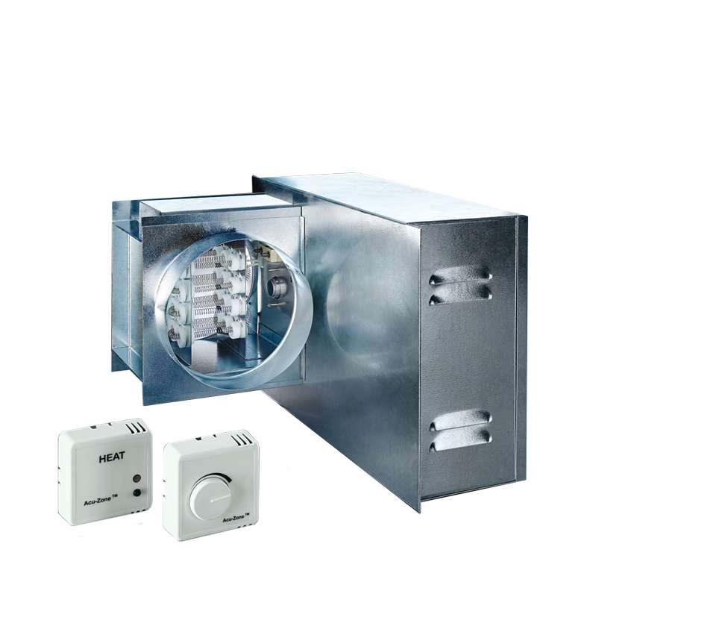
Acutherm Capabilities
Options & Accessories
Acu-Zone Electric Zone Heater
  Therma-Fuser™ Series – AZON-I-E & AZON-II-E
    The Acu-Zone™ electric zone heaters use a patented air flow sensor and the most advanced modulating SCR (Silicon Controlled Rectifier) proportional heat controller to vary the electrical power through the coil
    Electric heating units available in round, square and rectangular sizes.
Control | SCR | SCR
Inlet/Outlet diameter | Round, rectangular or square
Heating | Up to 21 kW/sq. ft. | Up to 226 kW/m²
Air volumes | Varies by size
Power | Varies by size

Slide 49
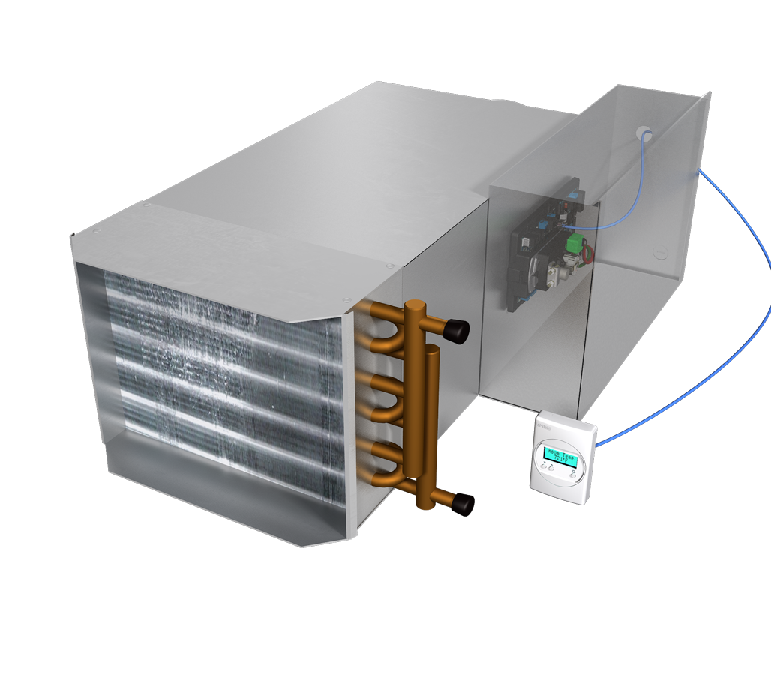
Acutherm Capabilities
Options & Accessories
Acu-Zone Hot Water Zone Heater
  Therma-Fuser™ Series – AZON-II-W
    The Acu-Zone hot water zone heaters use a modulating PI (proportional/integral) heat controller to vary the hot water through the coil and prevent excessive valve cycling.
    ¹optional pressure independent, two way or three way valve
    ²optional one or two row coil
Control | PID | PID
Valve¹ | PICCV or CCV | PICCV or CCV
Coil inlet diameter² | 6 / 8 / 10 / 12 / 14 / 16 in. | 150 / 200 / 250 / 300 / 350 / 400 mm
Coil heating² | 5 1 to 111.6 MBH | 17.4 to 380.9 kW
Coil air volumes² | < 15 to 37 NC | <15 to 37 NC

Slide 50
System Design

Slide 51
Acutherm Capabilities
System Design
The Acutherm by Price VAV diffuser is a simple stand-alone or networked device that provides VAV control when supplied with air in a suitable range of temperature and pressure.
Performance Requirements
Supply Air Temperature
Constant temperature. May be reset to another constant temperature.
Cooling between 50°F/10°C and 68°F/20°C.
Heating between 80°F/26.5°C and as low as possible but not to exceed 120°F/49°C.
Static Pressure
High enough for required air volume. No lower than 0.05 in.w.g./12 Pa.
Below rated static pressure for design sound level. No higher than 0.25 in.w.g./62 Pa suggested.

Slide 52
Acutherm Capabilities
System Design
Supply Air Temperature
When supplied with cool air, the VAV diffuser dampers modulate open on a rise in room temperature. When supplied with warm air, the dampers open on a room temperature drop.
Cool air should be a constant temperature not less than 50°F/10°C for standard models and warm air at a constant temperature of not more than 120°F/49°C. The constant discharge velocity of VAV diffusers at varying airflows provides good room circulation, which reduces stratification. Keeping heating supply air temperatures as low as possible will further reduce room air stratification to a negligible level.
Changeover from cooling to heating occurs as the supply air rises from 76°F/24.5°C to 80°F/26.5°C and change back from heating to cooling occurs when the supply air drops from 72°F/22°C to 68°F/20°C.

Slide 53
Acutherm Capabilities
System Design
Static Pressure
Noise level at any air diffuser is influenced by air velocity through the diffuser which is, in turn, a function of static pressure in the neck of the diffuser. Noise level at a VAV diffuser will not increase as it closes if the static pressure in the neck is held constant. As static pressure in the neck increases, sound level increases.
Static pressure at the inlet of the VAV diffuser must be high enough (0.05 in.w.g./12 Pa or more) to obtain the required air volume for room air induction. Static pressure above 0.25 in.w.g./62 Pa may cause the sound level to become noticeable (NC35).

Slide 54
Acutherm Capabilities
System Design
Location
Because VAV diffusers control room temperature by sensing room air induced up the center of the space, care should be taken not to disturb room air induction and entrainment. For example, location next to walls or dropped lights results in the reflection of primary air back at the VAV diffuser. Relocate either the diffuser or use directional blow baffles.
Duct Design
The goal of a high performance duct design is to design for lowest possible static pressure while providing ample air to each space. Duct design example: if VAV diffusers are to deliver nominal volume at inlet SP of 0.15 in.w.g./ 37 Pa and if a maximum SP of 0.25 in.w.g./ 62 Pa is to be held for quiet operation, size the duct for a maximum pressure drop of 0.1 in.w.g./25 Pa between the first and last takeoff.
Manual balancing dampers should be used at the takeoff for each diffuser. Manual balancing dampers may not be required with ducts designed to Acutherm specifications.

