Slide 1
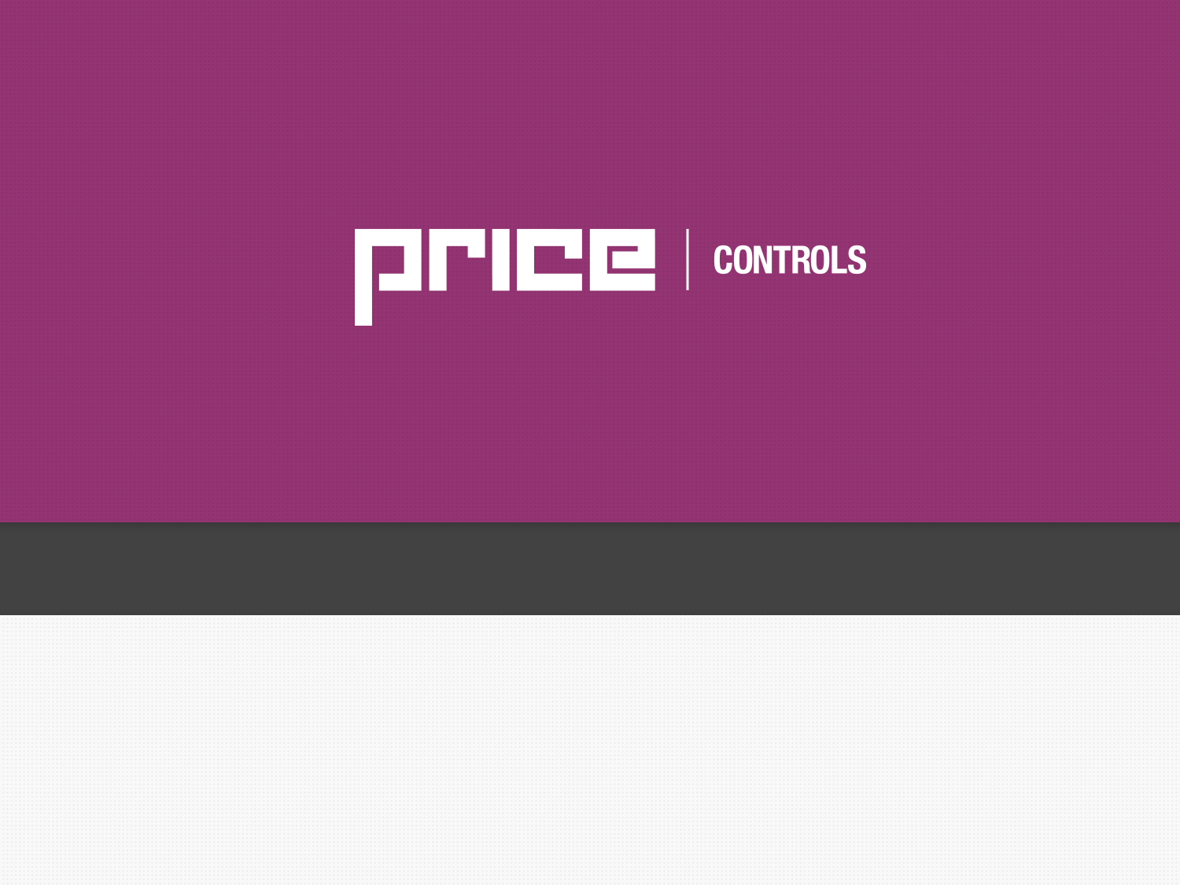
How To Win Projects (Identifying Opportunities)

Slide 2
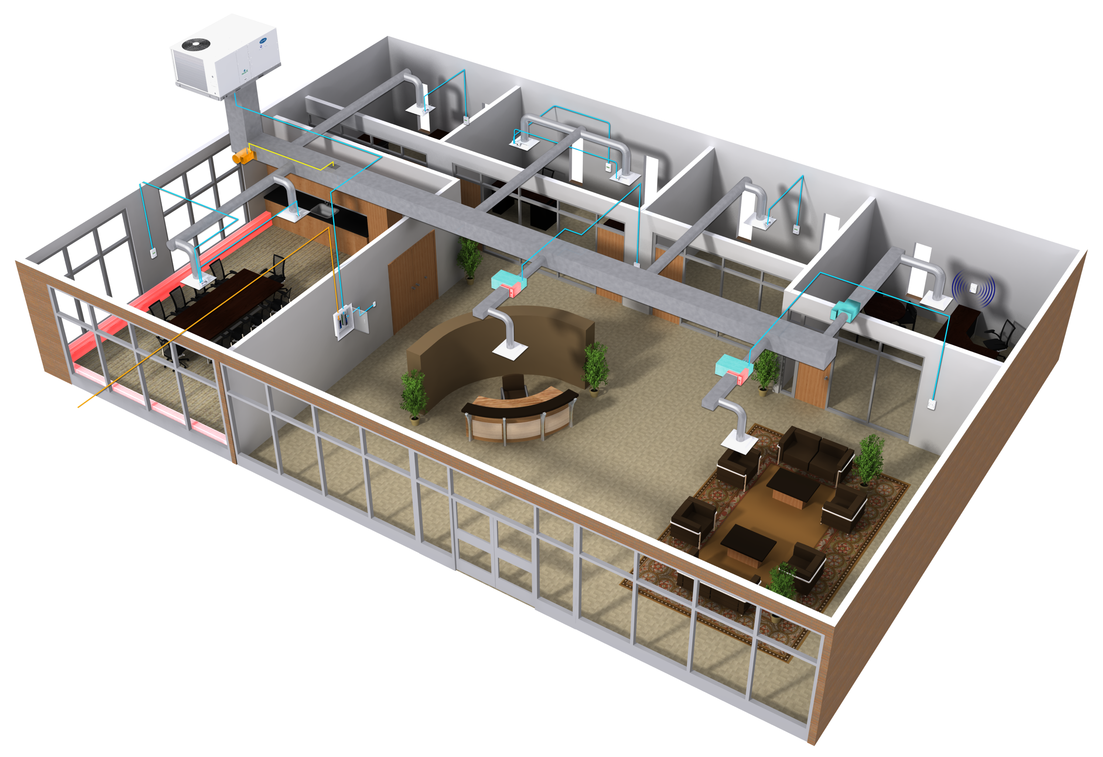
Price Controls - How To Win!
Market Strategy in your Territory
Controls market in your territory will vary from city to city, and your territory may be saturated with controls contractors
Figuring out if your territory is weighted more on the Bid & Spec market compared to the Design Build market
Not always a clear path to winning “controls” jobs out there
Depending on your market, the Design Build market may be a more defined path than the bid & spec market
The best type of buildings to go after are ones with 1 to 2 Rooftop units – E.g. Banks, Dealerships, Libraries, etc.

Slide 3
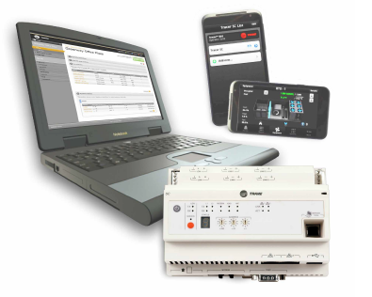
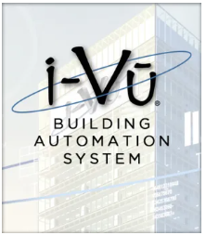
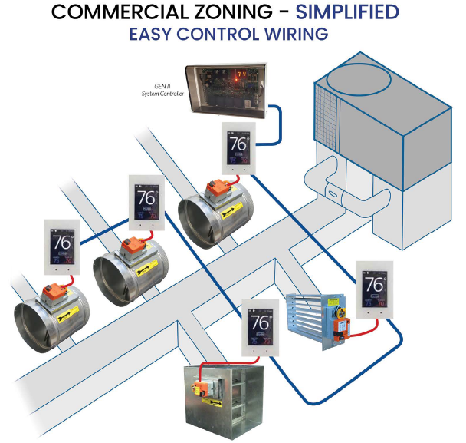

Price Controls - How To Win!
Alternatives Out There
Trane Concierge/Varitrac Zoning System
Carrier VVT I-Vu System
Zone-All Systems
Johnson Verasys
Notes:
Mention 10 binary outputs –
List analog outputs – VFD, cooling valve, heating

Slide 4
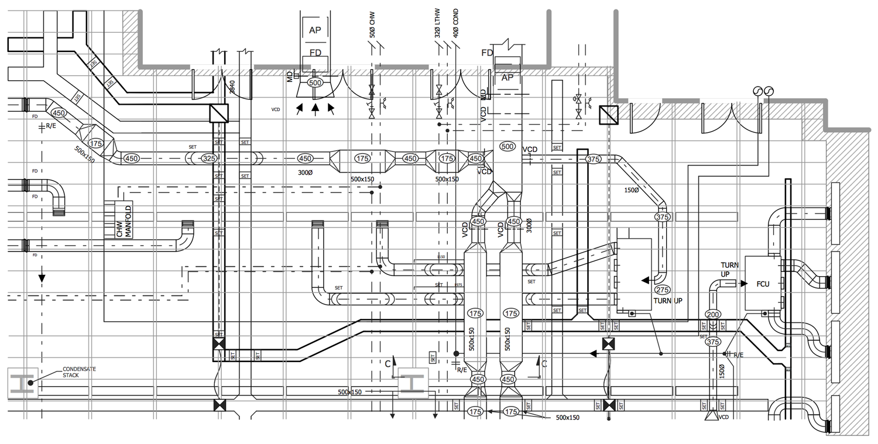
Price Controls - How To Win!
Bid & Spec Market
The goal here is to get Price Controls BOD – Basis of Design!
  Once they become BOD, then this makes it easy for engineers to specify our controls and the project will follow what is BOD
This could work as a Value Engineered (VE) option
Figure out if they are designing a Constant Volume system, Variable Volume, or VRF
Essentially, you can offer a “below the deck” controls package for a zoning system
If you are a sales office that reps Carrier, you can go in as a complete package with the RTU and our zoning system
Notes:
Mention 10 binary outputs –
List analog outputs – VFD, cooling valve, heating

Slide 5
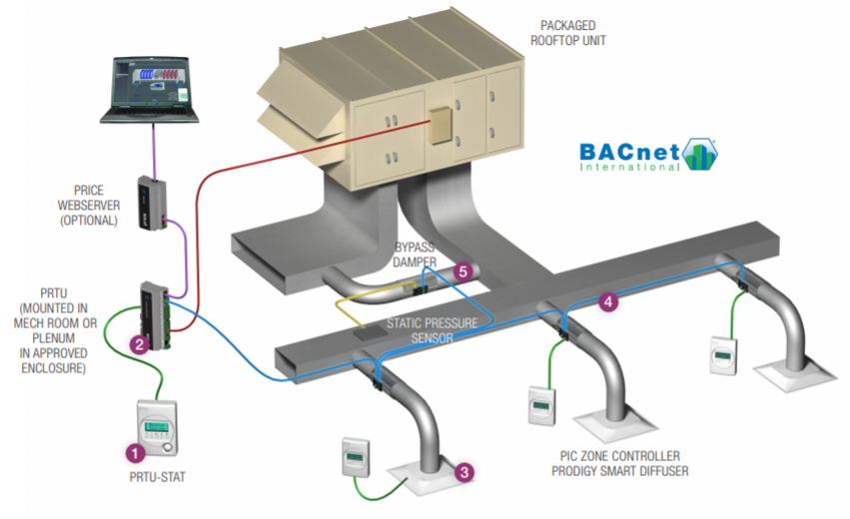
Price Controls - How To Win!
Bid & Spec Market
Price Zoning System:
  PRTU Rooftop Controller
  PCV Bypass
    (Constant Volume Systems)
  Single Duct
  Fan Powered Terminal Units
  VAV Diffusers
  BMS Package
    Basic = Price WEB Server
    Advanced = DISIO Cloud System
Essentially, a below the deck package (unless your office reps a rooftop line e.g. Carrier, Lennox, etc.)
Notes:
Mention 10 binary outputs –
List analog outputs – VFD, cooling valve, heating

Slide 6
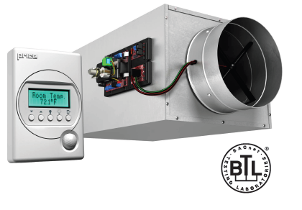
Price Controls - How To Win!
Bid & Spec Market
OR… a packaged solution with Terminals and Controls together
SDV Terminal Unit with Price Controls:
  Explain the advantages of pairing a Price Controller + Price Terminal Unit compared to providing “controls by others” on the unit
    Controls are factory mounted and installed
    Saves on lead times
    No coordination required when controls are provided by Price!
    Price Controls are plug & play, easy to install and commission, which saves on install costs
Notes:
Mention 10 binary outputs –
List analog outputs – VFD, cooling valve, heating

Slide 7
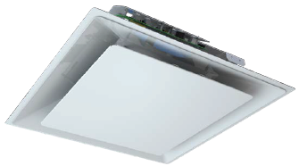
Price Controls - How To Win!
Bid & Spec Market
OR….VAV diffusers as another angle to design a building with Price Controls
VAV Diffusers:
  Maybe you can lay the job out with VAV diffusers instead of Terminal units
  Depending on what the site requires, maybe a VAV diffuser is easier to install where less ductwork is required
  VAV systems operate at a lower static pressure, so this can reduce the duct sizing and overall fan sizing of the rooftop unit
  Great for retrofits to fix problem areas!
Notes:
Mention 10 binary outputs –
List analog outputs – VFD, cooling valve, heating

Slide 8

Price Controls - How To Win!
Design Build Market
This might be your Golden Ticket to really go after this market.
Work with the Design Build Contractors to design an economic system for building owners
Price Zoning System c/w:
  PRTU Rooftop Controller
  PCV Bypass
    (for Constant Volume Systems)
  Single Duct or Fan Powered Terminal Units
  VAV diffusers
  BMS Package
    Basic = Price WEB Server
    Advanced = DISIO Cloud System
Notes:
Mention 10 binary outputs –
List analog outputs – VFD, cooling valve, heating

Slide 9
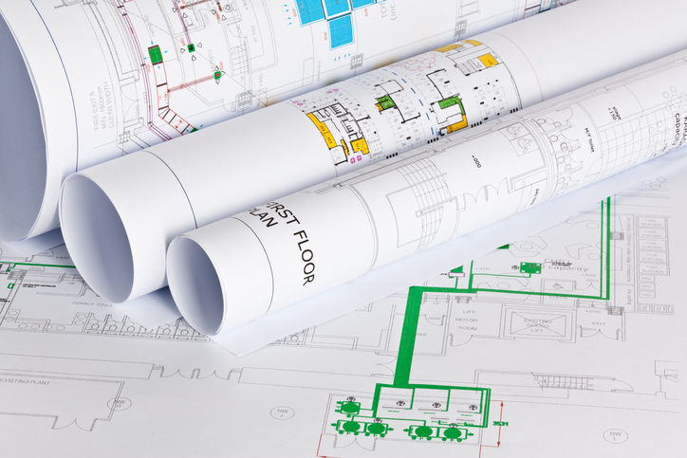
Price Controls - How To Win!
Key Sales Person in your Office
Ideally, need at least one person in each sales office to take on the “controls” jobs that come in and look for these types of opportunities
Whether this is on the Air Distribution side, or the Mechanical side, we will help train up that individual
Learning the Price Controls offering and then recognizing these opportunities as they come in can created added business to your rep firm
Service Techs are in your area to help support this product, as most of them have been trained on Price Controls
Notes:
Mention 10 binary outputs –
List analog outputs – VFD, cooling valve, heating

Slide 10

Price Controls - How To Win!
Who is best suited to install Price Controls?
Price Controls can be installed by anyone who is qualified:
    Mechanical Contractor
    HVAC Mechanic
    Sheet Metal Contractor
    Refrigeration Mechanic
Price Controls are designed to keep the “Controls Contractor” off the job where applicable
This can save the GC money on the job if the Mechanical or Sheet Metal contractor does the controls install
Notes:
Mention 10 binary outputs –
List analog outputs – VFD, cooling valve, heating

Slide 11
Adding Controls To Your Project - Pricing

Slide 12
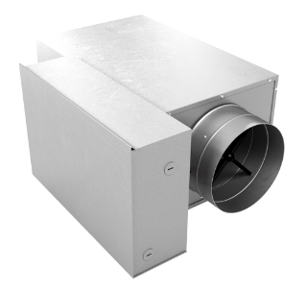
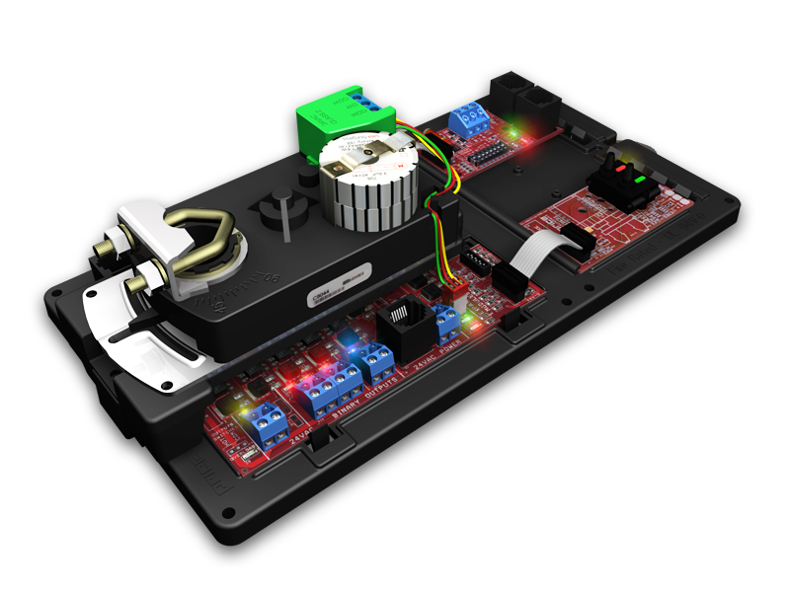
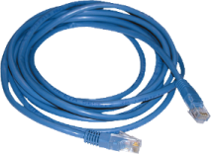
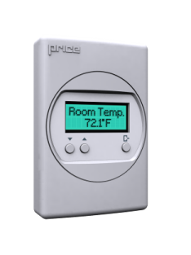
Price Controls - How To Win!
Price Controls + Price Terminal Unit
SDV Terminal Unit
PIC Controller c/w LCD Tstat
+
YOUR GP JUST WENT UP +500% !!
List = $431 CAD
List = $1525 CAD
RESULT = $1956 CAD List Price
$1956 x 0.4 Multiplier = $782 CAD NET!

Slide 13
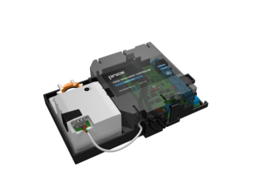
Price Controls - How To Win!
Price Controls + Price Terminal Unit
SDV Terminal Unit
PIC Controller c/w LCD Tstat
+
YOUR GP JUST WENT UP +500% !!
List = $431 CAD
List = $1165 CAD
RESULT = $1596 CAD List Price
$1596 x 0.4 Multiplier = $638 CAD NET!

Slide 14
Price Controls - How To Win!
Price Controls – Order Just the Controller
PIC Controller c/w LCD Tstat
PIC Controller c/w LCD Tstat
List = 1525 CAD X 0.4 = $610 CAD NET Sell
List = $1165 CAD x 0.4 =
$466 CAD Net Sell

Slide 15
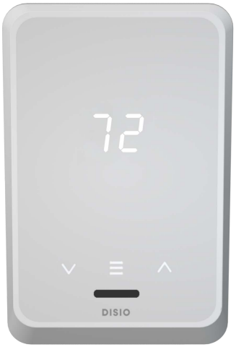
Price Controls - How To Win!
Bid & Spec OR Design Build Market
Work with your local engineer to spec in Price Controls with Price Terminals to offer a “Packaged Solution”
Once it is spec’d, then we are in!
Design Build Market:
  Retrofits
  TFs
  Tis
  New Installs
Mechanical Contractors can drive the market to influence what the engineer will spec!

Slide 16
Typical Zoning System Layouts & Schedules

Slide 17
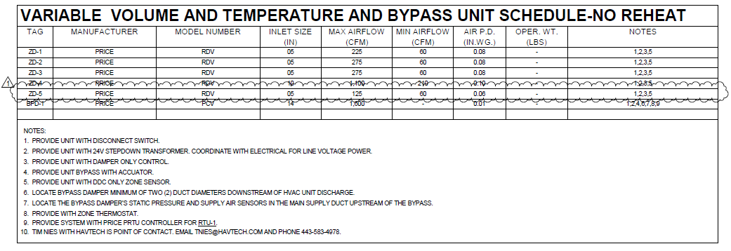
Price Controls - How To Win!
System Design & Layout – Example 1
Typical Schedule for a typical VVT Zoning System:
The Price Zoning System can compete on all jobs like this. New Installs, TIs, TFs, Constant or Variable Volume

Slide 18
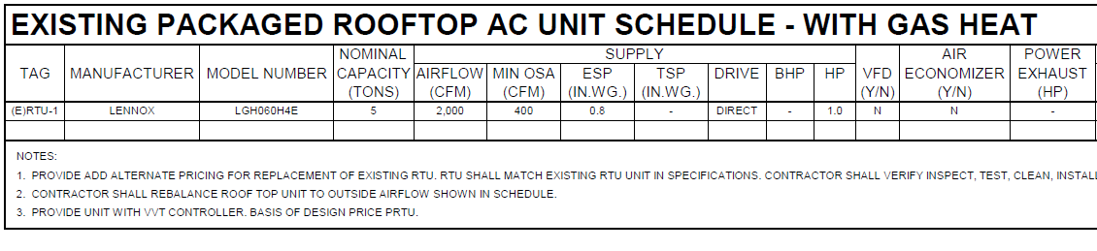
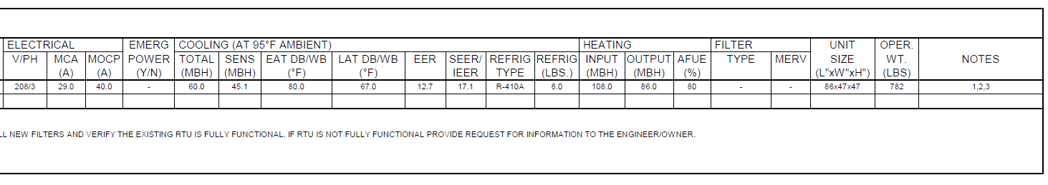
Price Controls - How To Win!
System Design & Layout – Example 1
Typical Schedule for an existing RTU (Lennox):
This schedule and spec calls out the PRTU as BOD

Slide 19
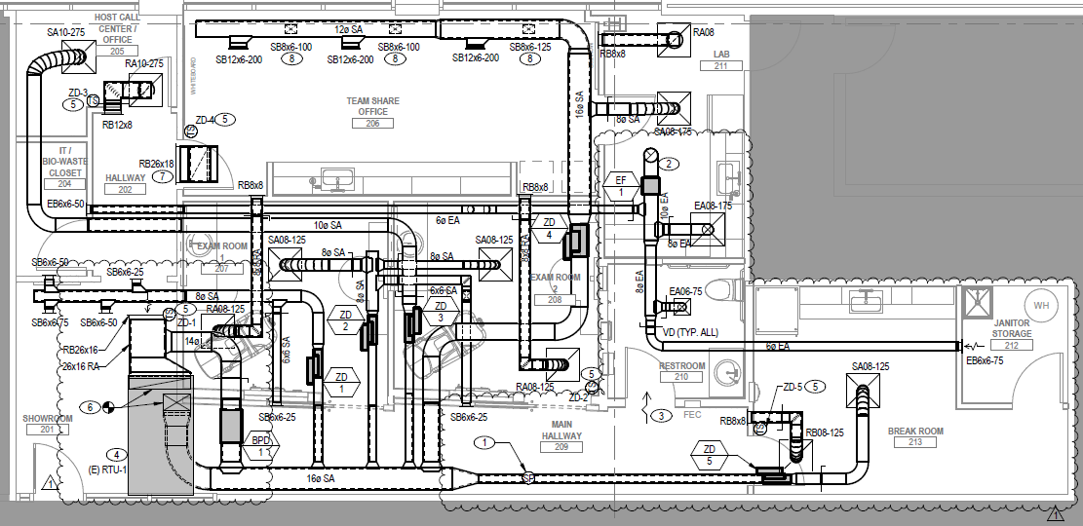
Price Controls - How To Win!
System Design & Layout – Example 1
RTU = PRTU
BPD = Bypass Damper (PCV)
ZD1 thru ZD5 = PIC Controller

Slide 20
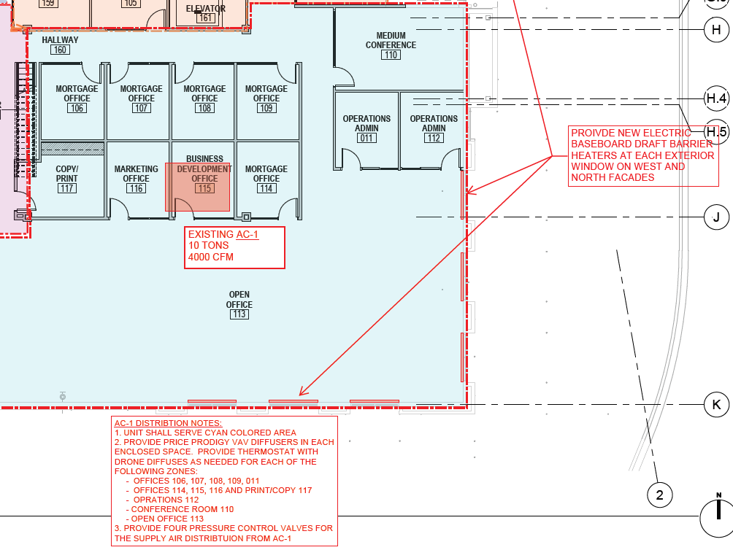
Price Controls - How To Win!
System Design & Layout – Example 2

Slide 21
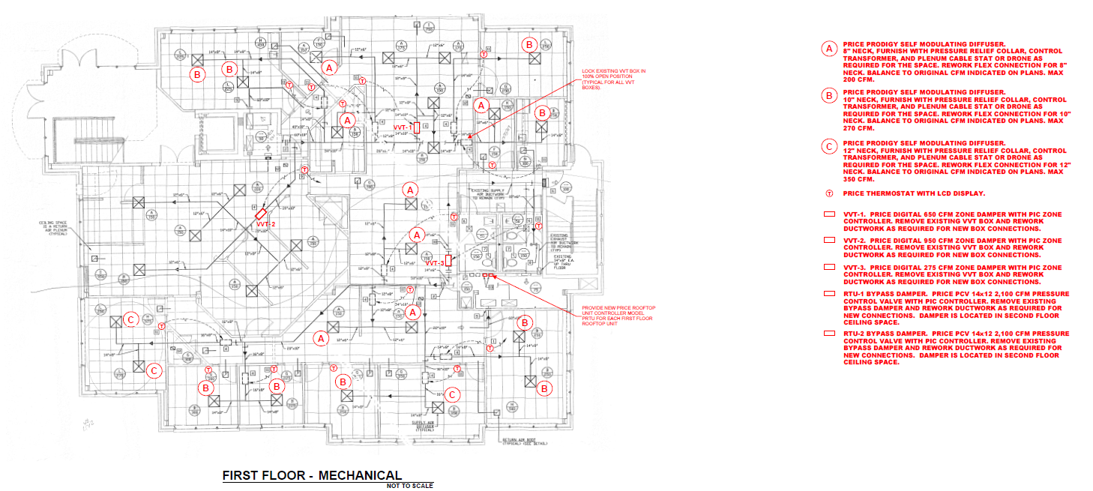
Price Controls - How To Win!
System Design & Layout – Example 3

Slide 22
AIO Selections – Price Controls

Slide 23
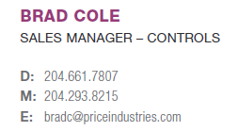
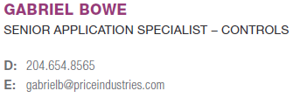
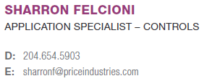
Price Controls - How To Win!
Key Contacts to Help Win Controls Jobs
Controls Support
Main Contact:
Hotline: (204) 654-5613 Option 4
Email: controls@priceindustries.com

