Slide 1

Introduction to VAV Diffusers

Slide 2

Copyright Materials
This presentation is protected by U.S. and international copyright laws. Reproduction, distribution, display and use of this presentation without written permission of the speaker is prohibited.
® Price Industries, Incorporated 2023

Slide 3
VAV Diffusers
Course Description
Introduction to VAV diffusers, how they work, and how to use them in HVAC system designs.

Slide 4
VAV Diffusers
Learning Objectives
By the end of this lecture, you will be able to:
Describe what a VAV diffuser is and how it works
Identify design features unique to VAV diffusers
Outline basic system design principles

Slide 5
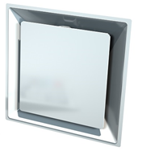
Overview
Agenda
Comfort
How VAV Diffuser Work
Benefits
Design Basics
Example Projects
Product Summary

Slide 6
Comfort

Slide 7
VAV Diffusers
What are VAV Diffusers?
A ceiling diffuser with an individual thermostat and built-in VAV damper.

Slide 8
VAV Diffusers
What are VAV Diffusers?
Like having a little VAV box in each space.

Slide 9
VAV Diffusers
Like having a little VAV box in each space.

Slide 10
VAV Diffusers
What are VAV Diffusers?
Like having a little VAV box in each space.

Slide 11
VAV Diffusers
What are VAV Diffusers?
Like having a little VAV box in each space.

Slide 12
VAV Diffusers
What are VAV Diffusers?
Like having a little VAV box in each space.

Slide 13
VAV Diffusers
What are VAV Diffusers?
Like having a little VAV box in each space.

Slide 14
VAV Diffusers
What are VAV Diffusers?
Like having a little VAV box in each space.
T
T
T
T
T

Slide 15
VAV Diffusers
What are VAV Diffusers?
This allows for individual comfort.
T
T
T
T
T

Slide 16
VAV Diffusers
What are VAV Diffusers?
Each VAV diffuser location provides an opportunity for customized adjustment.
T
T
T
T
T
72°
74°
73°
70°
76°

Slide 17
VAV Diffusers
What are VAV Diffusers?
Adjusting each individual space to the inevitable load changes.
T
T
T
T
T
72°
74°
73°
70°
76°

Slide 18
VAV Diffusers
What are VAV Diffusers?
Using fewer resources – no over cooling or over heating of individual spaces.
T
T
T
T
T
72°
74°
73°
70°
76°

Slide 19
VAV Diffusers
What are VAV Diffusers?
A diffuser with the VAV damper and thermostat built in.

Slide 20
VAV Diffusers
What are VAV Diffusers?
A diffuser with the VAV damper and thermostat built in.
Individual control

Slide 21
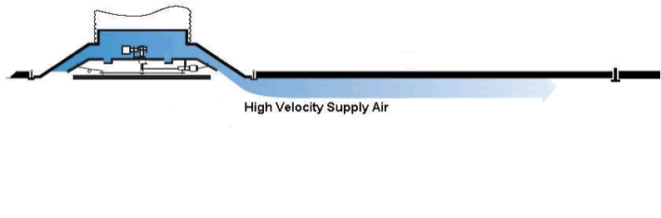
VAV Diffusers
What are VAV Diffusers?
Air Distribution

Slide 22

VAV Diffusers
What are VAV Diffusers?
Air Distribution
The Coanda effect (or wall-attachment effect) is the tendency of a moving fluid, either liquid or gas, to attach itself to a surface and flow along it - Henri Coanda 1930

Slide 23
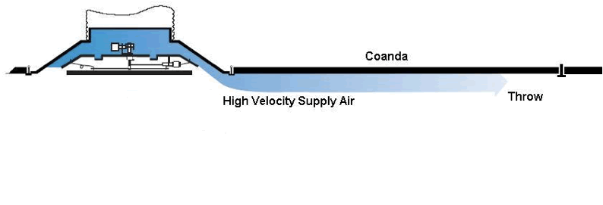
VAV Diffusers
What are VAV Diffusers?
Air Distribution

Slide 24
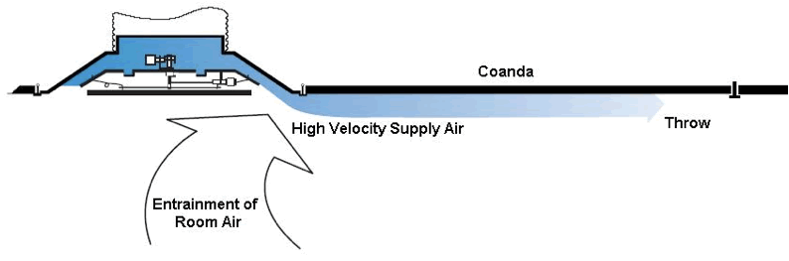
VAV Diffusers
What are VAV Diffusers?
Air Distribution

Slide 25
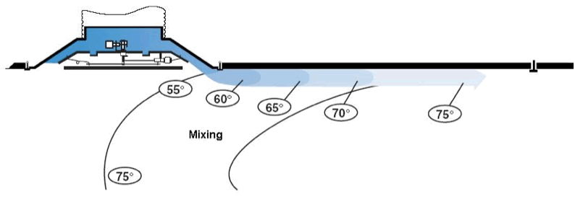
VAV Diffusers
What are VAV Diffusers?
Air Distribution

Slide 26
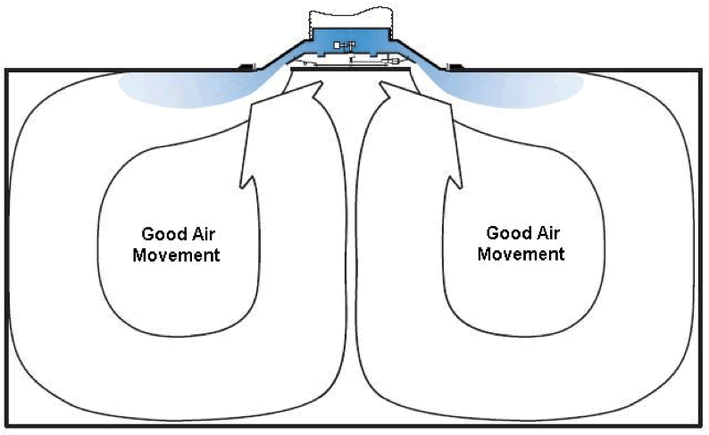
VAV Diffusers
What are VAV Diffusers?
Air Distribution

Slide 27
VAV Diffusers
What are VAV Diffusers?
Select equipment for design conditions.

Slide 28
VAV Diffusers
What are VAV Diffusers?
Select equipment for design conditions.
VAV Systems operate at or below 50% turndown for 85% of the time!

Slide 29
VAV Diffusers
What are VAV Diffusers?
Variable opening – high discharge velocity – good room air movement at design and turndown conditions
Select equipment for design conditions.
VAV Systems operate at or below 50% turndown for 85% of the time!

Slide 30
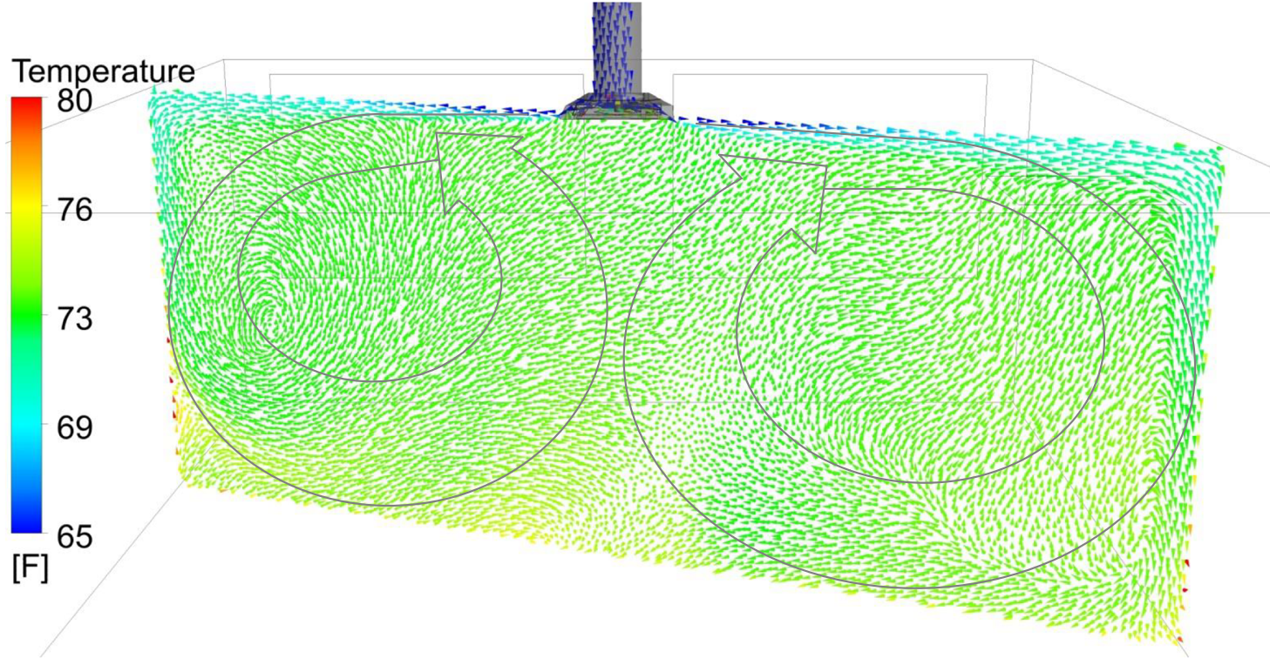
VAV Diffusers
What are VAV Diffusers?
Modeling - CFD Analysis: Airflow pattern colored by temperature - Isometric View
Computational Fluid Dynamics Software
ANSYS - CFX-5 Solver Theory and Solver Modeling
100% Air Flow 25% Air Flow

Slide 31
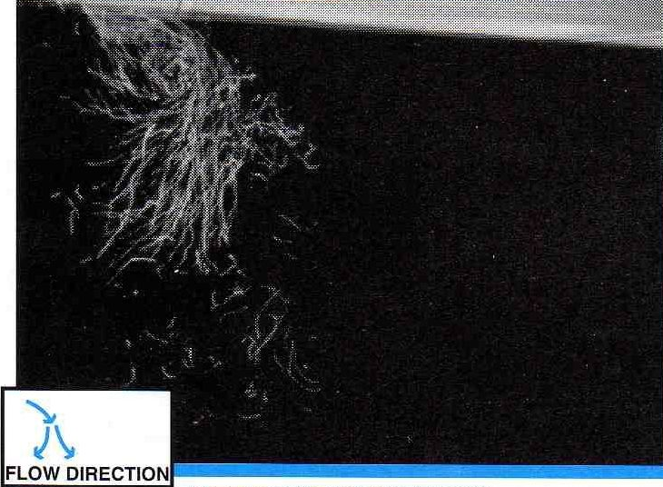
VAV Diffusers
What are VAV Diffusers?
VAV Diffuser
VAV Diffuser
VAV Diffuser
Variable opening – high discharge velocity – good room air movement at design and turndown conditions
100% Air Flow 50% Air Flow 25% Air Flow
Poor Diffuser Dumping
No Dumping

Slide 32
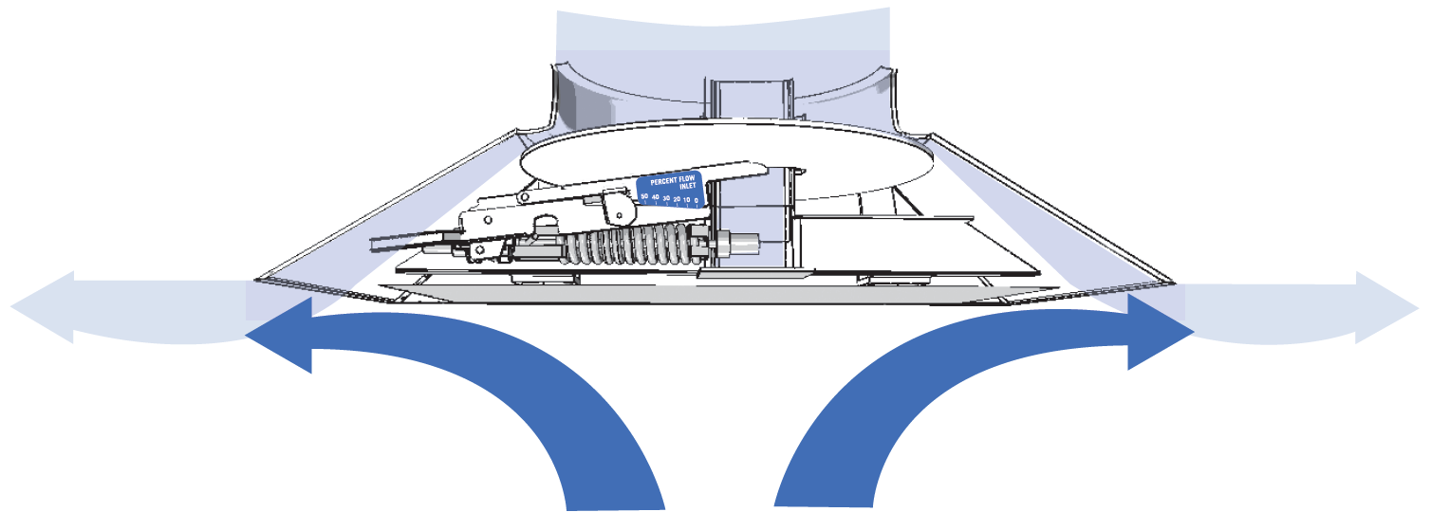
VAV Diffusers
What are VAV Diffusers?
Variable opening = constant discharge velocity
Maintains room air distribution:
Coanda (no dumping)
Throw
Entrainment
Mixing
Under design and turndown conditions

Slide 33
VAV Diffusers
What are VAV Diffusers?
A diffuser with the VAV damper and thermostat built in.
Individual control

Slide 34
VAV Diffusers
What are VAV Diffusers?
A diffuser with the VAV damper and thermostat built in.
Superior air distribution
Individual control

Slide 35
VAV Diffusers
What are VAV Diffusers?
Comfort!
A diffuser with the VAV damper and thermostat built in.
Superior air distribution
Individual control

Slide 36
Benefits

Slide 37
VAV Diffusers
Benefits
Comfort
Individual Zones of Control – built in thermostat
Room Air Mixing – built in VAV damper

Slide 38
VAV Diffusers
Benefits
Comfort
Reliability
No maintenance
Varitherm - 10 Year Warranty
Prodigy - 1 year Warranty

Slide 39
VAV Diffusers
Benefits
Comfort
Reliability
Adaptable Design
Walls may be relocated without splitting zone

Slide 40
VAV Diffusers
Benefits
Comfort
Reliability
Adaptable Design
Energy Efficiency
Low pressure system
Small zones of control

Slide 41
VAV Diffusers
Cost
Compare installed costs of the system
Size of Zone Cost vs. Comfort
$
$$
$$$

Slide 42
VAV Diffusers
Cost
Compare installed costs of the system
Size of Zone Cost vs. Comfort
$
$$
$$$
$$
VAV Diffusers

Slide 43
How VAV Diffuser Work

Slide 44
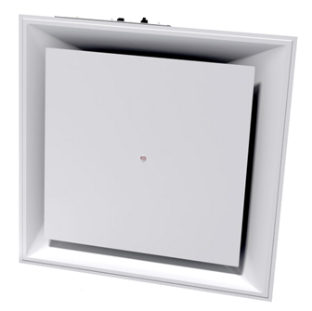

VAV Diffusers
How VAV Diffusers Work
Mechanical (thermal) Varitherm (VPD)
Digital (electric) Prodigy (PPD)
VPD
PPD

Slide 45
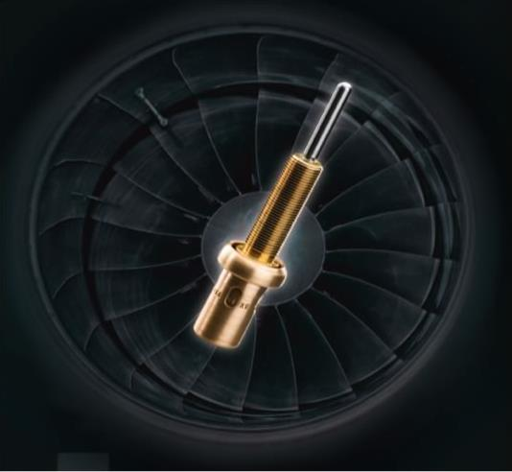
VAV Diffusers
How VAV Diffusers Work
Varitherm (VPD)
Thermostat Actuator
Accurate
Repeatable
Reliable
Robust

Slide 46
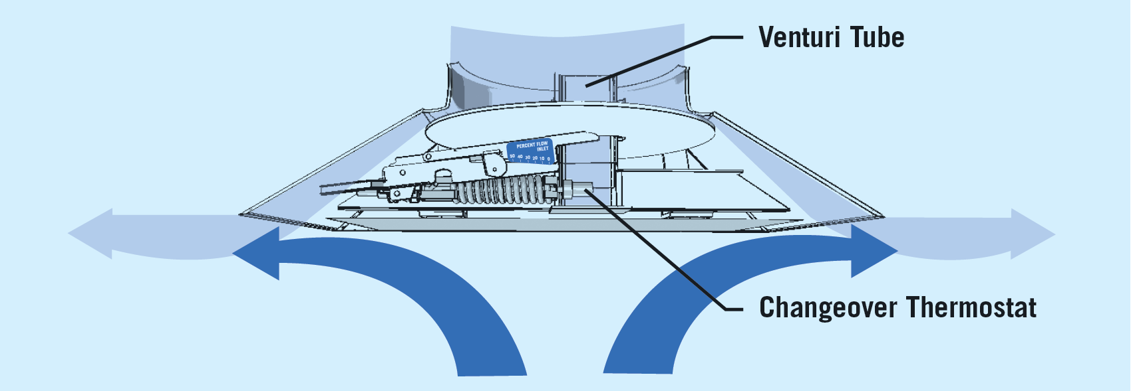
VAV Diffusers
How VAV Diffusers Work
Varitherm (VPD)

Slide 47
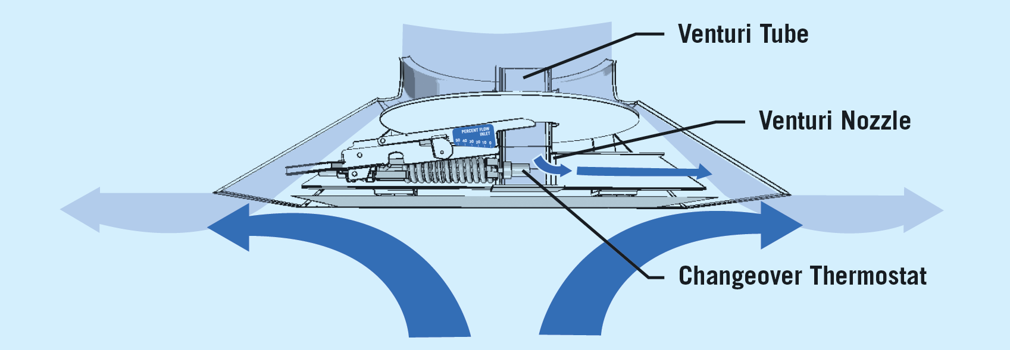
VAV Diffusers
How VAV Diffusers Work
Varitherm (VPD)

Slide 48
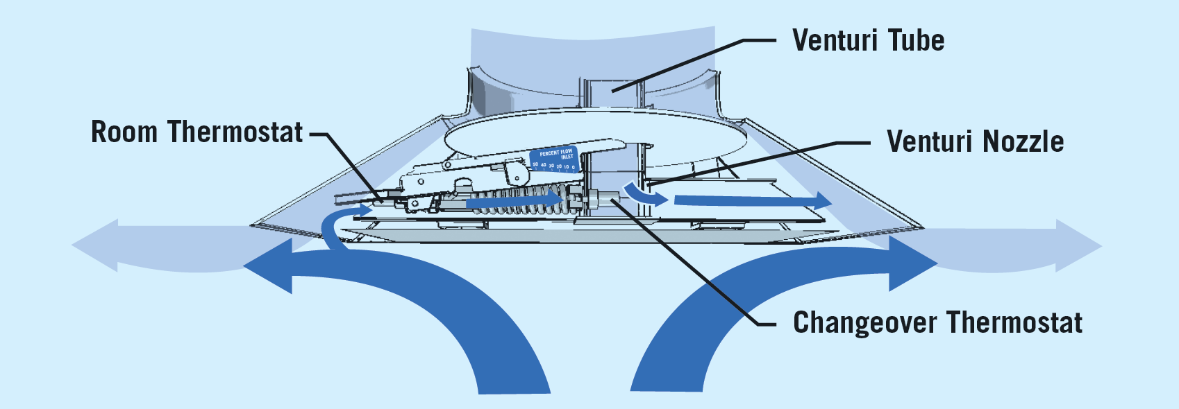
VAV Diffusers
How VAV Diffusers Work
Varitherm (VPD)

Slide 49
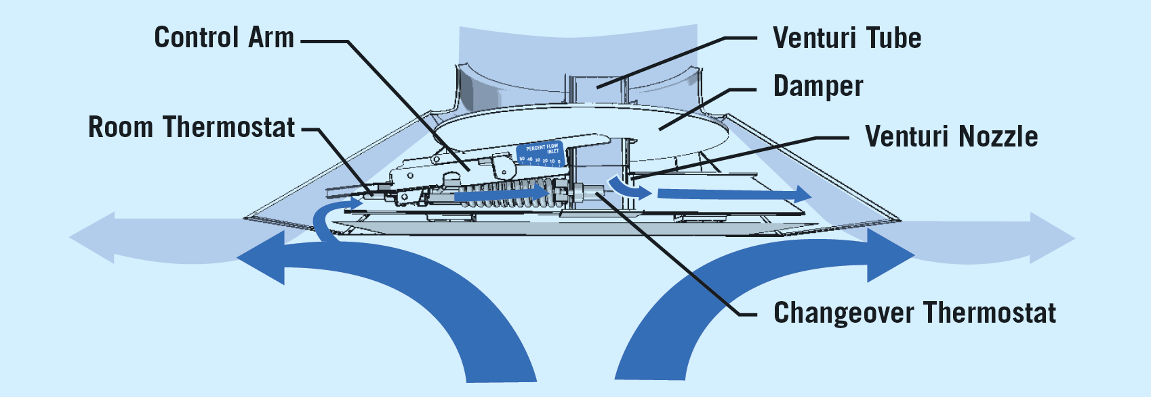
VAV Diffusers
How VAV Diffusers Work
Varitherm (VPD)

Slide 50
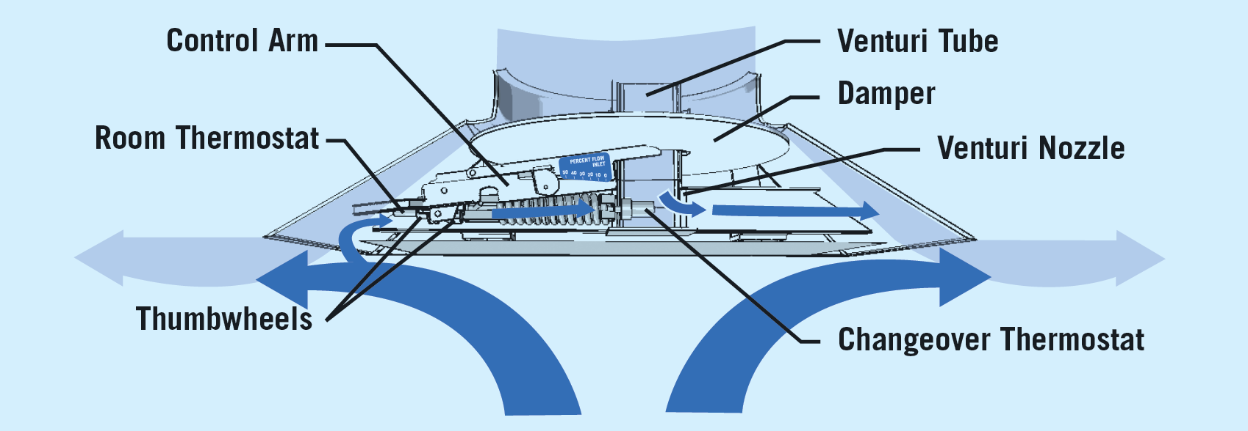
VAV Diffusers
How VAV Diffusers Work
varitherm (VPD)

Slide 51
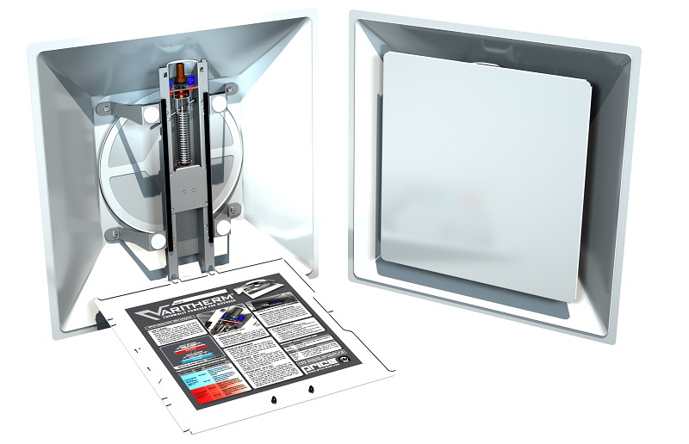
VAV Diffusers
How VAV Diffusers Work
Varitherm (VPD)

Slide 52
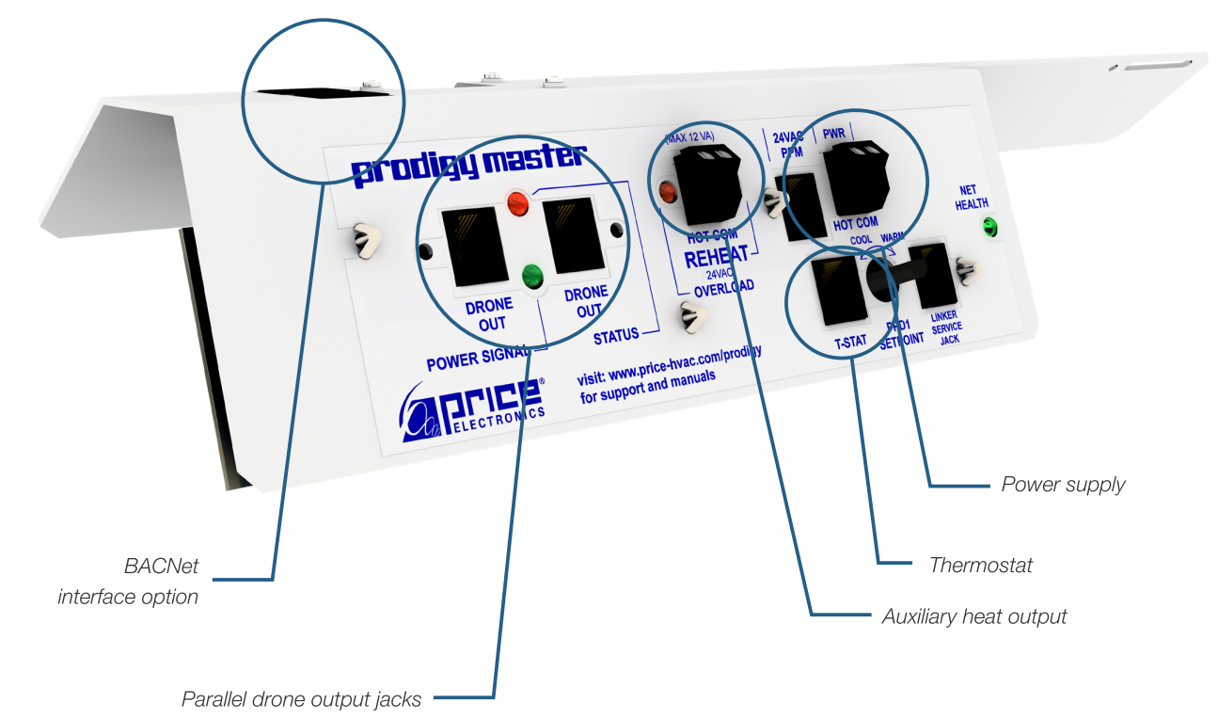
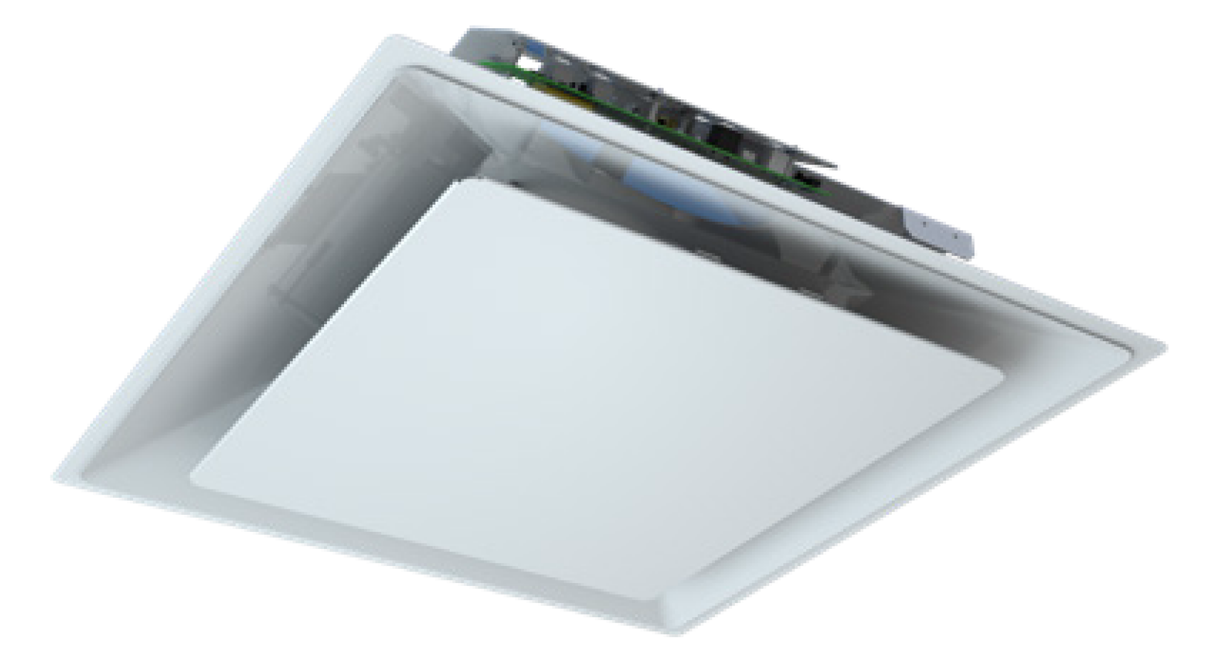
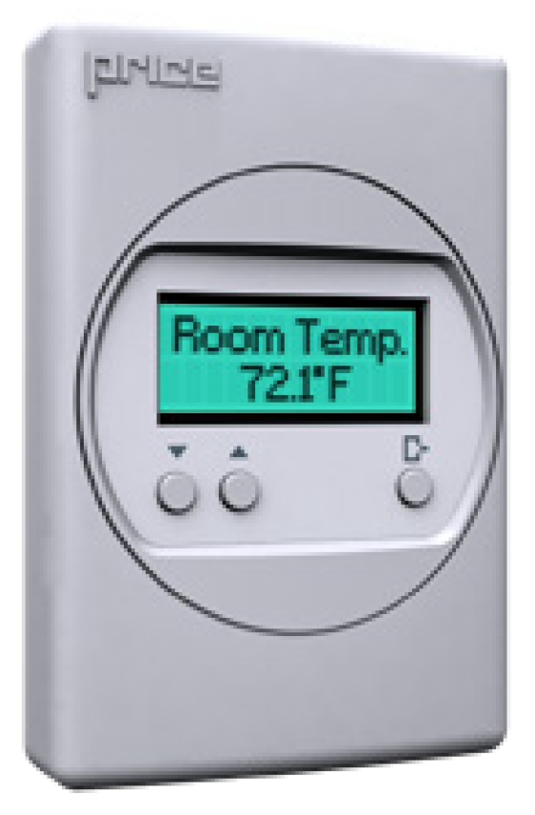
VAV Diffusers
How VAV Diffusers Work
Prodigy (PPD)

Slide 53
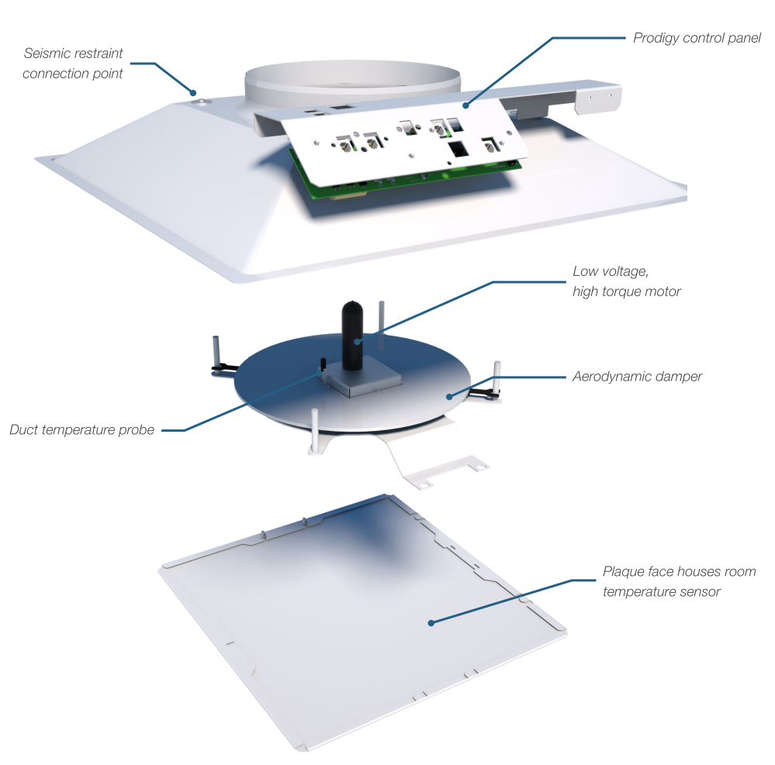
VAV Diffusers
How VAV Diffusers Work
Prodigy (PPD)

Slide 54
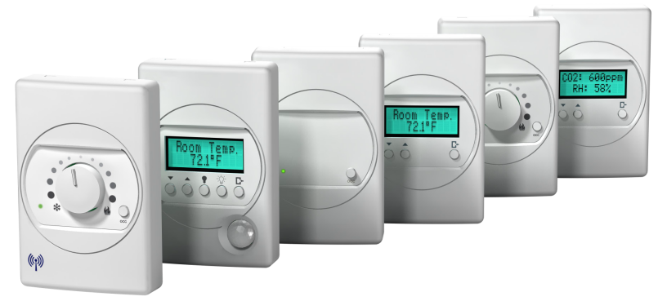
VAV Diffusers
How VAV Diffusers Work
Prodigy (PPD)

Slide 55
VAV Diffusers
How VAV Diffusers Work
Prodigy
or
Master and up to 5 Drones
Standalone

Slide 56
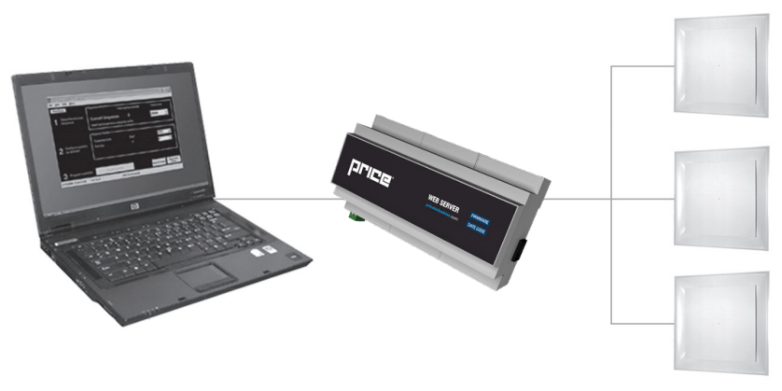
VAV Diffusers
How VAV Diffusers Work
Prodigy
BACnet Network

Slide 57
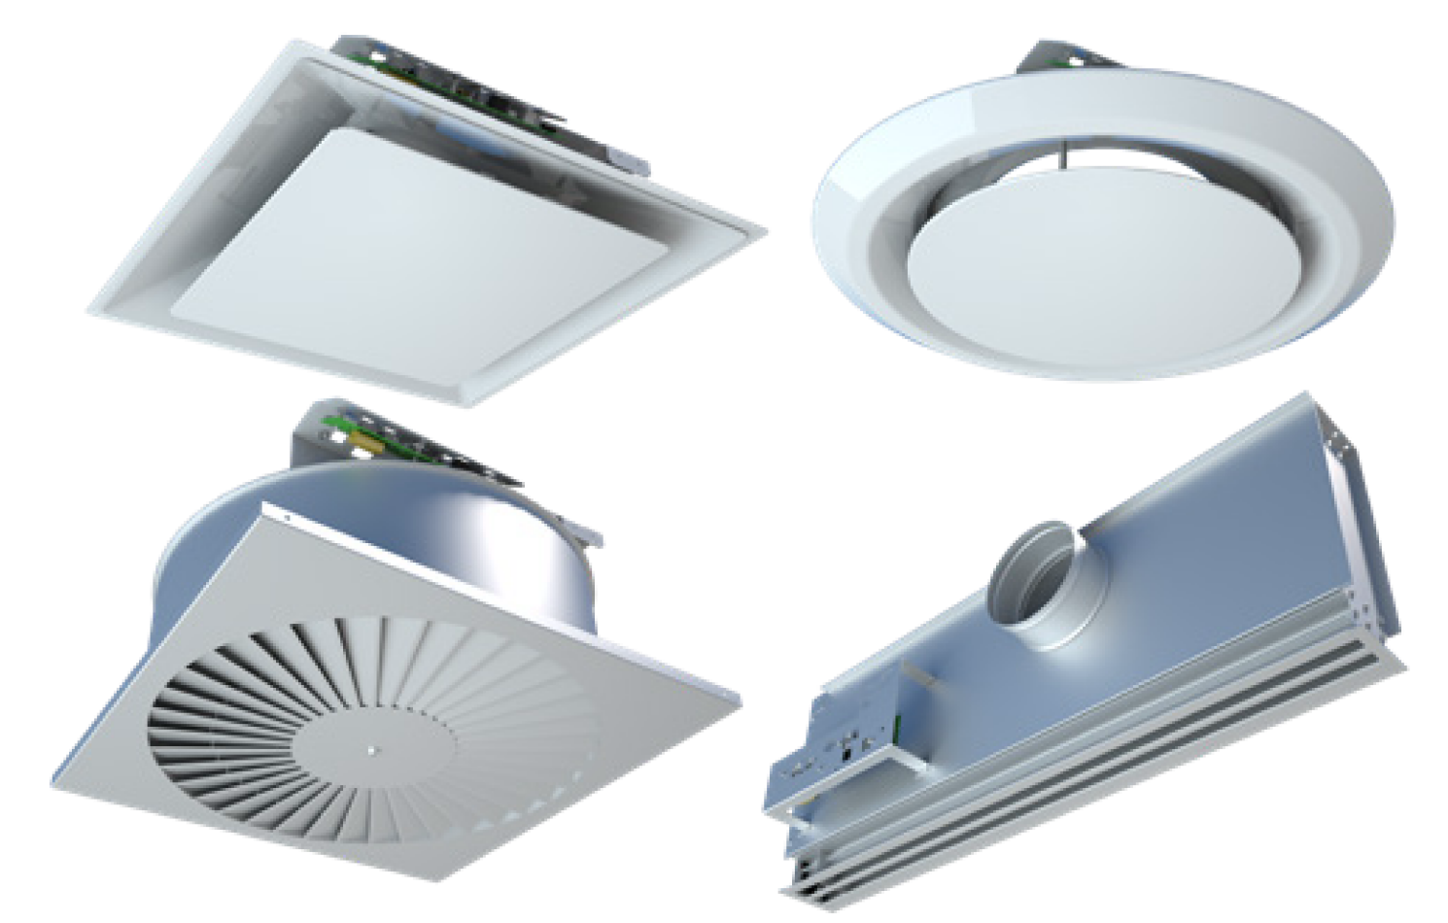
VAV Diffusers
How VAV Diffusers Work
Prodigy
PPD
PRD
PSD
PLD

Slide 58
Design Basics

Slide 59
VAV Diffusers
Application and Design
Design Basics
Small Zones of Control
One or two Small Rooms

Slide 60
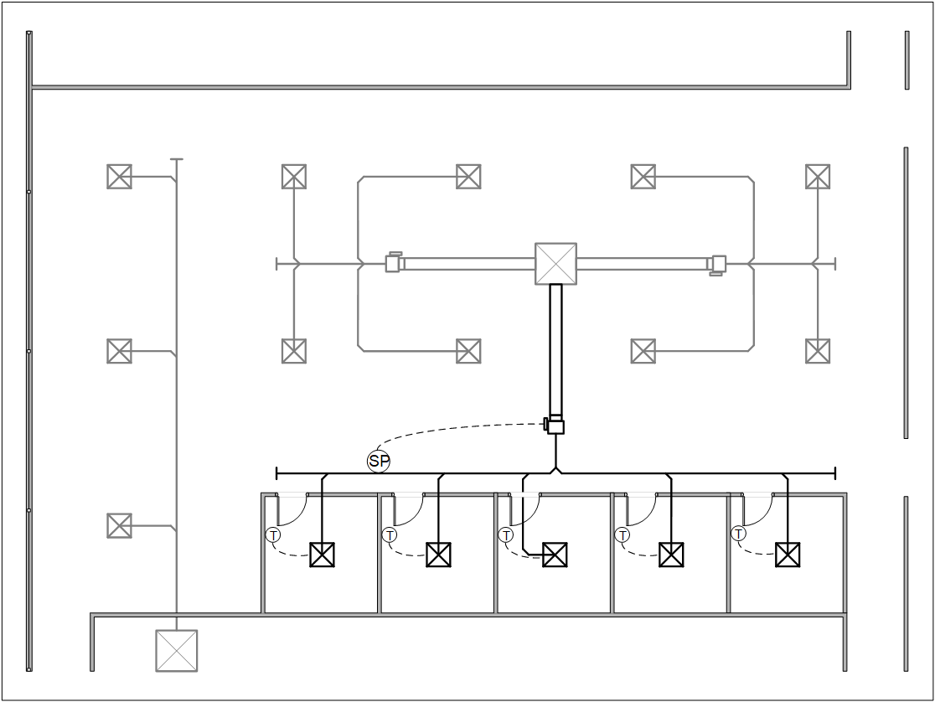
VAV Diffusers
Design Basics
Small Zones of Control
Group of Small Spaces

Slide 61
VAV Diffusers
Design Basics
Small Zones of Control
Complete Building

Slide 62
VAV Diffusers
Design Basics
Sizing and Locating
Zoning
Pressure Control
Supply Air Temperature

Slide 63
VAV Diffusers
Design Basics
Sizing and Locating
Size and locate VAV diffusers
as you would ANY diffuser

Slide 64
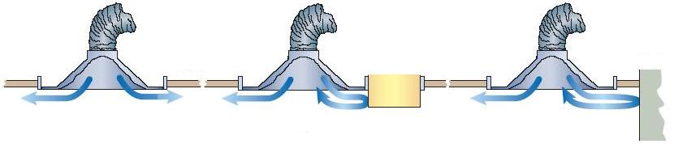
VAV Diffusers
Design Basics
Sizing and Locating - Varitherm
At least 2ft/0.6m from obstruction not to disturb room air induction and entrainment
OK Near dropped light Near wall – use
or beam – use directional baffle
directional baffle

Slide 65
VAV Diffusers
Design Basics
Sizing and Locating
VAV Cooling Only – heights around 20ft/6m
VAV Heating – below 10ft/3m preferred

Slide 66
VAV Diffusers
Design Basics
Sizing and Locating
Max Flow - Balancing
Manual volume damper at takeoff to diffuser
Open diffuser for balancing
Minimum Flow - Ventilation
Set at diffuser

Slide 67
VAV Diffusers
Design Basics
Sizing and Locating
Zoning

Slide 68
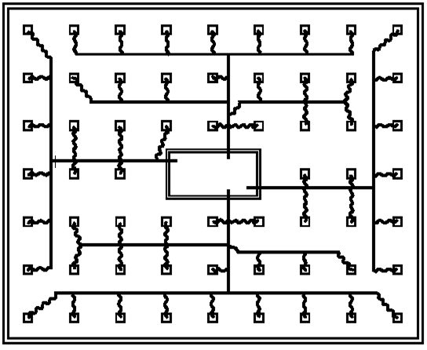
VAV Diffusers
Design Basics
Zoning – Heating and Cooling
Provide correct building zoning
(e.g. separating North Perimeter from Interior and from South Perimeter)
Multiple AHU/RTU
Separate Perimeter System
Reheat System

Slide 69
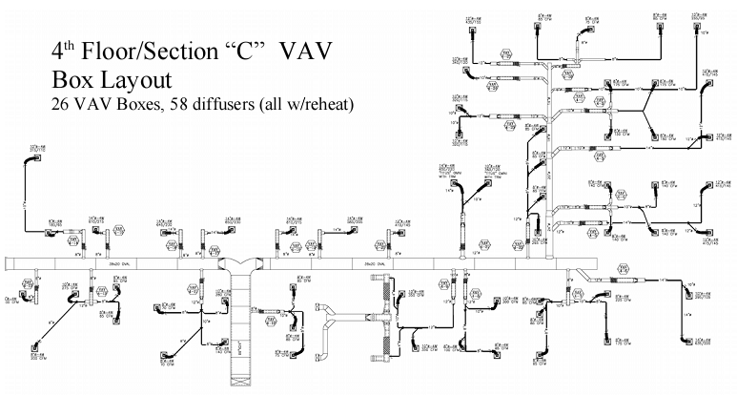
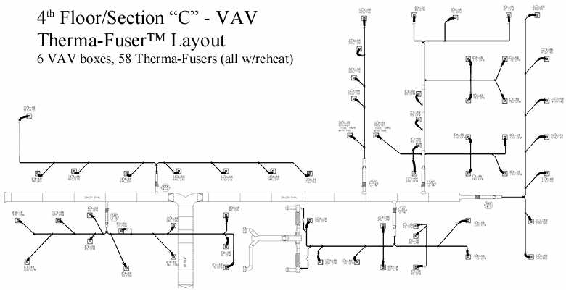
VAV Diffusers
Design Basics
Zoning – Heating and Cooling
Create larger zones of like usage and exposure and sub zone with VAV diffusers

Slide 70
VAV Diffusers
Design Basics
Sizing and Locating
Zoning
Pressure Control

Slide 71
VAV Diffusers
Design Basics
Pressure Control
Objectives:
Provide high enough static pressure
0.05”wg / 12Pa minimum
Limit the static pressure
0.25”wg / 62Pa max to limit noise
Pressure independence

Slide 72
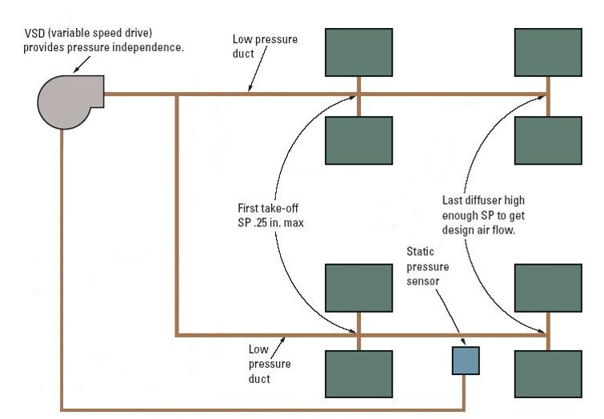
VAV Diffusers
Design Basics
Pressure Control
Methods:
Fan speed control

Slide 73
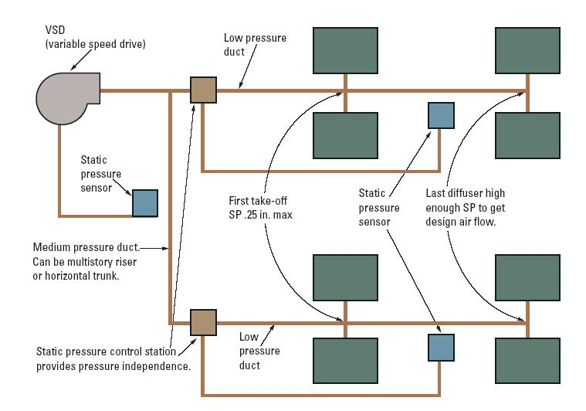
VAV Diffusers
Design Basics
Pressure Control
Methods:
Zone control plus
Fan speed control

Slide 74
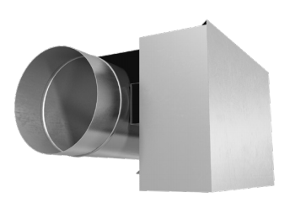
VAV Diffusers
Design Basics
Pressure Control
Methods:
Zone control plus
Fan speed control
Pressure Control
Valve (PCV)

Slide 75
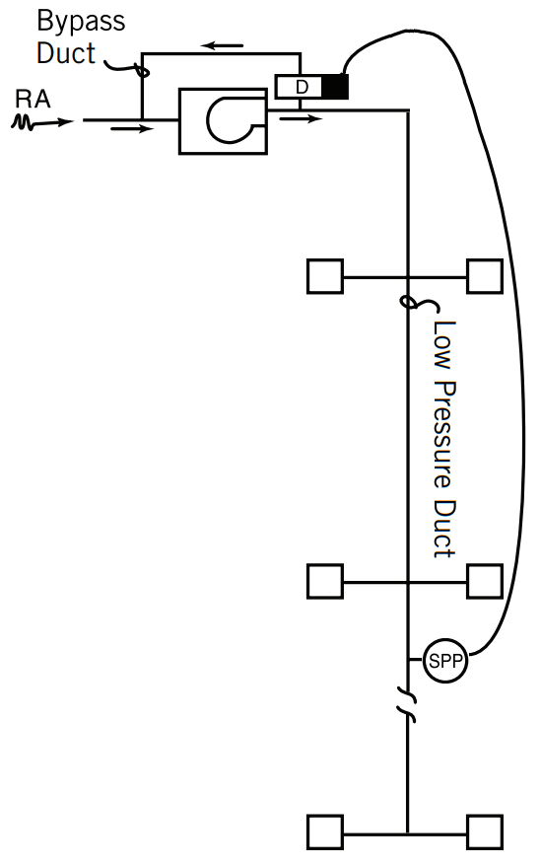
VAV Diffusers
Design Basics
Pressure Control
Methods:
Bypass
(Constant volume fan)
Pressure Control
Valve (PCV)

Slide 76
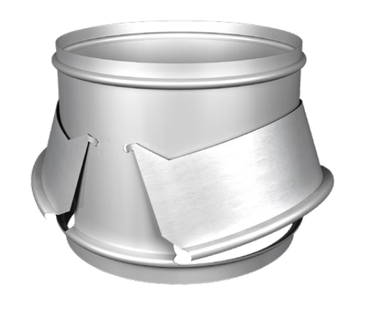
VAV Diffusers
Design Basics
Pressure Control
Methods:
Diffuser Bypass
(Constant volume fan)
Requires plenum return
Pressure Relief Collar (PRC)

Slide 77
VAV Diffusers
Design Basics
Sizing and Locating
Zoning
Pressure Control
Supply Air Temperature

Slide 78
VAV Diffusers
Design Basics
Supply Air Temperature
Objectives:
Provide consistent supply air temperature
Can reset supply air temperature
Limit the supply air temperature - Varitherm
Cooling 50˚F/10˚C to 68˚F/20˚C
Heating 80˚F/26.5˚C to as low as possible but not to exceed120˚F/49˚C
Provide changeover from cooling to heating

Slide 79
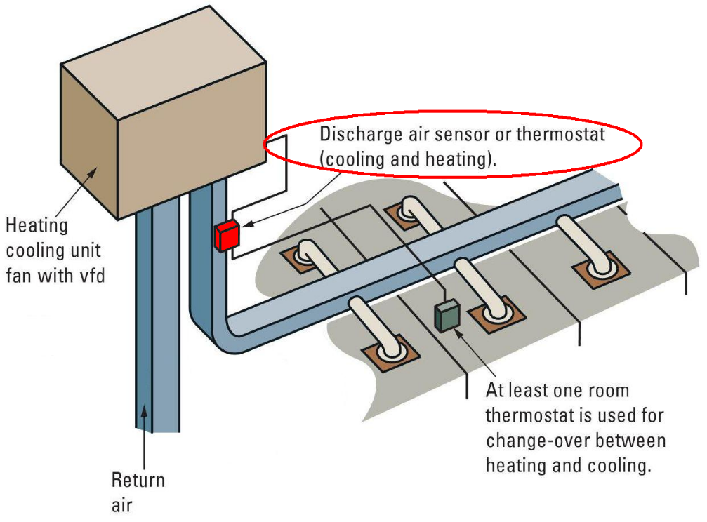
VAV Diffusers
Design Basics
Supply Air Temperature
Methods:
Consistent SAT
Limit SAT

Slide 80
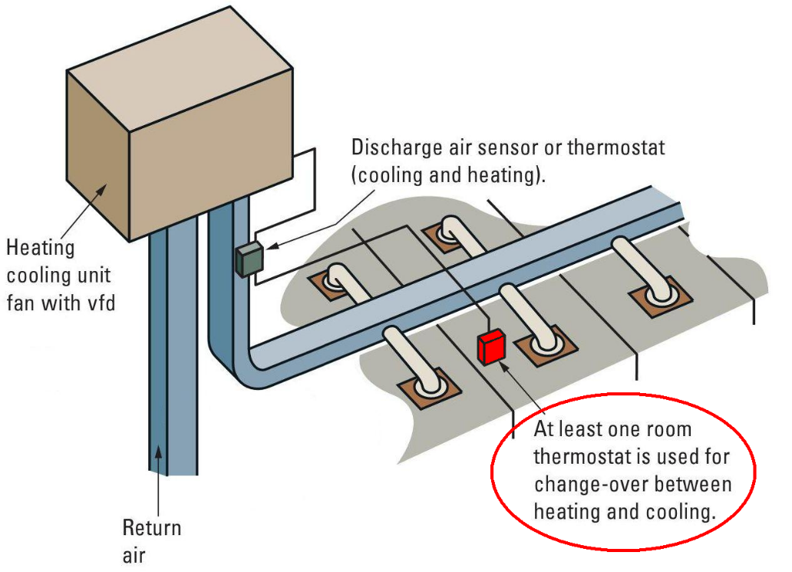
VAV Diffusers
Design Basics
Supply Air Temperature
Methods:
Changeover

Slide 81
Example Projects

Slide 82
VAV Diffusers
Example Projects
One or two small rooms part of a larger space
Pressure control
<30% by volume
VAV Diffuser
(VPD or PPD)
2022-0208-01 CA Oakmead

Slide 83
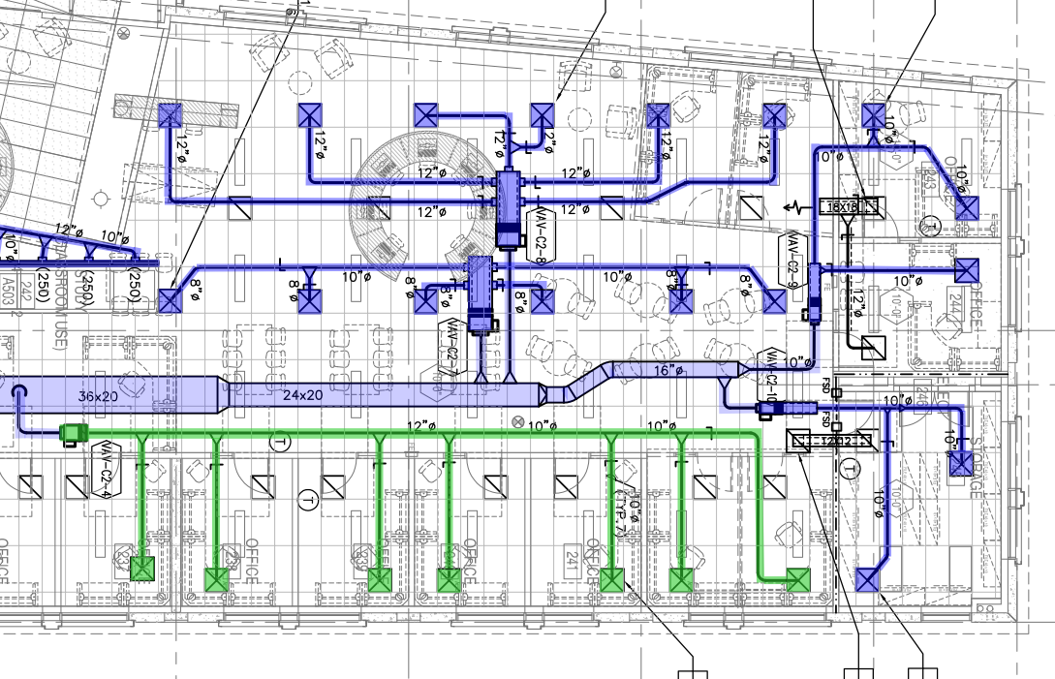
VAV Diffusers
Example Projects
Sub-zone similar spaces
Reheat System
Pressure control and Heat (PCV or SDV)
VAV Diffuser
(VPD or PPD)

Slide 84
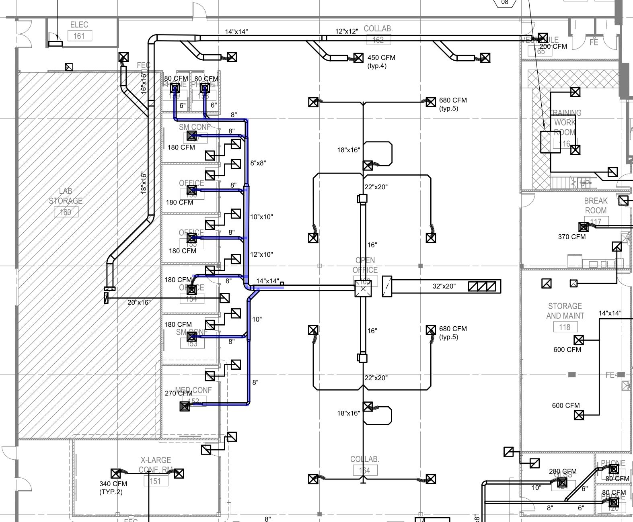
VAV Diffusers
Example Projects
Sub-zone similar spaces
Reheat System
Pressure control and Heat (PCV or SDV)
VAV Diffuser
(VPD or PPD)
2022-0208-01 CA Oakmead

Slide 85
VAV Diffusers
Example Projects
Unit dedicated to multiple small zones
RTU, HP, FCU, FPB, etc…
Fan speed
VAV Diffuser

Slide 86
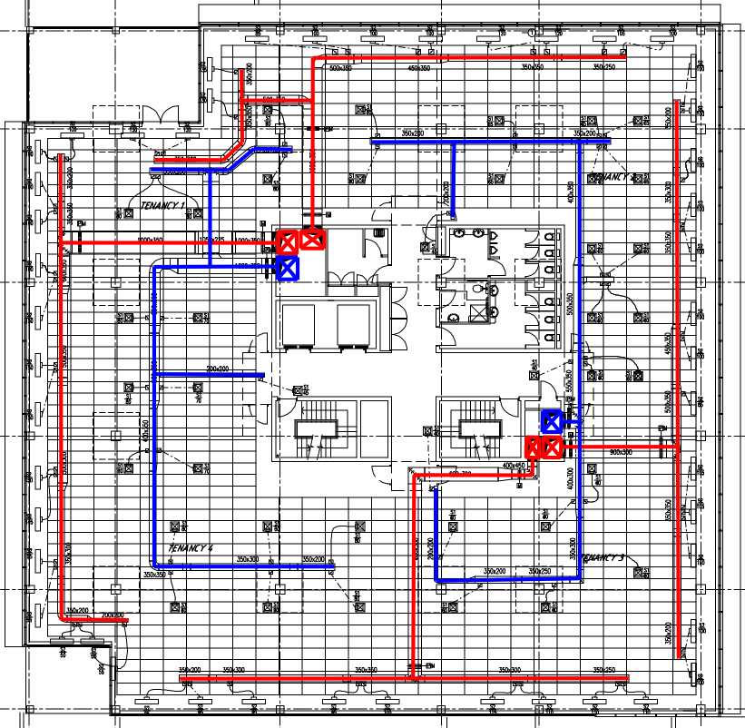
VAV Diffusers
Example Projects
Zoning by dedicated unit RTU/AHU
Pressure control and Heat (PCV or SDV)
VAV Diffuser
(VPD or PPD)

Slide 87
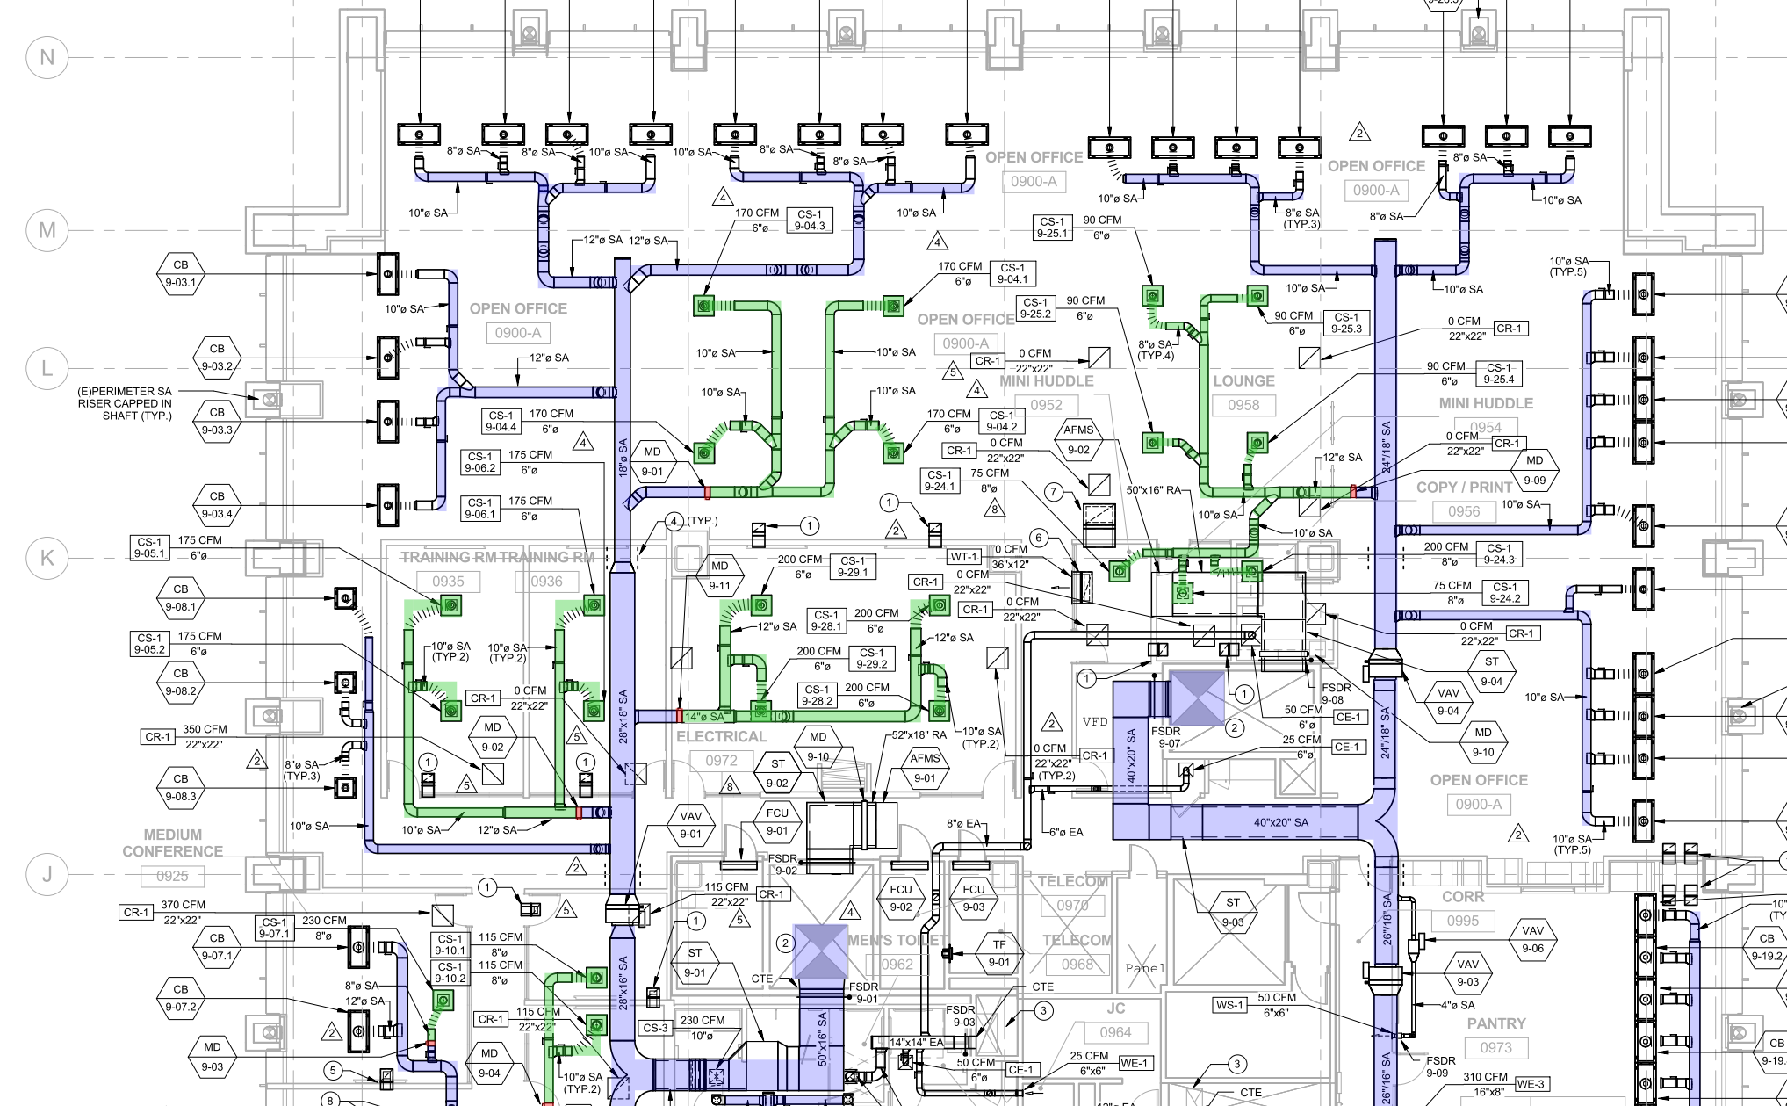
VAV Diffusers
Example Projects
Sub-zone sections of a building
Separate perimeter system
VAV Diffuser
(VPD or PPD)
Active Chilled
Beam (ACBL)
PG&E

Slide 88
VAV Diffusers
Example Projects
Sub-zone whole
building
Reheat system
VAV Diffuser
Digital PPD
VAV Diffuser
Mechanical VPD
Kaiser 1600 Owens

Slide 89
Product Summary

Slide 90
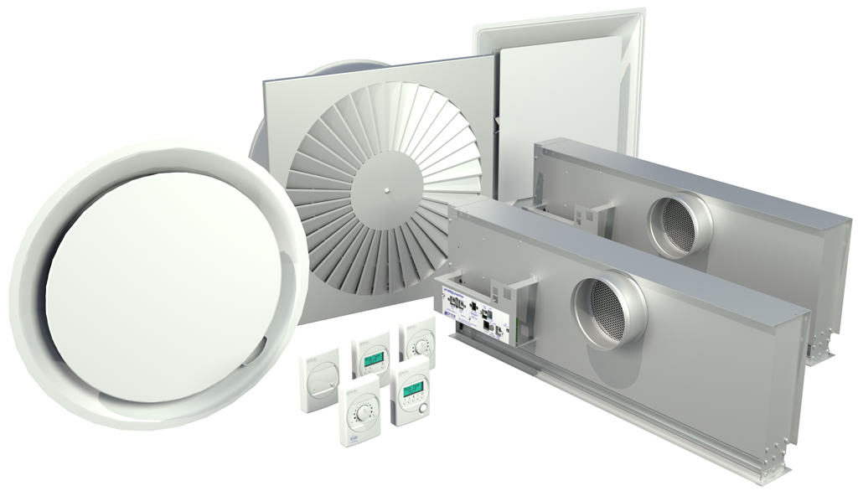
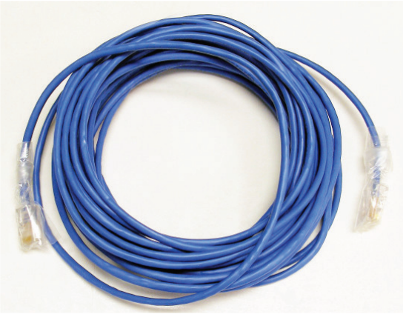
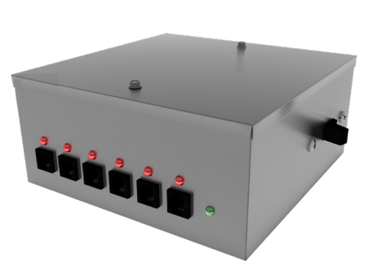

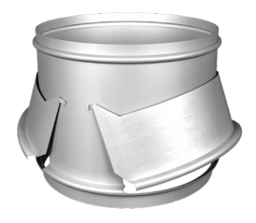
VAV Diffusers
Product Summary
PPM
VPD
Prodigy Series
PRTU
PRTU-WEB
PRC PCV

Slide 91
VAV Diffusers
Summary
Benefits

Slide 92
VAV Diffusers
Summary
Benefits
Comfort

Slide 93
VAV Diffusers
Summary
Benefits
Comfort
Individual Zones
Good room air mixing

Slide 94
VAV Diffusers
Summary
Benefits
Comfort
Individual Zones
Good room air mixing
Reliability

Slide 95
VAV Diffusers
Summary
Benefits
Comfort
Individual Zones
Good room air mixing
Reliability
Adaptable Design

Slide 96
VAV Diffusers
Summary
Benefits
Comfort
Individual Zones
Good room air mixing
Reliability
Adaptable Design
Energy Efficient Design

Slide 97
VAV Diffusers
Summary
System Design

Slide 98
VAV Diffusers
Summary
System Design
Pressure Control

Slide 99
VAV Diffusers
Summary
System Design
Pressure Control
Supply Air Temperature Control

Slide 100
VAV Diffusers
Summary
System Design
Pressure Control
Supply Air Temperature Control
Zoning

Slide 101
Questions?

