Slide 1
NC Selection Software (AIO)

Slide 2
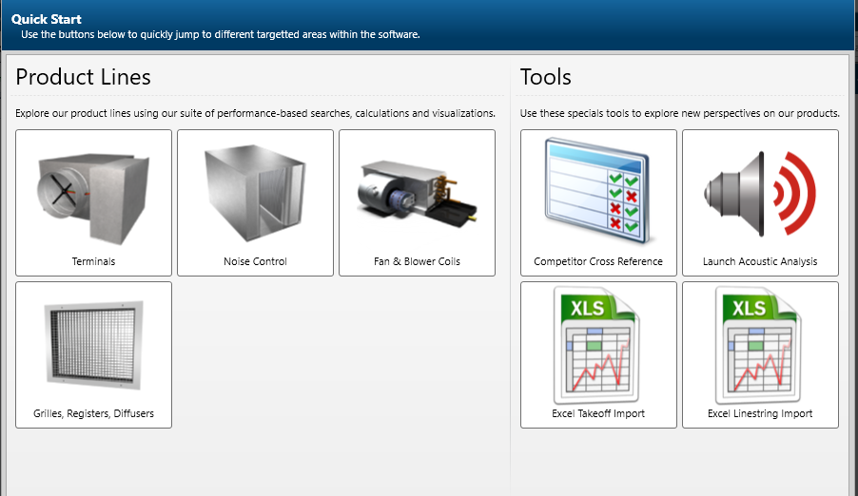
NC Selection Software (AIO)
Agenda
AIO Software Demo
Silencer Selection Summary
Silencer Selection Exercise
Factors Affecting Performance

Slide 3
AIO Software Demo

Slide 4
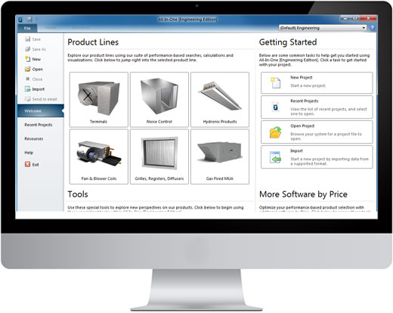
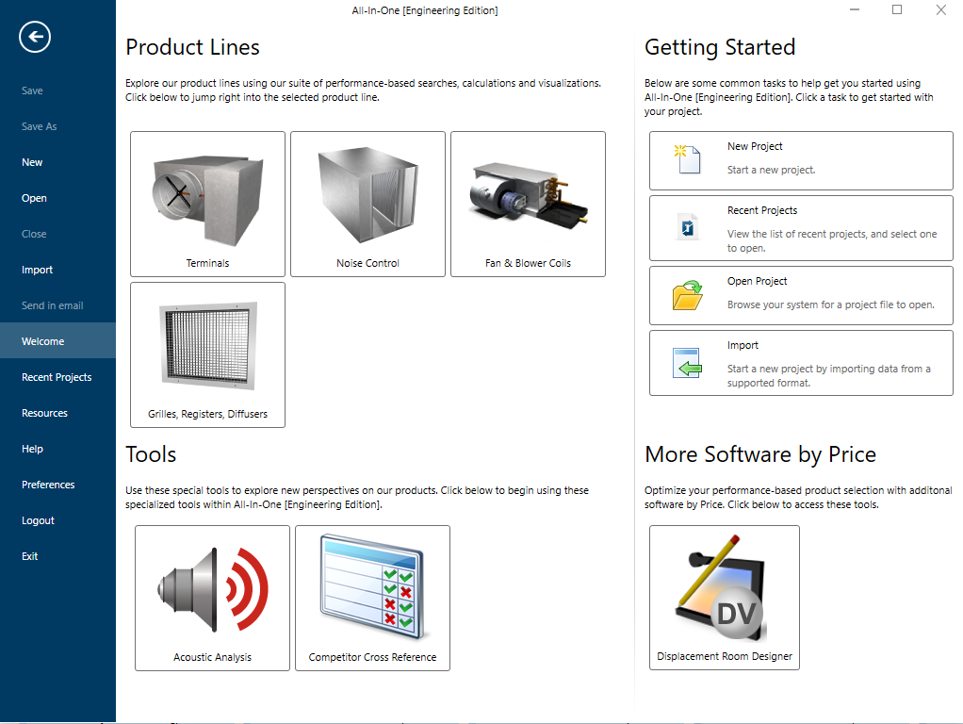
NC Selection Software
ALL-IN-ONE Software
AIO (All in one software)
Available for “Free” download at:
https://www.priceindustries.com/software/all-in-one/

Slide 5
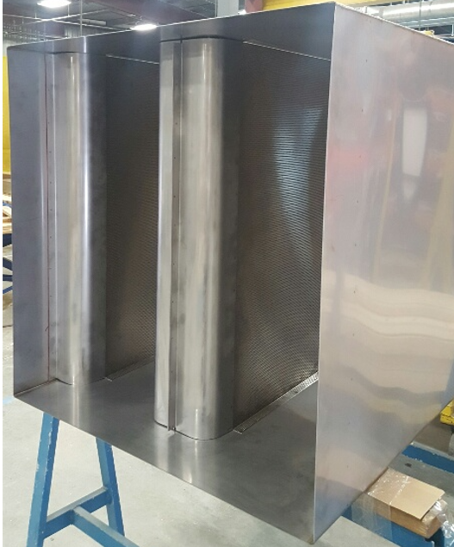
NC Selection Software
ALL-IN-ONE Software
Silencer Selection:
Powerful tool for selecting Noise Control Products:
Three(3) Search Types:
- Selection by Scheduled Performance
- Selection by Design Criteria
- Selection by Price Industries Model

Slide 6
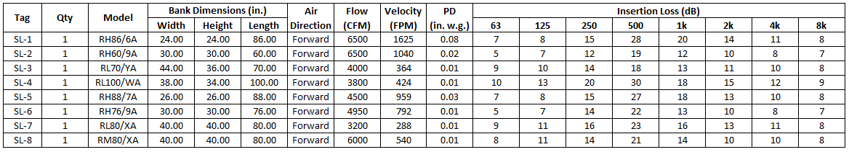
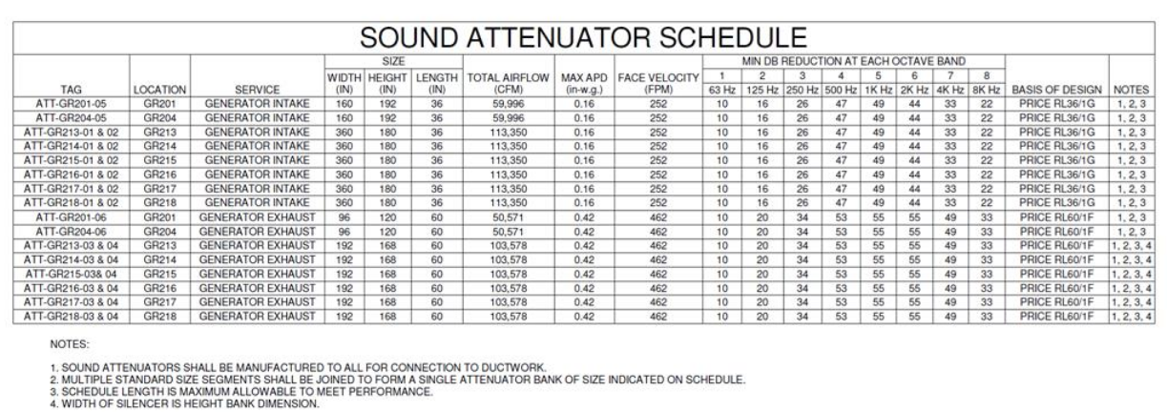
NC Selection Software
ALL-IN-ONE Software
Selections by scheduled performance

Slide 7
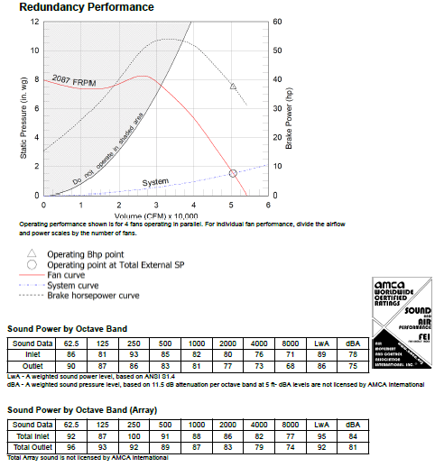
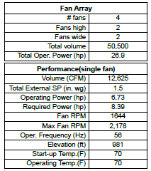
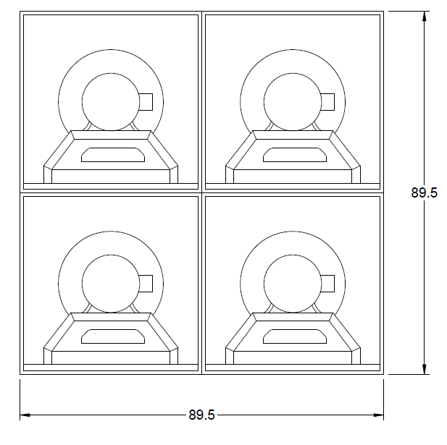
NC Selection Software
ALL-IN-ONE Software
Selection by design criteria

Slide 8
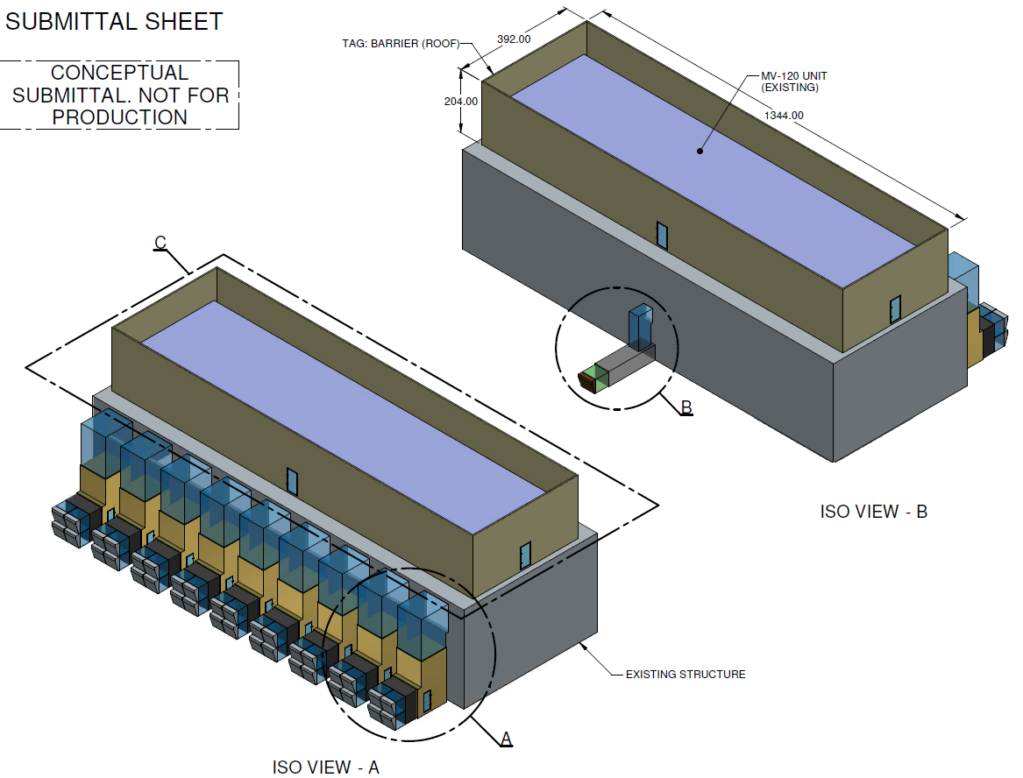
NC Selection Software
ALL-IN-ONE Software

Slide 9
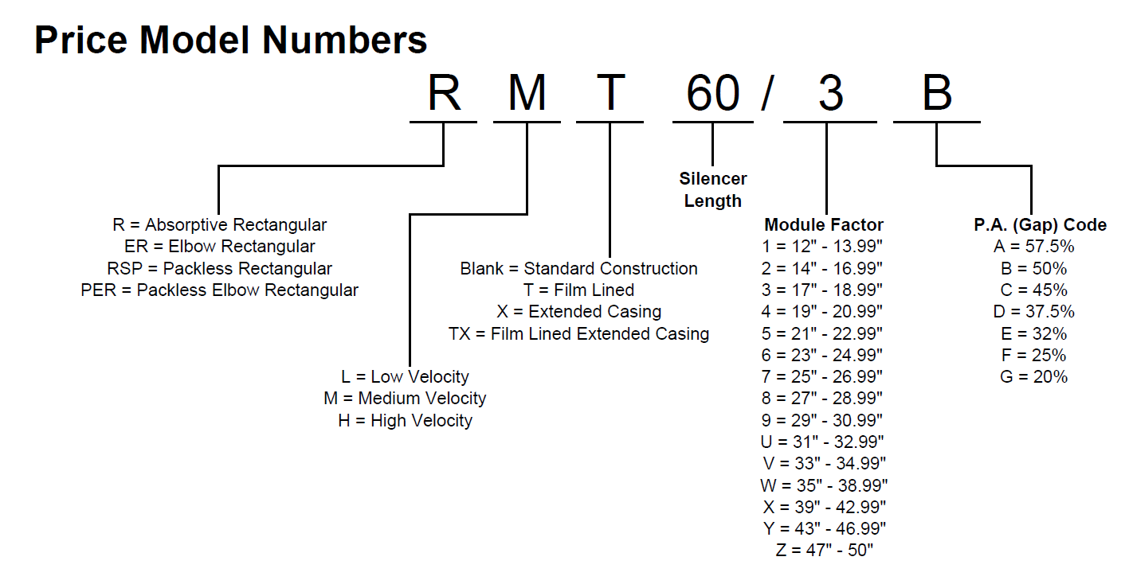
NC Selection Software
ALL-IN-ONE Software
By Model

Slide 10
Silencer Selection Summary

Slide 11
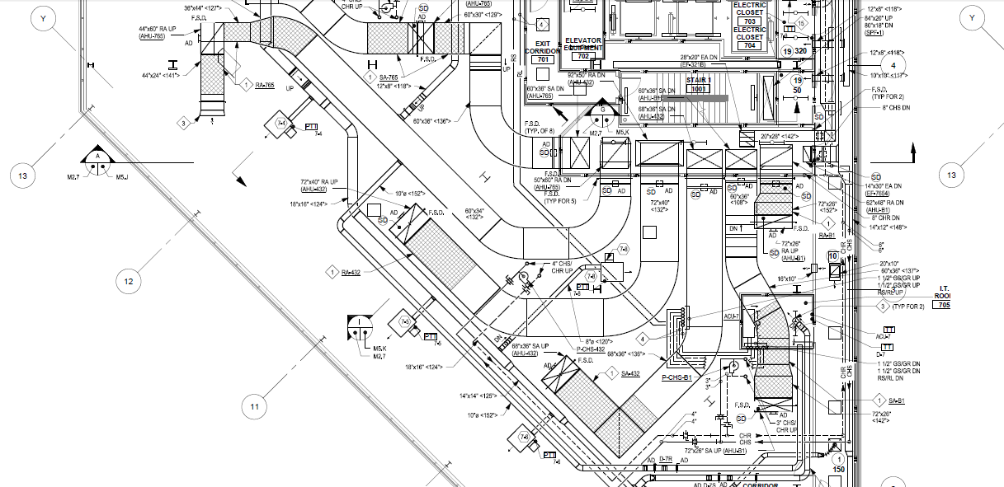
NC Selection Software
Silencer Selection Summary

Slide 12
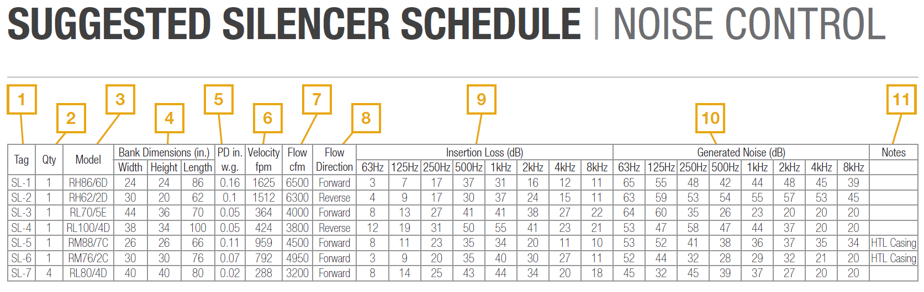
NC Selection Software
Silencer Selection Summary
Typical Silencer Schedule

Slide 13
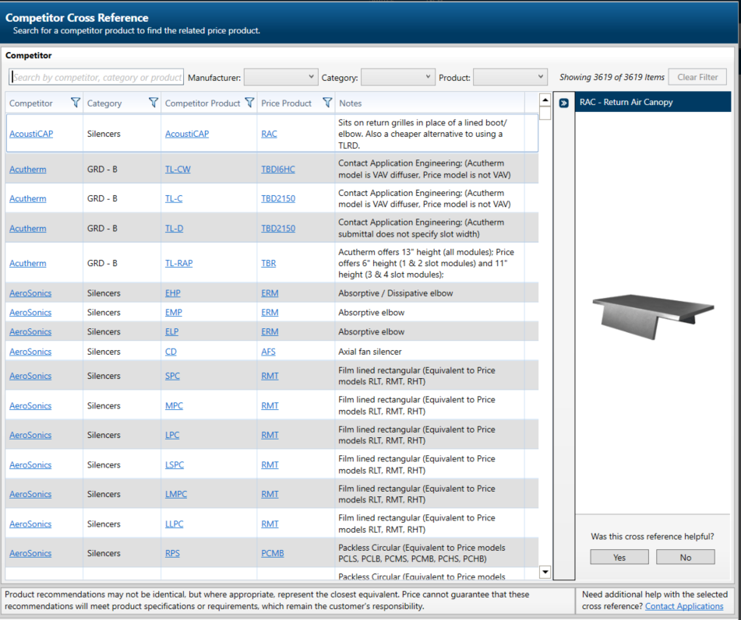
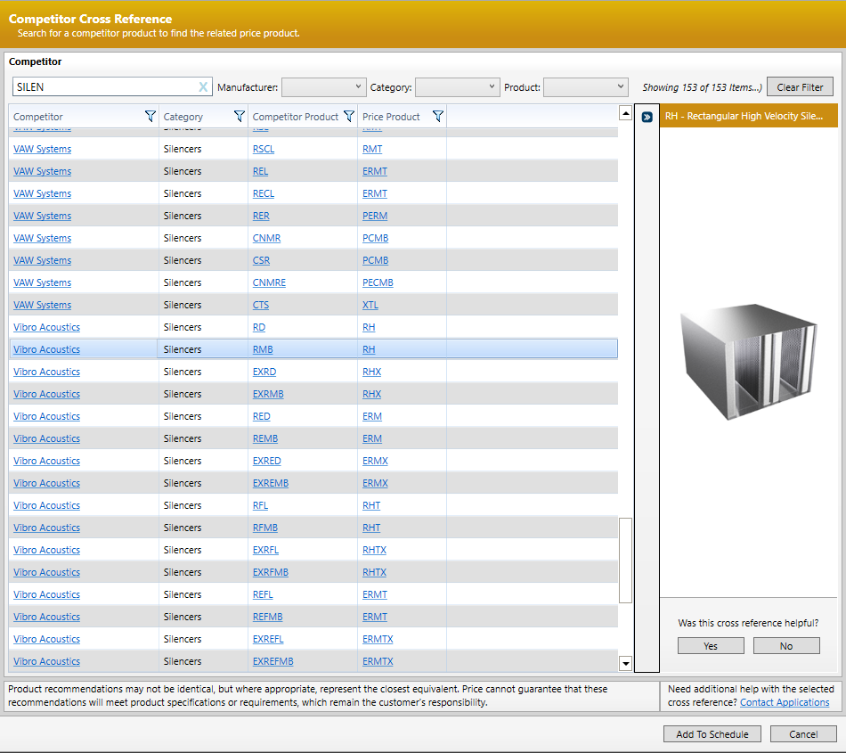
NC Selection Software
Silencer Selection Summary
Competitor Cross Reference

Slide 14
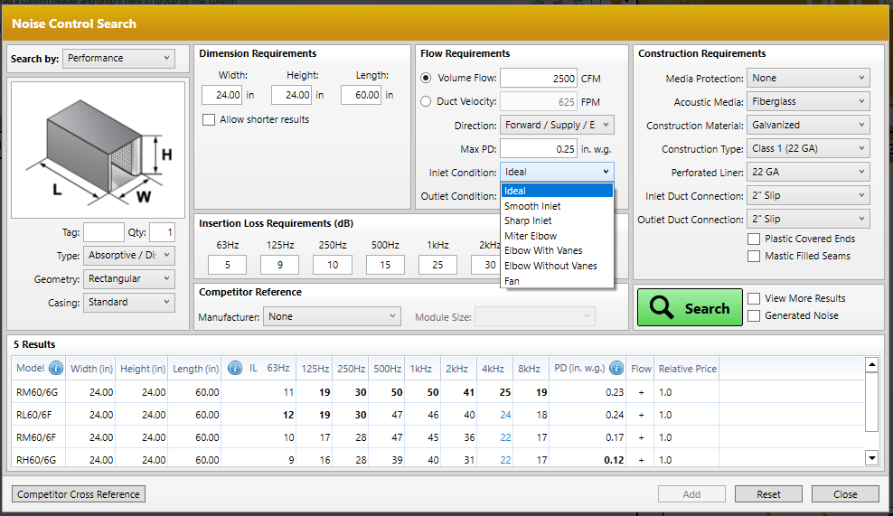
NC Selection Software
Silencer Selection Summary

Slide 15

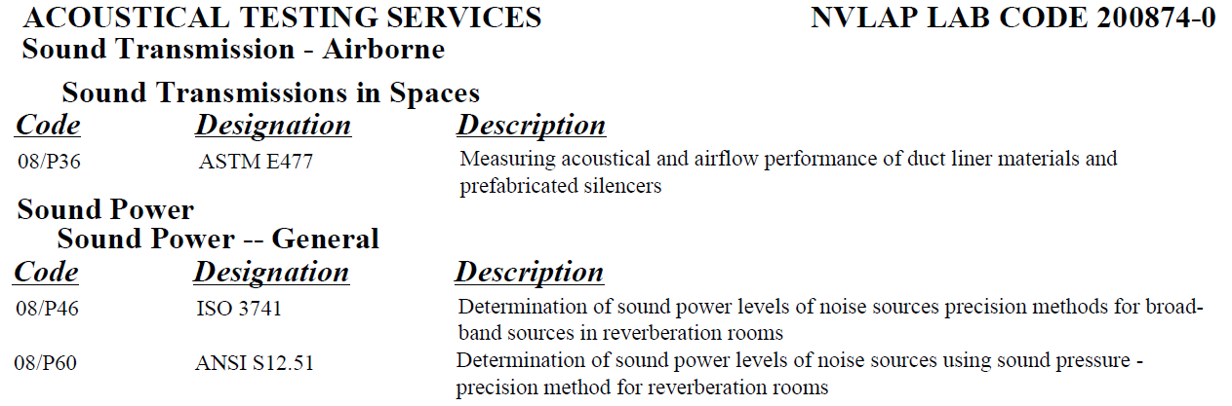
NC Selection Software
Silencer Selection Summary
Silencer models & options
Schedule creation
Submittal creation
Construction options
Tested Performance
Cross reference
System effects

Slide 16
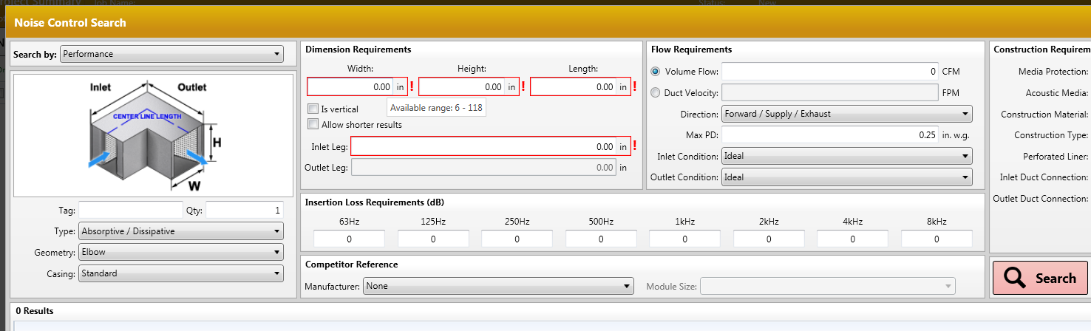
NC Selection Software
Silencer Selection Summary
Elbow leg length (non-equal)

Slide 17
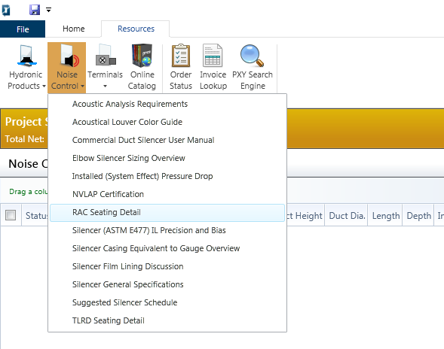
NC Selection Software
Silencer Selection Summary
Resources

Slide 18
NC Selection Software
Silencer Selection Summary
Silencer Selection:
Project Properties
Shape (Rectangular, Elbow, & Circular, Air Transfer Silencers)
Dimensions
Performance (Insertion Loss & Pressure Drop)
System Effects
Construction (Material, Gauge, Inlet/Outlet, etc.)
Search Results
Submittals/Schedules
Resources
Competitor Reference

Slide 19
Silencer Selection Exercise

Slide 20
NC Selection Software
Silencer Selection Ex.
Select the follow schedule in AIO:
Silencer Information |  |  |  | Duct System Information |  |  |  | Dynamic Insertion Loss (dB)
Tag | Width (in) | Height (in) | Length (in) | Air Flow | Flow (CFM) | Velocity (FPM) | PD (in. w.g.) | 63 | 125 | 250 | 500 | 1k | 2k | 4k | 8k | Notes | Casing Gauge
SA-1 | 12.00 | 12.00 | 36 | Forward | 1000 | 1000 | 0.25 | 5 | 8 | 15 | 30 | 35 | 30 | 23 | 17 | 1-4 | HTL1 CASING
RA-1 | 12.00 | 12.00 | 60 | Reverse | 1000 | 735 | 0.13 | 8 | 12 | 20 | 32 | 33 | 30 | 24 | 16 | 1-4 | HTL1 CASING
SA-2 | 20.00 | 20.00 | 36 | Forward | 1000 | 360 | 0.03 | 5 | 9 | 16 | 26 | 25 | 21 | 16 | 12 | 1-4 | HTL1 CASING
RA-2 | 24.00 | 24.00 | 120 | Reverse | 1000 | 360 | 0.10 | 23 | 24 | 48 | 55 | 55 | 55 | 55 | 46 | 1-4 | HTL1 CASING
Notes:
1. | RECTANGULAR STRAIGHT DISSIPATIVE SILENCER
2. | HTL EQUIVALENT TO 10Ga GALVANIZED STEEL CASING
3. | 22GA PERFORATED LINER
4. | FIBERGLASS ACOUSTIC MEDIA
Notes:
Printed copies for Reps to come up and do selections

Slide 21
Factors Affecting Performance

Slide 22
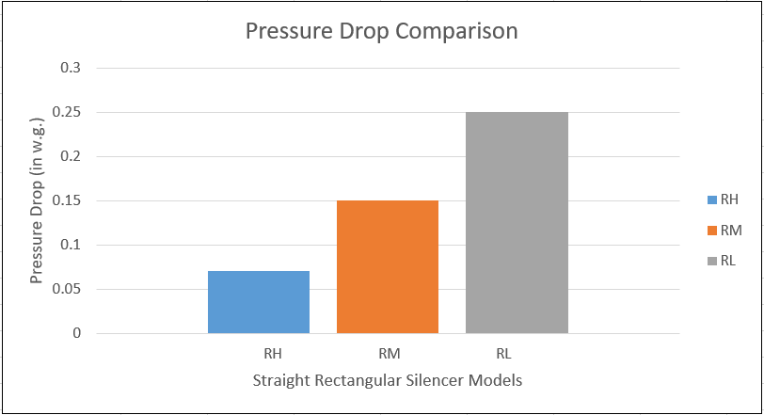
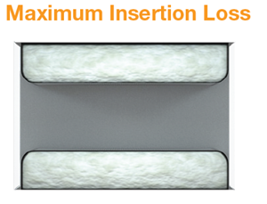
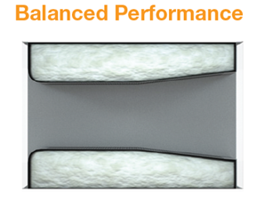
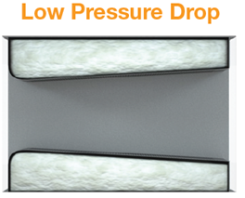
NC Selection Software
Factors Affecting Performance
Internal Silencer Geometry
Rectangular
Low velocity
Rectangular
Medium velocity
Rectangular
High velocity
*Based on a 12”Wx12”Hx36”L @ 1000FPM 1 Module D Gap
 | Insertion Loss (dB)
 | 63Hz | 125Hz | 250Hz | 500Hz | 1000Hz | 2000Hz | 4000Hz | 8000Hz
RL | 7 | 10 | 17 | 32 | 37 | 32 | 25 | 19
RM | 5 | 8 | 14 | 27 | 33 | 31 | 23 | 19
RH | 5 | 7 | 13 | 24 | 29 | 27 | 20 | 16
Notes:
Printed copies for Reps to come up and do selections

Slide 23
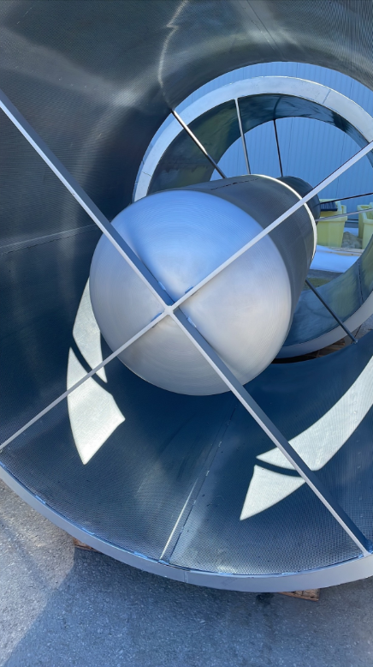
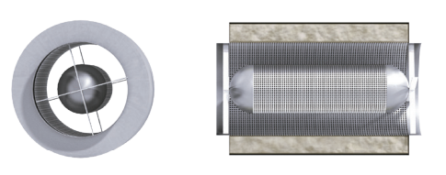
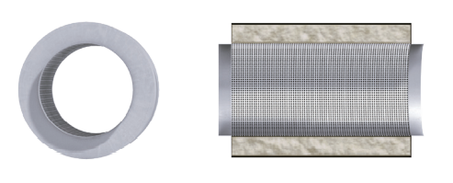
NC Selection Software
Factors Affecting Performance -Internal Geometry
Internal Silencer Geometry
CS – Circular Medium velocity
CS – Circular High velocity
These silencers do not have a center pod. This design minimizes pressure drop at high velocities while still providing high levels of insertion loss, up to 8000 fpm.
Best suited for applications with velocities ~ 4,000 fpm These silencers feature a center pod that increases acoustical performance.
Notes:
Internal geometry of the silencer. On this slide are the three main configurations available for our rectangular model. The first model, the RL, is our low velocity, or high velocity model, which has a nose in and nose out design. The RL is recommended for a velocity range up to 750 FPM. The second model is the RM, our medium velocity model, which as a nose in design with a slightly tapered tail. This design is recommended up to a velocity of 1750 FPM. And the third model, the RH high velocity or low pressure drop design has a nose in and a full tail along the length of the silencer. This model is recommended up to a velocity of 2500 FPM.

Slide 24
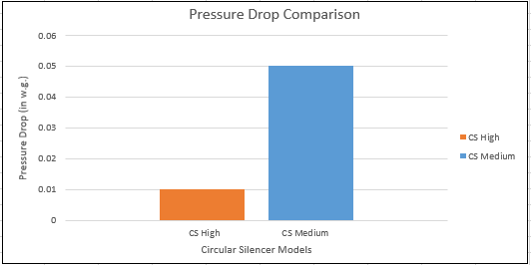
NC Selection Software
Factors Affecting Performance-Internal Geometry
Internal Silencer Geometry
Circular Medium velocity
Circular High velocity
*Based on a 14” Diameter 60”L @ 1000FPM
0.05
0.01
 | Insertion Loss (dB)
 | 63Hz | 125Hz | 250Hz | 500Hz | 1000Hz | 2000Hz | 4000Hz | 8000Hz
CS Med | 6 | 10 | 26 | 42 | 46 | 46 | 42 | 30
CS High | 5 | 8 | 22 | 39 | 40 | 25 | 17 | 18
Notes:
Internal geometry of the silencer. On this slide are the three main configurations available for our rectangular model. The first model, the RL, is our low velocity, or high velocity model, which has a nose in and nose out design. The RL is recommended for a velocity range up to 750 FPM. The second model is the RM, our medium velocity model, which as a nose in design with a slightly tapered tail. This design is recommended up to a velocity of 1750 FPM. And the third model, the RH high velocity or low pressure drop design has a nose in and a full tail along the length of the silencer. This model is recommended up to a velocity of 2500 FPM.

Slide 25
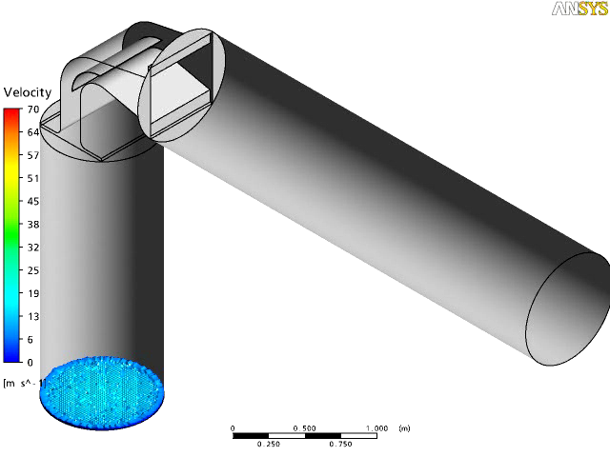
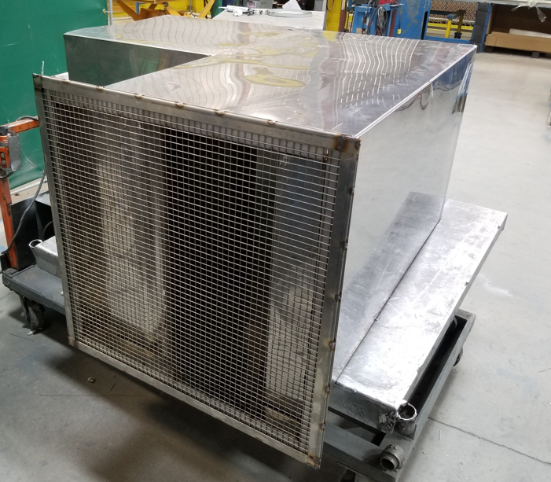
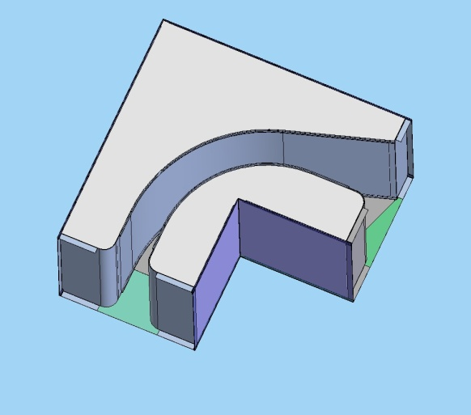
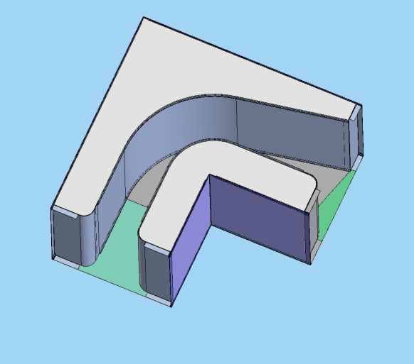
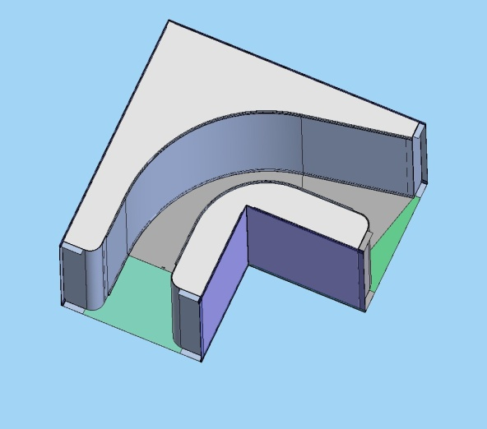
NC Selection Software
Factors Affecting Performance -Internal Geometry
Internal Silencer Geometry – (ERM)
-Price Industries has a modified tail design resulting in better pressure drop performance.
-Features variable turning ratios depending on internal free Area
Notes:
Internal geometry of the silencer. On this slide are the three main configurations available for our rectangular model. The first model, the RL, is our low velocity, or high velocity model, which has a nose in and nose out design. The RL is recommended for a velocity range up to 750 FPM. The second model is the RM, our medium velocity model, which as a nose in design with a slightly tapered tail. This design is recommended up to a velocity of 1750 FPM. And the third model, the RH high velocity or low pressure drop design has a nose in and a full tail along the length of the silencer. This model is recommended up to a velocity of 2500 FPM.

Slide 26
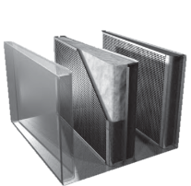
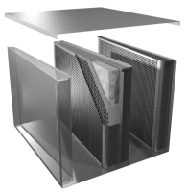
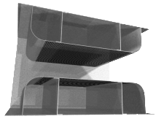
NC Selection Software
Factors Affecting Performance – Silencer Type
Silencer Media Type:
Absorptive/Dissipative
Film Lined
Packless/ Reactive
 | Insertion Loss (dB)
 | 63Hz | 125Hz | 250Hz | 500Hz | 1000Hz | 2000Hz | 4000Hz | 8000Hz | PD (in w.g.)
Absorptive | 5 | 6 | 11 | 21 | 26 | 24 | 18 | 15 | 0.05
Film Lined | 5 | 6 | 9 | 16 | 23 | 24 | 18 | 13 | 0.05
Pack-less | 3 | 3 | 5 | 12 | 13 | 8 | 7 | 6 | 0.1
*Based on a 12”Wx12”Hx36”L @ 1000FPM 1 Module C Gap
Notes:
The next letter A, acoustic media represents how different media types and liner options affect the performance of the silencer. The standard media type for absorptive silencers is glass fiber acoustic media. On the graph of insertion loss versus octave band, this is represented by the blue line. I should also mention, one of the silencer manufacturers does a really good job at promoting the natural fiber so it is an option that is available as well, even though we prefer to use glass fiber, hence the large disclaimers that appear on quotes and submittals. However, it is believed to perform the same as the standard glass fiber.
As you may have noticed, the pressure drop comparison is not represented on this graph as the acoustic media type does not affect the performance of a silencer.
Now, lets look at the green, pink and yellow lines on the graph. The green line represents fiberglass cloth, which is used to protect the acoustic media from erosion at high velocities. We say that fiberglass cloth is acoustically transparent, so this means that it does not affect the performance of the silencer, as you can see the green line and the blue line have the same insertion loss performance.
Tedlar film liner, which provides further protection to the acoustic media however is not acoustically transparent. Adding this option does degrade the performance of the silencer, buy up to 40% in some octave bands. As you can see from the graph, the yellow line, which represents Tedlar liner, has the lowest insertion loss. We add acoustic standoff to the Tedlar so that it does not plug the holes of the perforated liner, as you can see by the pink line, this does bring up the insertion loss.

Slide 27
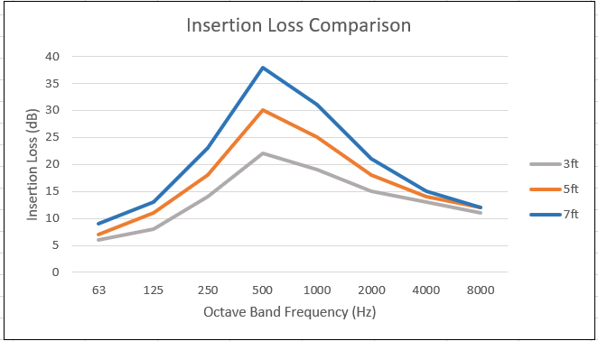
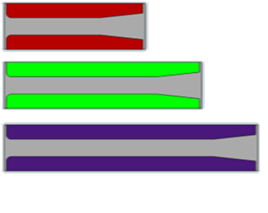
NC Selection Software
Factors Affecting Performance – Silencer Length
Silencer Standard Lengths
Minimum Length = 24” (2’)
Maximum Length = 120” (10’)
3ft
PD = 0.06 in w.g.
5ft
PD = 0.07 in w.g.
7ft
PD = 0.08 in w.g.
*Based on a 24”Wx24”H @ 1000FPM 1 Module D Gap

Slide 28
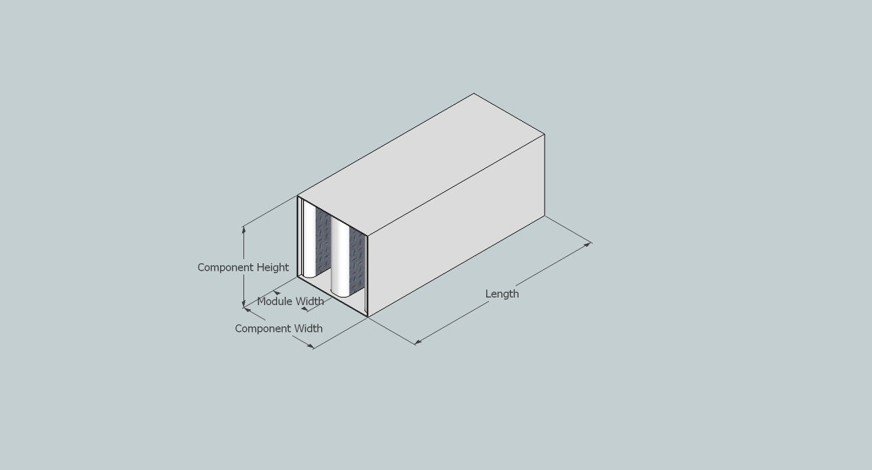
NC Selection Software
Factors Affecting Performance – Silencer Module
Silencer Component “Standard” Size Limits
Component Size Limits:
Width: Maximum 48”
Height: Maximum 48”
Notes:
The first letter F for Free Area is denoted by a P.A. Code, or pressure attenuation code. For most silencer models the available pressure codes range from A through to G, where A represents highest free area, or largest air gap through the silencer, and G represents the lowest free area and therefore the tightest air gap.

Slide 29
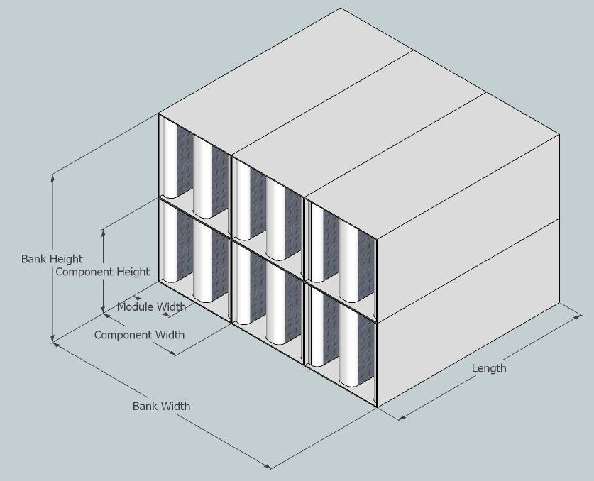
NC Selection Software
Factors Affecting Performance – Silencer Module
Silencer Bank Size Limits
Bank Size Limits:
Width: Maximum 450”
Height: Maximum 450”
Larger sizes can be selected by using multiple banks, For example:
Qty-1, 500”W @ 1500 fpm =
QTY-2, 250”W @ 750fpm
Notes:
The first letter F for Free Area is denoted by a P.A. Code, or pressure attenuation code. For most silencer models the available pressure codes range from A through to G, where A represents highest free area, or largest air gap through the silencer, and G represents the lowest free area and therefore the tightest air gap.

Slide 30
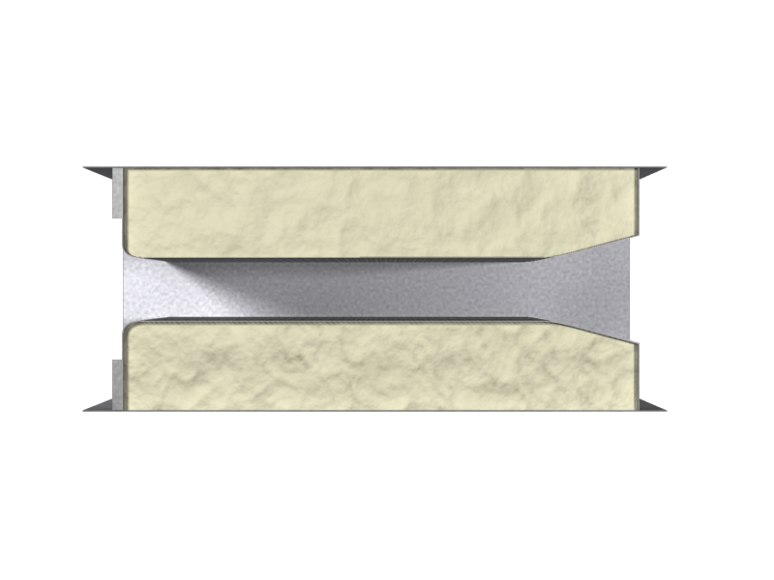
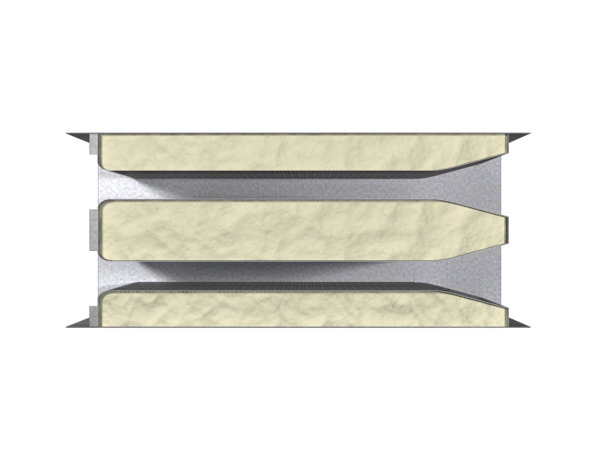
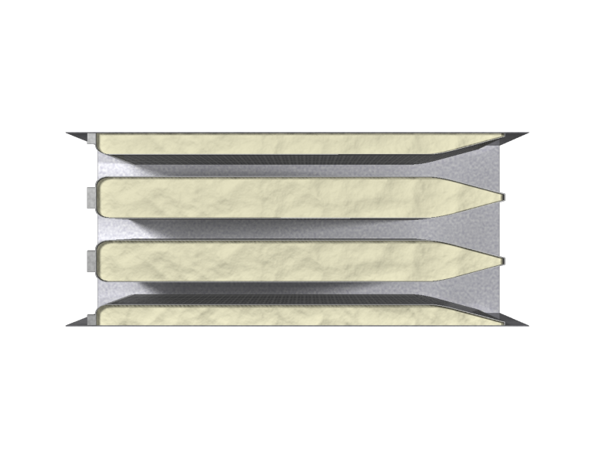
NC Selection Software
Factors Affecting Performance – Silencer Module
Number of Modules Example – 36” Wide x 48” High
1 Module
Module Width =36”
W=35”-38”
2 Module
Module Width =18”
3=17”-19”
3 Module
Module Width =12”
1=12”-14”
Notes:
The first letter F for Free Area is denoted by a P.A. Code, or pressure attenuation code. For most silencer models the available pressure codes range from A through to G, where A represents highest free area, or largest air gap through the silencer, and G represents the lowest free area and therefore the tightest air gap.

Slide 31
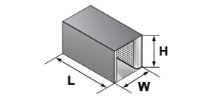
NC Selection Software
Factors Affecting Performance – Silencer Module
Number of Modules – 36” Wide x 48” High
1 Module
Module Width =36”
W=35”-38”
2 Module
Module Width =18”
3=17”-19”
3 Module
Module Width =12”
1=12”-14”
 | Insertion Loss (dB)
 | 63Hz | 125Hz | 250Hz | 500Hz | 1000Hz | 2000Hz | 4000Hz | 8000Hz | PD (in w.g.)
1 Module | 7 | 10 | 14 | 19 | 15 | 11 | 10 | 8 | 0.11
2 Module | 5 | 9 | 14 | 24 | 26 | 21 | 18 | 14 | 0.14
3 Module | 5 | 8 | 14 | 27 | 33 | 31 | 23 | 19 | 0.16
*Based on a model RM 36”Wx48”Hx36”L @ 1000FPM D Gap
Notes:
The first letter F for Free Area is denoted by a P.A. Code, or pressure attenuation code. For most silencer models the available pressure codes range from A through to G, where A represents highest free area, or largest air gap through the silencer, and G represents the lowest free area and therefore the tightest air gap.

Slide 32
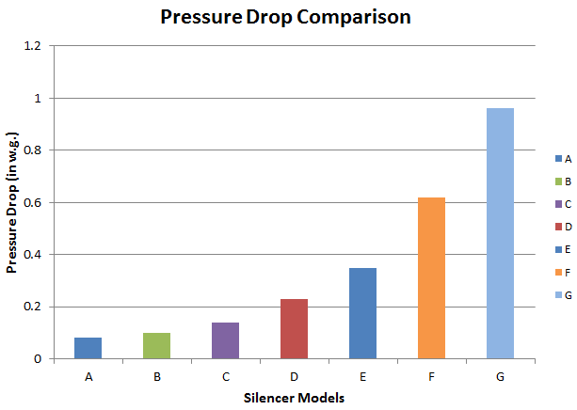
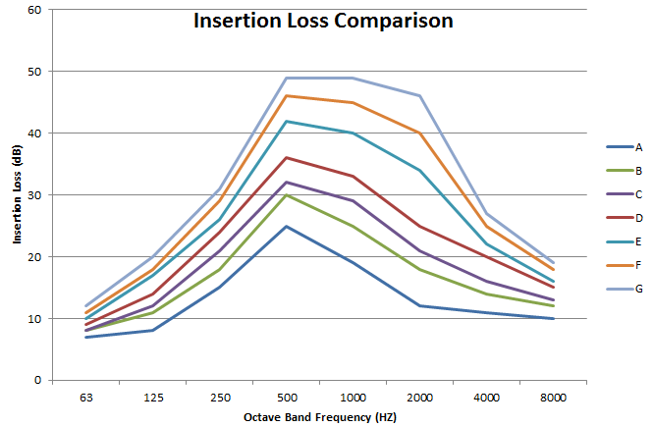
NC Selection Software
Factors Affecting Performance – Silencer Gap Code
PA codes range from 60-20% corresponding from A to G
Notes:
The first letter F for Free Area is denoted by a P.A. Code, or pressure attenuation code. For most silencer models the available pressure codes range from A through to G, where A represents highest free area, or largest air gap through the silencer, and G represents the lowest free area and therefore the tightest air gap.

Slide 33
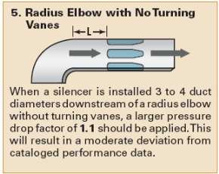
NC Selection Software
Factors Affecting Performance
System Effect
Accounts for added pressure drop due to less than ideal inlet and outlet conditions
System Effect factors are available from:
AMCA Fans & Systems
SMACNA HVAC Systems Duct Design
ASHRAE Applications Handbook
Price Engineering Guide
Notes:
System Effect is defined as the negative impact on performance that results when a unit is connected to a duct system. What this means is that the installed performance can deviate from the tested lab performance. Lab conditions are considered ideal to provide a fair comparison between products, however the actual installed conditions are usually somewhat less than ideal due to various constraints often beyond the control of the designer. (space, cost, legacy systems etc)
Therefore when the installed conditions deviate significantly from the tested lab conditions one needs to consider how the silencer will perform when installed versus the catalog performance. The catalog performance is based on the current silencer ASTM E477 testing standard which requires at least 5 equivalent duct diameters upstream, and at least 10 equivalent duct diameters downstream. These conditions seldom exist in the real world.
How do we account for system effect? There are several sources that you can draw upon. AMCA, SMACNA, ASHRAE Applications handbook, and the pages 15-17 of the Price Engineering guide (which you have in front of you)
System Effect is Velocity dependant and accounts for added pressure drop due to less than ideal duct conditions.
System Effect is important when installed conditions of a silencer deviate significantly from the laboratory testing conditions
System Effect Factors are available from:
AMCA Fans and Systems
SMACNA HVAC Systems Duct Design
ASHRAE Applications Handbook
Price Engineering Guide

Slide 34
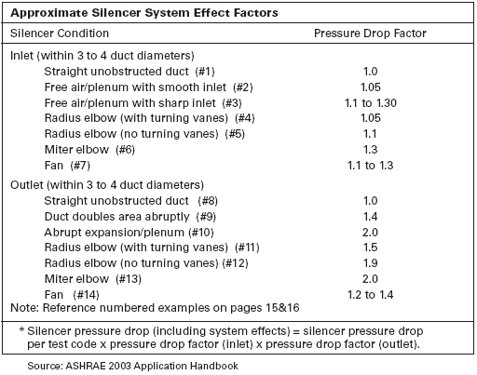
NC Selection Software
Factors Affecting Performance
System Effect
Pd_{system effect} = Pd_{catalog} x Factor_{inlet} x Factor_{outlet}
Notes:
Here is a table of the Silencer system effect factors as shown in the Price Silencer Engineering Guide. As you can see we need to take into consideration the inlet and outlet conditions for the silencer in order to adequately account for system effect. So lets start with a simple example to illustrate the concept with some actual numbers.

Slide 35
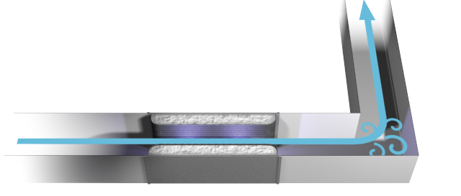
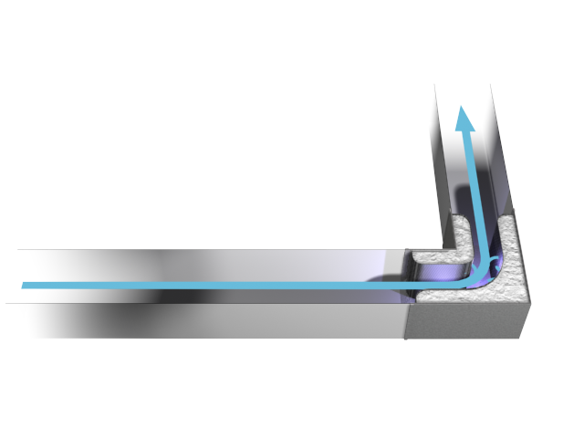
NC Selection Software
Factors Affecting Performance
System Effect
50% Free Area
~ 3000 FPM
Duct Design at 1500 FPM
Silencer PD = 0.25 “ w.g.
PD System Effect = 0.50 “ w.g.
Silencer PD = 0.25 “ w.g.

Slide 36
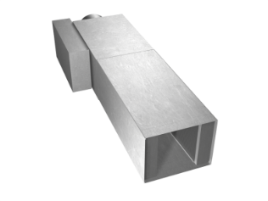



NC Selection Software
Factors Affecting Performance
System Effect
Specify silencers designed to be close coupled
AHRI Certified quiet terminal units
Single Duct Supply
Fan Powered Terminal
Venturi Valves

Slide 37
Questions?

