Slide 1
Noise Control Products & Solutions

Slide 2
Copyright Materials
Noise Control
This presentation is protected by U.S. and international copyright laws. Reproduction, distribution, display and use of this presentation without written permission of the speaker is prohibited. ® Price Industries, Incorporated 2020

Slide 3


Noise Control
Presenter
Mauricio Salinas P.Eng.
Application Engineering Manager, Noise Control
Oversees the noise application engineering team focusing in noise control solutions, and product development
10+ Years of Experience in HVAC Industry
Primarily focused on commercial building HVAC acoustics

Slide 4
Noise Control
Agenda
Sound Laboratory – 5 minutes
Product Overview – 15 minutes
Acoustic Analysis – 10 minutes
Noise Control Solutions – 10 minutes

Slide 5
Noise Control Laboratory

Slide 6
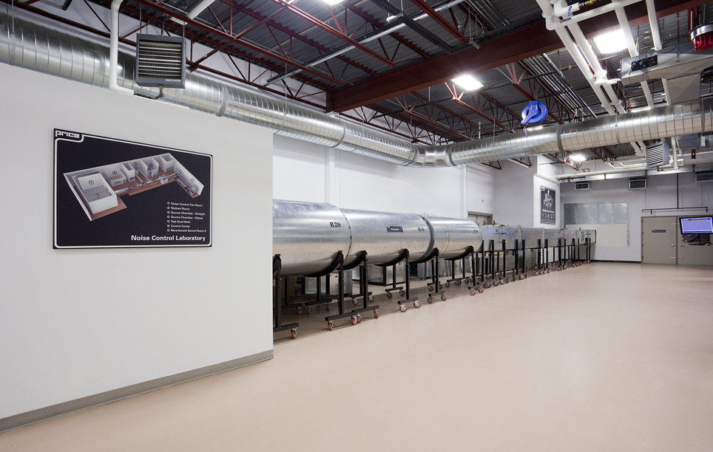
Noise Control
Noise Control Laboratory
Notes:
The Noise Control Laboratory is a state-of-the-art acoustical test facility.
From ground breaking through commissioning, great care was taken to ensure that the noise data produced by the lab would be accurate, repeatable, and the most reliable in the industry.
At peak capacity, the lab is capable of testing over 30 silencers a week. This high testing output has enabled Price to develop the most thoroughly tested product line in the industry.
All components of the lab have been designed to meet or exceed both current and future versions of ASTM E477 Standard for testing acoustical duct silencers.
The solid concrete Sound Source Chambers can generate over 100 decibels (dB) of sound pressure which allows us to attain accurate insertion loss measurements for long silencers.
This gives us the flexibility to test a wide range of products including fan systems, air handling units, and silencers.
The Control Center houses the heart of the operation; a data acquisition system, frequency analyzer, and sound generator that leave nothing to chance.
The Test Duct Work employed in the system had to be designed to minimize sound break-out and break-in of the high test signals produced by the Source Chambers. Multiple layers of sheet metal, drywall mass, and insulation were employed to keep the sound power levels in the general lab area below 70 dB.
The Fan Room consists of a vane axial fan that can produce over 25,000 CFM at 4 in. of static pressure. To ensure that quiet acoustically treated air is used for silencer testing, a range of different noise control solutions are employed including axial fan silencers (AFS), rectangular silencers (RL), acoustical plenums, and custom elbow plenums. Two airflow measuring stations are used to obtain accurate airflow and pressure drop data.
As a part of Price’s ongoing commitment to quality and innovation, the laboratory is accredited by NIST’s National Voluntary Laboratory Accreditation Program (NVLAP) for testing in accordance with ASTM E477. The NVLAP accreditation audits the lab management systems and technical capabilities and ensures that systems are in place to guarantee the best data possible.

Slide 7
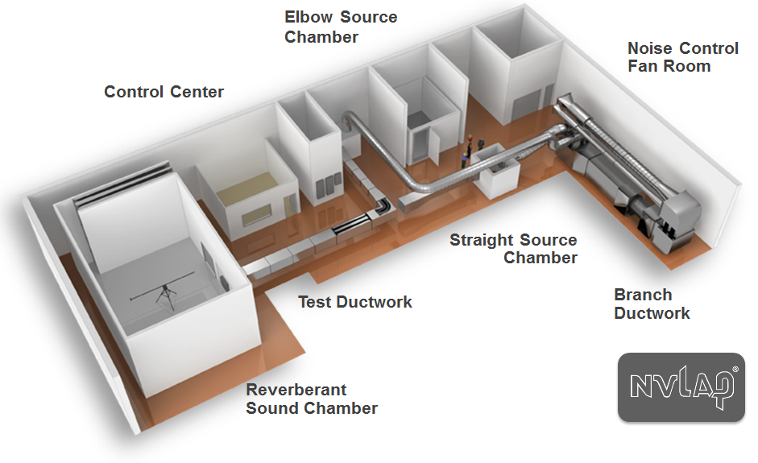

Noise Control
Noise Control Laboratory

Slide 8
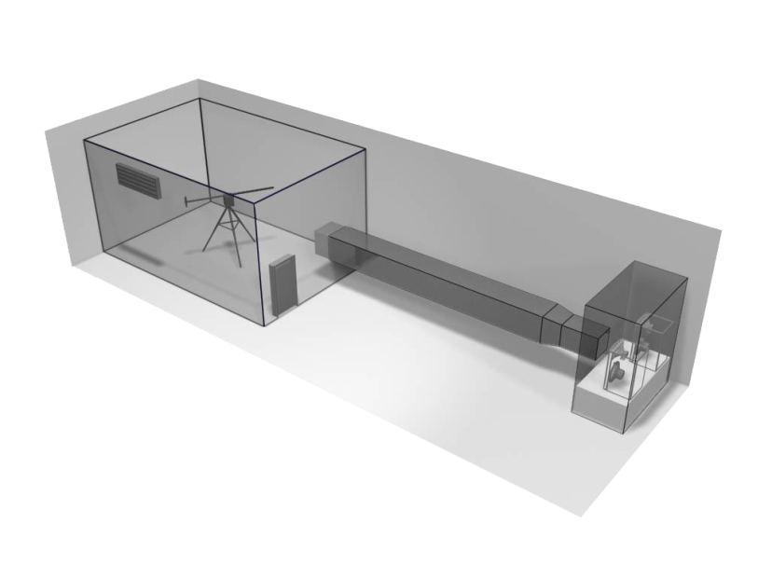

Noise Control
Test Method – ASTM-E477-20
Ductwork
Sound Source
Reverberant Room
Notes:
Witness tests
Lab visits
Tech center visits
Lab accreditations

Slide 9

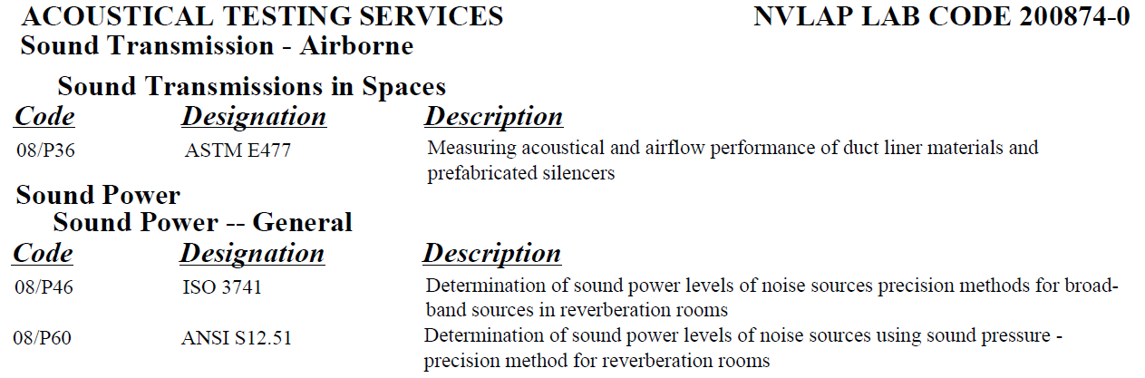
Noise Control
Noise Control Laboratory
NVLAP Accreditation
Certifies laboratory is technically qualified and competent to carry out specific tests

Slide 10
Product Overview

Slide 11
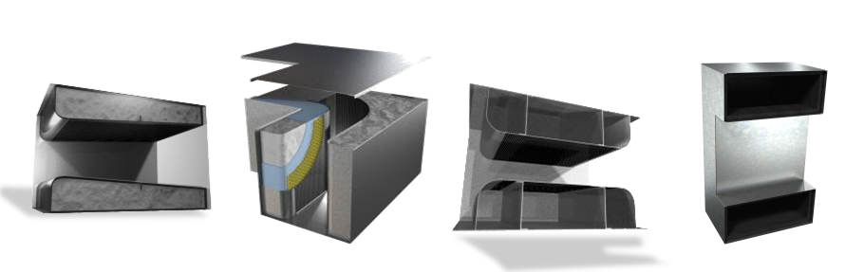
Noise Control
Product Categories
Absorptive | Film Lined | Packless | Air Transfer
Notes:
The second most common silencer is the elbow type silencer. These are typically used where there is not enough space for a standard rectangular silencer, such as in short runs of duct. However the elbow silencer generally has higher pressure drop than the rectangular silencer, but has an increase in the high band performance.

Slide 12
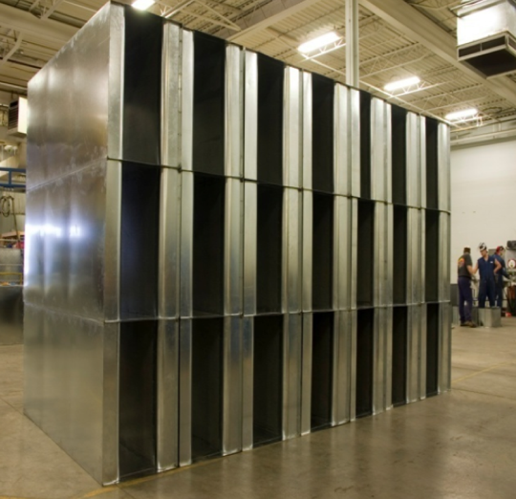
Noise Control
Product Categories
Rectangular Silencers
Most common type of silencer
Lowest cost
Breakout noise reduced using heavier gauge casing
Notes:
Typical insulation good for up to 250F … optional insulation up to 1000F

Slide 13
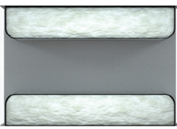
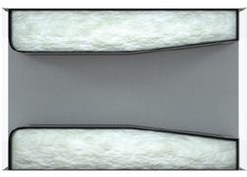
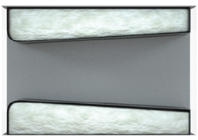
Noise Control
Product Categories
Internal Silencer Geometry
RL - Rectangular
Low velocity
RM - Rectangular
Medium velocity
RH - Rectangular
High velocity
Ideal for applications that require very high insertion loss.
The sloped tail provides an optimal balance between insertion loss & pressure drop.
Minimizes pressure drop for applications with high air velocities or poor outlet conditions.

Slide 14
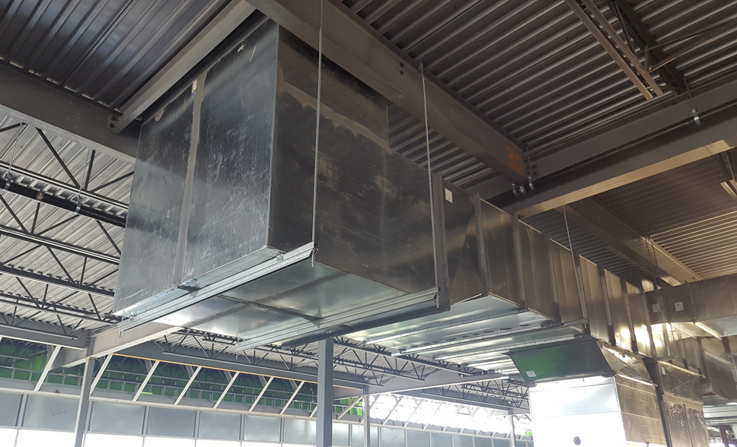
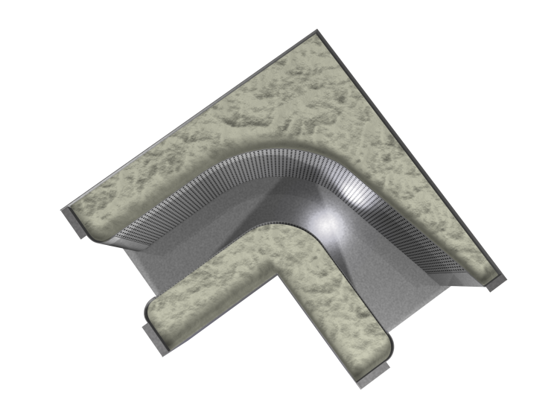
Noise Control
Product Categories
Elbow Silencers
Where standard rectangular silencers will not fit
Generated noise should be considered
Recommended velocity below 1500 fpm (can work at higher fpm, special attention to gauge and location)

Slide 15
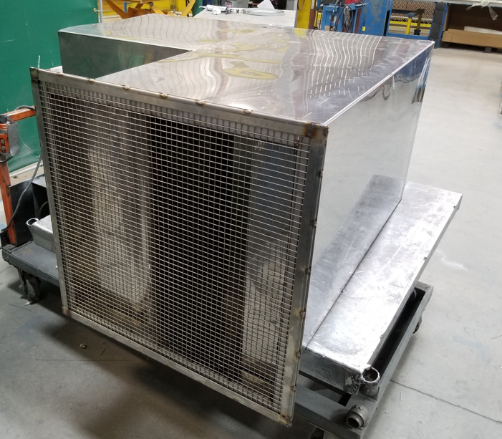
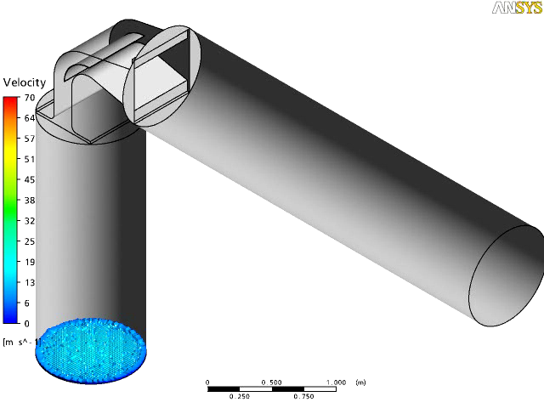
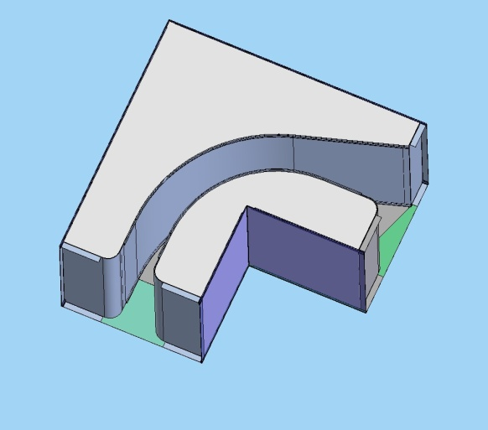
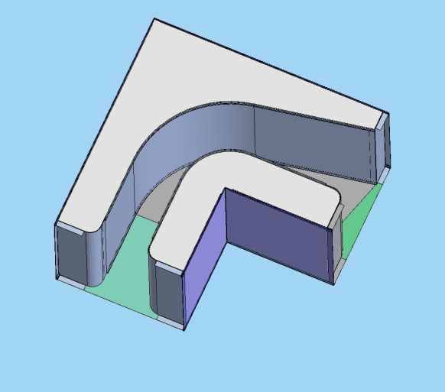
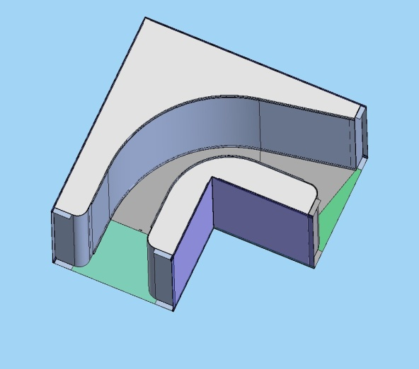
Noise Control
Product Categories
Internal Silencer Geometry – (ERM)
-Price Industries has a modified tail design resulting in better pressure drop performance.
-Only manufacturer featuring variable turning ratios depending on internal free Area
Notes:
Internal geometry of the silencer. On this slide are the three main configurations available for our rectangular model. The first model, the RL, is our low velocity, or high velocity model, which has a nose in and nose out design. The RL is recommended for a velocity range up to 750 FPM. The second model is the RM, our medium velocity model, which as a nose in design with a slightly tapered tail. This design is recommended up to a velocity of 1750 FPM. And the third model, the RH high velocity or low pressure drop design has a nose in and a full tail along the length of the silencer. This model is recommended up to a velocity of 2500 FPM.

Slide 16
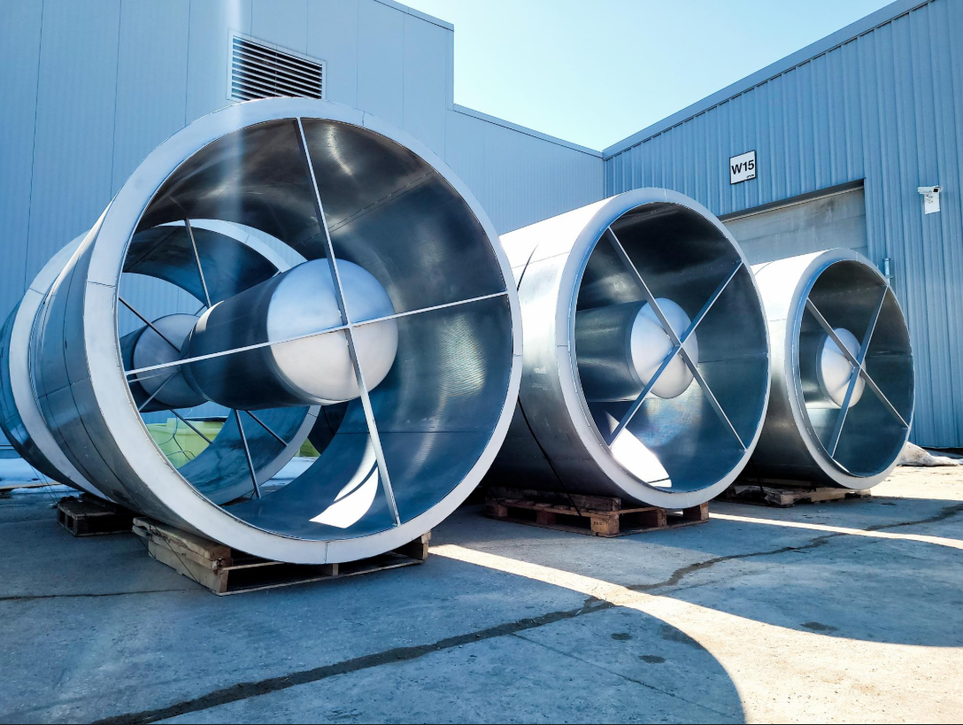
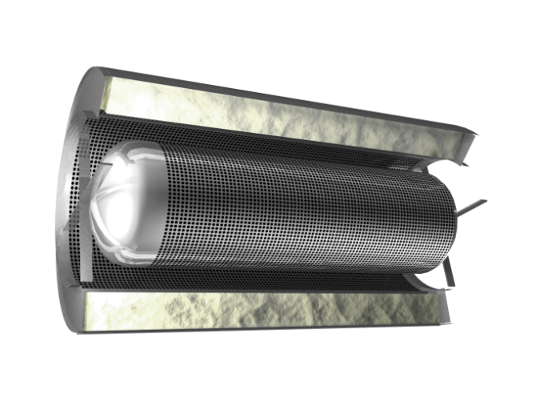
Noise Control
Product Categories
Circular Silencers
Round duct applications
Higher velocity up to 8000 fpm
Acoustic media surrounding entire silencer provides high transmission loss

Slide 17
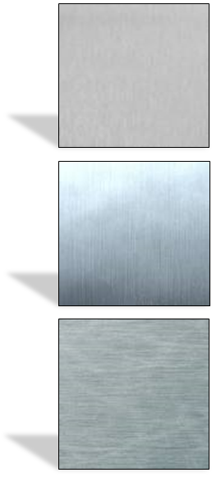
Noise Control
Product Categories
Galvanized (Standard)
G90 Finish
Satin Coat (Galvanneal)
Paintable finish
Aluminum
Light Weight
Outdoor applications
Corrosive applications
Stainless Steel (304 & 316)
Outdoor applications
Corrosive applications

Slide 18
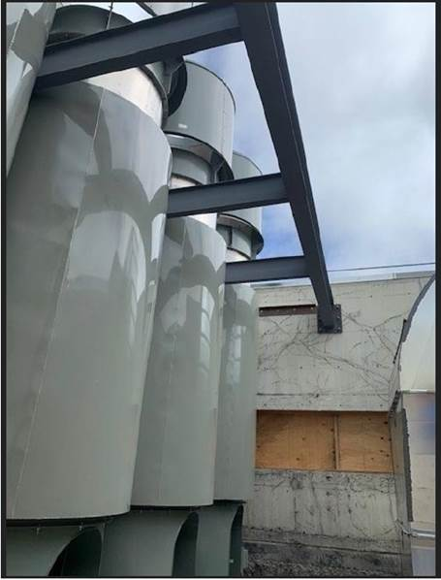
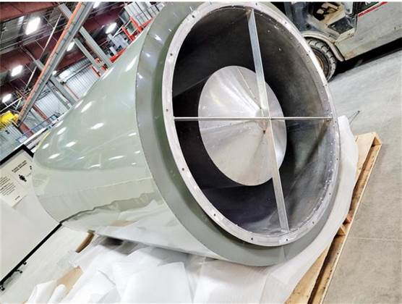
Noise Control
Product Categories
Painted Silencers Available

Slide 19
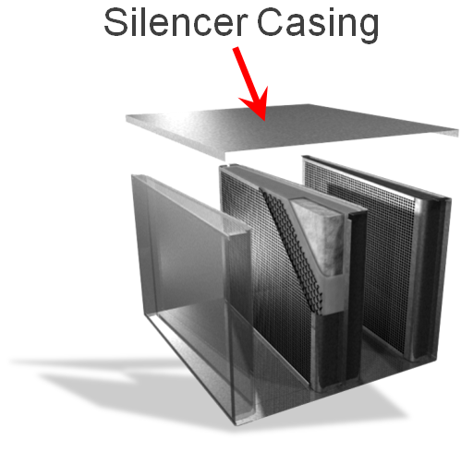
Noise Control
Product Categories
22 Gauge (CL1)
18 Gauge (CL2)
16 Gauge (HTL1)
10 Gauge (HTL2)
Thicker material prevents
sound “breakout”

Slide 20
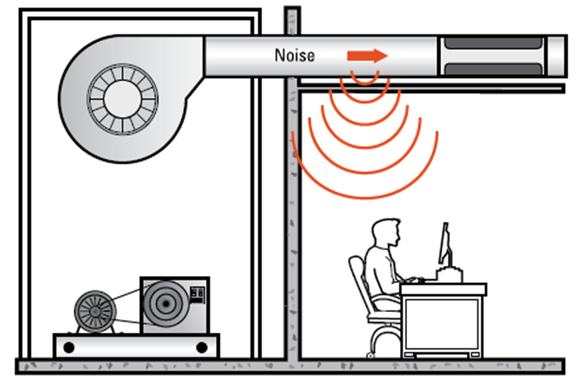
Noise Control
Product Categories

Slide 21
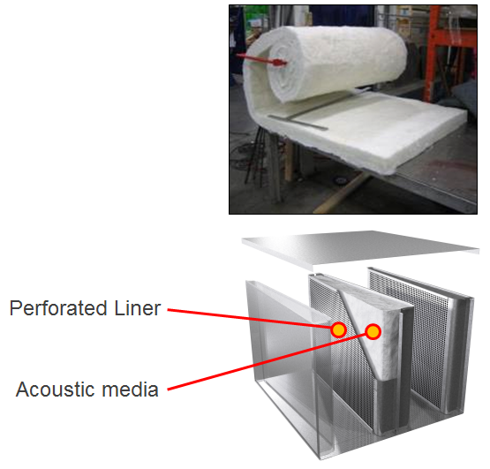
Noise Control
Product Categories
Absorptive Silencers
Casing
Perforated Liner
Acoustic Media
Glass Fiber
Natural Cotton Fiber
Mineral Wool

Slide 22
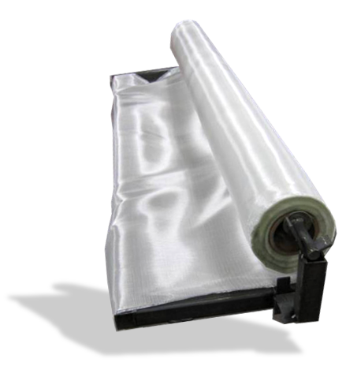
Noise Control
Product Categories
Fiberglass Cloth Liner
Woven fiberglass cloth
High air velocities
Prevents acoustic media erosion

Slide 23
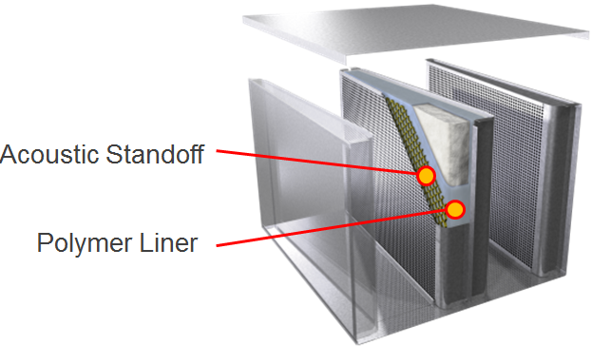
Noise Control
Product Categories
Film Lined Silencers
Polymer liner + acoustic standoff
Applications requiring contaminant free environment
Hospital grade

Slide 24
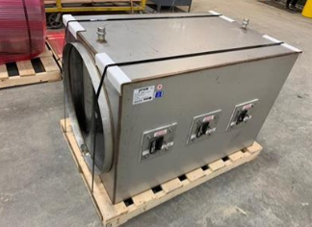
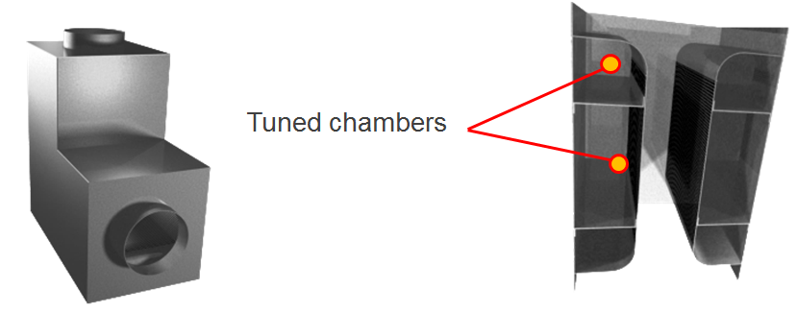
Noise Control
Product Categories
Packless
No acoustic media
Applications requiring contaminant free environment
Cleanable / Hospital grade
For applications with extremely high air quality standards

Slide 25
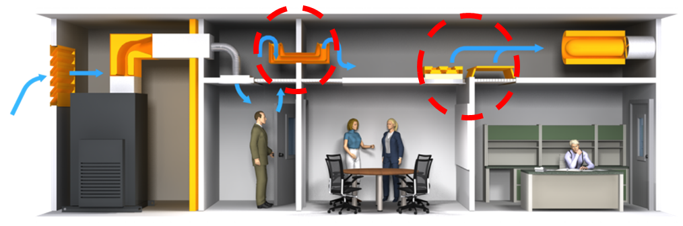
Noise Control
Product Categories
Air Transfer Silencers - Transfer Air / Block Sound
Maintain privacy
Minimize intrusive noise
Common return air plenum
Various liner options

Slide 26
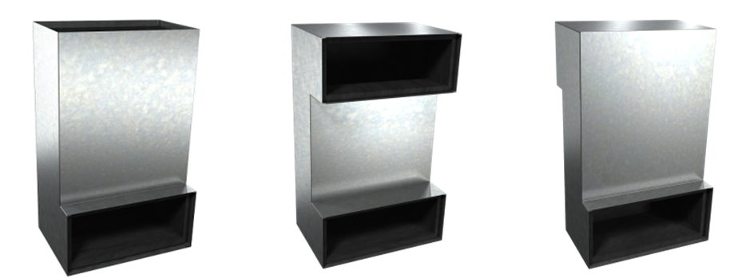
Noise Control
Product Categories
Cross-Talk Silencers
Un-ducted air transfer
Low air volumes

Slide 27
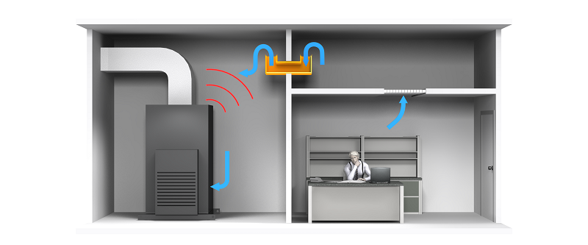
Noise Control
Product Categories

Slide 28
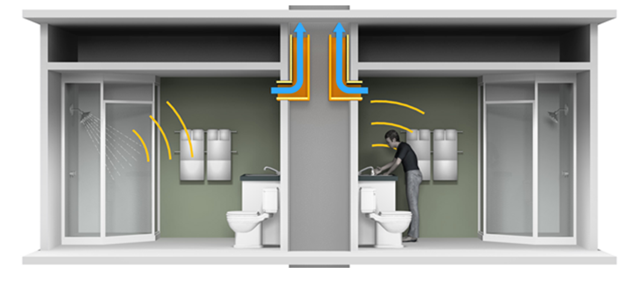
Noise Control
Product Categories

Slide 29
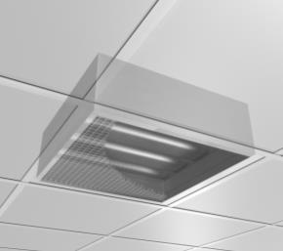
Noise Control
Product Categories
Transfer Silencer
4” thick
Installed behind return air grilles
Can be provided with powdercoat paint finish

Slide 30
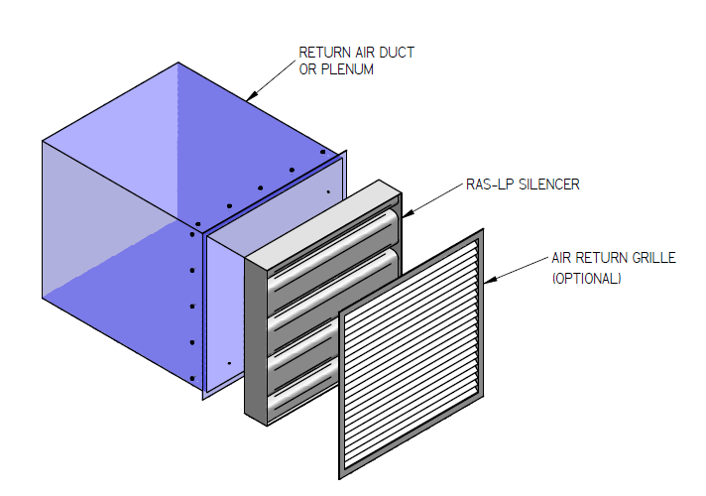
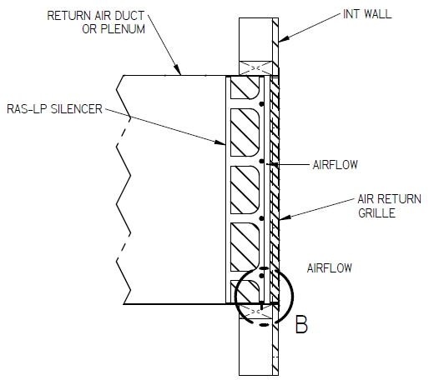
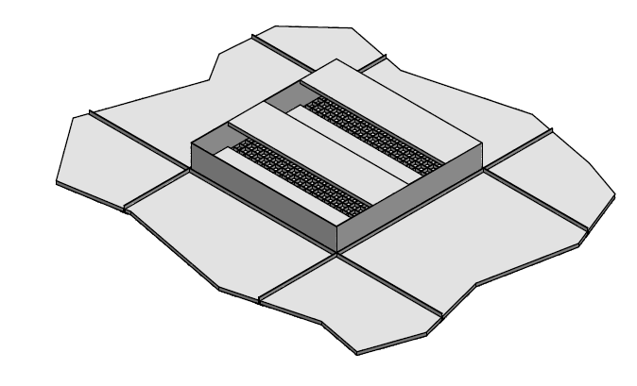
Noise Control
Product Categories
RAS Silencers – Return Air Silencers
4” thick
Installed behind return air grilles
Can be provided with powdercoat paint finish
Ducted
Wall
Ceiling

Slide 31
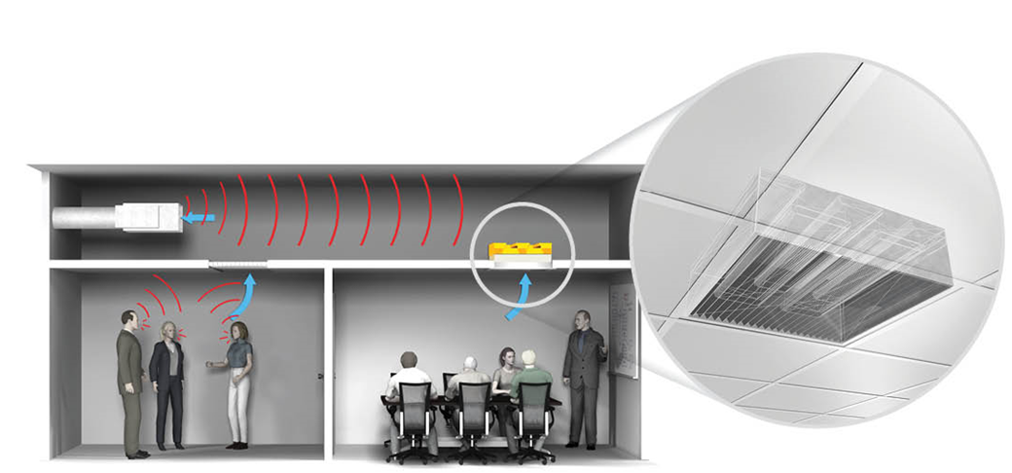
Noise Control
Product Categories
Return Silencer close coupled with return grille

Slide 32
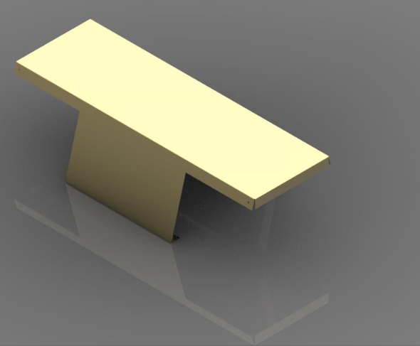
Noise Control
Product Categories
Return Air Canopy
7” height
Easy Installation – Sits on ceiling grid
Low Cost

Slide 33
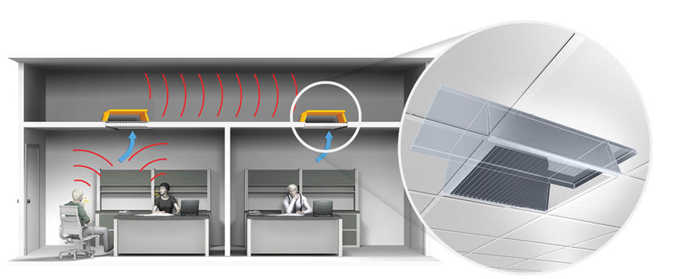
Noise Control
Product Categories
Return Air Canopy

Slide 34
Noise Control
Product Categories
Main point: NR is equal or greater than ceiling tile

Slide 35
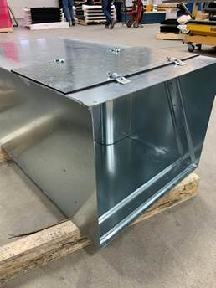
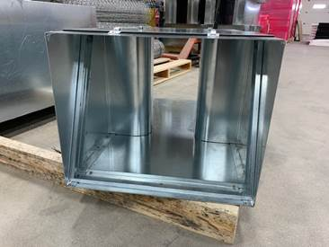
Noise Control
Product Categories
Custom Silencers
Outlets of fans or AHU
Unique duct configurations
Extremely high insertion loss requirements

Slide 36
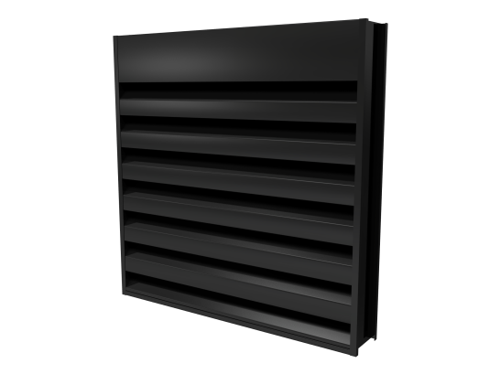
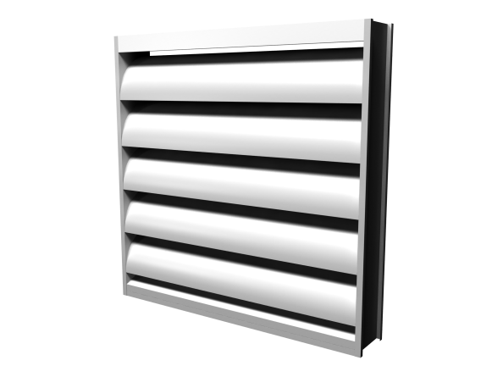
Noise Control
Product Categories
Acoustic Louvers

Slide 37
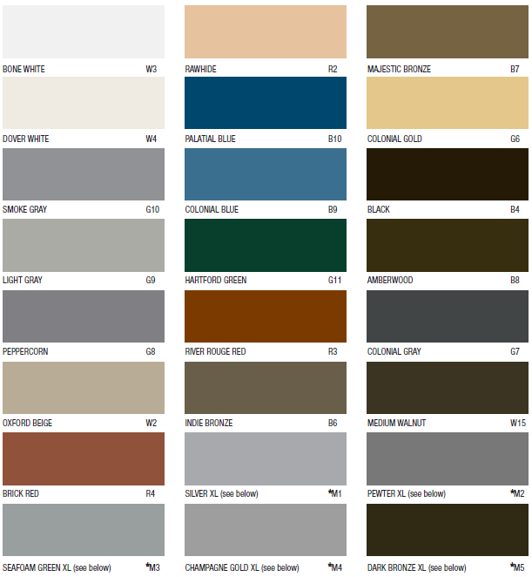
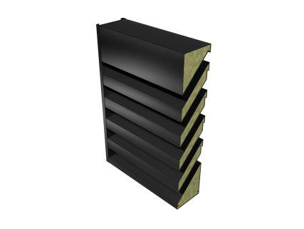

Noise Control
Product Categories
Blade & Airfoil Louver styles
6”, 8”, & 12” depths
Aluminum, stainless & galvanneal
7 durable finishes

Slide 38
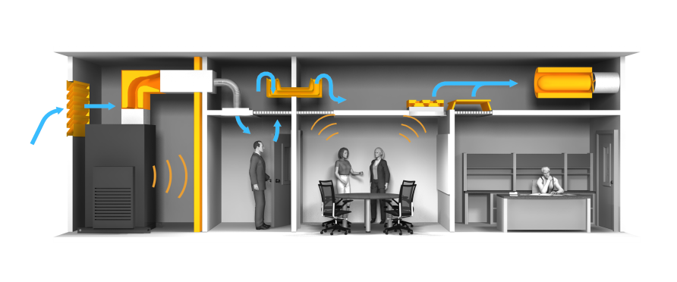
Noise Control
Product Categories
Acoustic Panels
Notes:
An product that we have been developing over the last few years are Acoustic Panels. Why Price Acoustic Panels? .. They are an excellent option to maintain radiated noise at adequate levels. They are typically located close to the noise source. Noise sources can be Air Handling units, Chillers, and Mechanical Equipment . Also, because the sound energy created by a source can be transmitted along multiple paths to the receiver, the incorporation of acoustic panel walls in a mechanical room for example can provide a considerable reduction in noise transmission. Thus, it becomes a potential and effective solution for controlling noise.

Slide 39
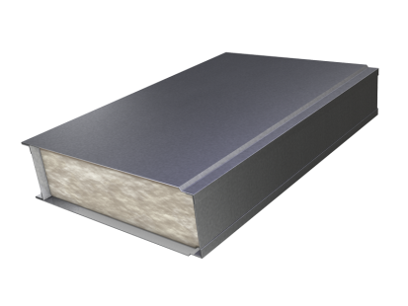
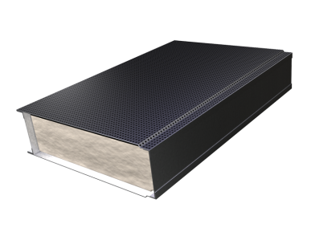
Noise Control
Product Categories
Acoustic Panels
Solid metal outer casing, fiberglass acoustic media with a perforated or solid inner liner
Provides transmission loss (STC) & sound absorption (NRC) for various applications

Slide 40
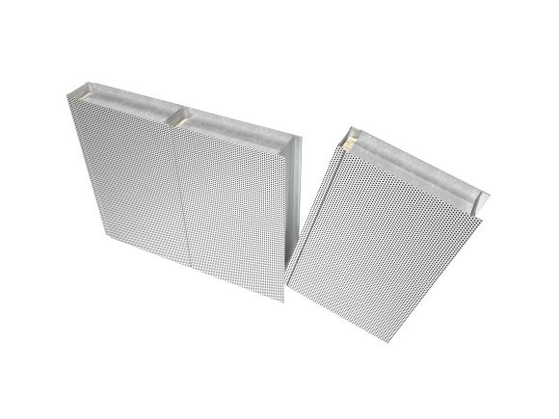
Noise Control
Acoustic Panels
Models:
2” thickness
4” thickness
6” thickness
Custom available
Construction:
Tongue & groove, H-Channel
22Ga, 18Ga, & 16Ga
Galvanized steel, Aluminum, 304SS, 316SS, & Galvanneal painted
Fiberglass acoustic media with various liners

Slide 41
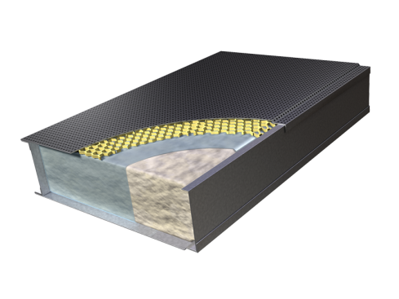
Noise Control
Product Overview
Additional features:
Rigid fiber media
Mineral wool media
Polymer film liner
Fiber glass cloth
Painted finish
Heavy gauges 14Ga, 12Ga, 10Ga
Access doors with wire glass view ports
Removable panels
Customized windows
Integration with silencers & louvers
Notes:
Additional features:
Rigid fiber media
Mineral wool media
Polymer film liner
Fiber glass cloth
Painted finish
Custom heavy gauges 16Ga, 14Ga, 12Ga, 10Ga
Access doors with wire glass view ports
Removable panels
Customized windows
Integration with silencers & louvers

Slide 42

Noise Control
Product Categories
Enclosures shipped knocked down for field assembly
Complete with:
Trim
Mounting channels
Caulking
Hardware
Assembly drawings

Slide 43


Noise Control
Acoustic Panels
AMP (Architectural Modular Panel):
- Tested Under ASTM-C423-17
NRC- 0.95 (2” Thick)
Powder Coated
Improves speech intelligibility
Ideal for Boardrooms/ Offices

Slide 44
Acoustic Analysis

Slide 45

Noise Control
Acoustic Analysis
Acoustic Environments
Notes:
In our commercial HVAC industry there are a variety of acoustic environments we are involved with.
From operating rooms to …. Each one of these environments have their own characteristics, challenges and design goals.
For example in schools and theaters we need to minimize fan noise so that a teacher can communicate effectively and concert goers can enjoy music.
In hospital rooms and office spaces privacy is needed so confidential conversations are not over heard.
For each environment different types of noise control can be applied to suit the application
Sound is an important part of the environment that we live in. It affects our ability to communicate, work productively, sleep.
Concert hall you can the hear the music, enjoy the performance, conference room needs to talk without hearing or being heard by occupants of adjacent rooms. Hospital requires privacy between rooms, and environment quite enough to sleep well in. Classrooms you don’t want ot noise to affect he ability of the students to hear and learn.
The acoustic needs and requirements depend on the space’s intended use.
Various acoustical environments that we typically analyze to determine if noise control is required.
Hospitals and offices – patient room noise transfer, privacy
Schools and theaters - fan noise
Different types of noise control can be applied to suit the application, such as hospitals may require increased air quality and film lined or packless type silencers

Slide 46


Noise Control
Acoustic Analysis
Acoustic Environments
The Acoustical Environment: "Dead" → "Live"
Use of the room dictates the acoustical goals
Highly reflective = "live"
Very absorptive = "dead"
Requirements of most rooms will fall somewhere between these two extremes

Slide 47
Noise Control
Acoustic Analysis
Air Handling Unit
Chiller
Terminal Unit
3 Aspects to consider
Sound Power, dB
Attenuation, dB
Sound Pressure, dB
SOURCE
PATH
RECEIVER
Ductwork
Walls, Ceilings/Floors
Open/Exposed
Conference Room
Classroom
Property Line

Slide 48
Noise Control
Acoustic Analysis
Duct lining & Elbows
Silencers & Panels
Relocated Source?
3 Types to consider
SUPPLY
RETURN
RADIATED
Typically longer path
Often shorter path
Uh Oh!
Duct lining & Elbows
Silencers & Panels
Relocated Source?
MER Adjacencies
Exposed Terminals
Transfer air flanking

Slide 49

Noise Control
Acoustic Analysis
Common Sound Paths
Path A – Structure born path
Path B – Airborne path
Path C – Duct born path

Slide 50


Noise Control
Acoustic Analysis
Example AHU Return Path Analysis
Determine expected sound level in space

Slide 51


Noise Control
Acoustic Analysis
Example
Determine reduction in sound required
Space estimated at NC >65
Target criteria of NC40
Calculate Required IL

Slide 52


Noise Control
Acoustic Analysis
Acoustic Analysis Software:
Powerful HVAC modelling tool for:
Sale Representatives
Engineers
Architects
Consultants
Acousticians
Contractors
Educators

Slide 53

Noise Control
Acoustic Analysis

Slide 54



Noise Control
Acoustic Analysis

Slide 55









































Noise Control
Acoustic Analysis
A few of our users…

Slide 56

Noise Control
AIO Software
AIO (All in one software)
Available for “Free” download at:
https://www.priceindustries.com/software/all-in-one/

Slide 57

Noise Control
AIO Software

Slide 58

Noise Control
Acoustic Analysis
Competitive landscape
Dynasonics / Pottorff – Acoustics Information Modeling - AIM
Discontinued support in 2019. No longer active.
Trane – Trane Acoustics Program - TAP
Outdated. $495 cost per license + annual licensing fee
Vibro-Acoustics – VA Design
Web/Cloud based platform

Slide 59
Solutions

Slide 60






Noise Control
Solutions
chiller enclosure
Reston Library
reston, va

Slide 61

Noise Control
Solutions
Rooftop chiller silencers
Mixed use luxury building
New york City, ny
Rooftop Chiller - NY, NY (2012)

Slide 62

Noise Control
Solutions
Acoustic plenums
Mercy hospital joplin
Joplin, mo

Slide 63

Noise Control
Solutions
Acoustic barrier wall
CSM bakery
Atlanta, ga

Slide 64

Noise Control
Solutions
WALL MOUNT ACOUSTIC PANELS
CSM bakery
Atlanta, ga

Slide 65

Noise Control
Solutions
Acoustic barrier wall
CSM bakery
Atlanta, ga

Slide 66

Noise Control
Solutions
Return Air silencers
Poslinelli headquaRters
Kansas city, mo
Fan Enclosures

Slide 67

Noise Control
Solutions
Louver Penthouse
Hotel Georgia Vancouver, 2011
Notes:
Hotel Georgia Vancouver, 2011
Will U, EH Price – Vancouver
Rosewood Hotel Georgia protected heritage property by city of Vancouver. 2011 Renovation project.
Concern of noise and aesthetics from new cooling tower for residential building siting behind hotel.

Slide 68

Noise Control
Solutions
Enclosure- warming HUT
The Forks
Winnipeg, MB
Notes:
Hotel Georgia Vancouver, 2011
Will U, EH Price – Vancouver
Rosewood Hotel Georgia protected heritage property by city of Vancouver. 2011 Renovation project.
Concern of noise and aesthetics from new cooling tower for residential building siting behind hotel.

Slide 69


Noise Control
Solutions
chiller enclosure
Residential Condo
Winnipeg, MB

Slide 70

Noise Control
Solutions
cu enclosure
Sarnia, ON

Slide 71

Noise Control
Solutions
Architectural Ceiling Panels
PRCN , WINNIPEG, mb

Slide 72
Questions?

